Slide 1


Facility Manager Responsibilities
Lesson 2 of 3
In-Person Education Module

Slide 2
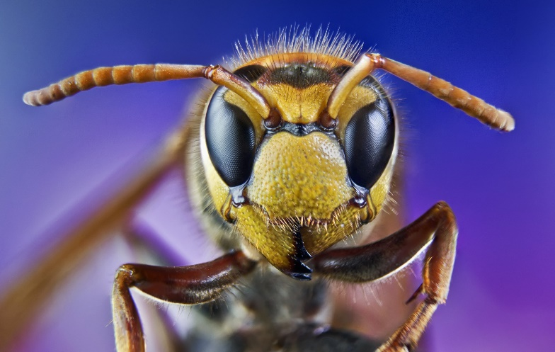
Learning Objectives
Explain the importance of:
  Pest entry points
  Proper storage procedure
  Sanitation, exclusion, inspection and monitoring
  Timely work order follow-up
Describe effective ways to educate lead staff about IPM practices and explain the importance of communication between them
Describe methods of tracking facility costs and IPM-related cost savings
Describe how to start an IPM program at your school

Slide 3
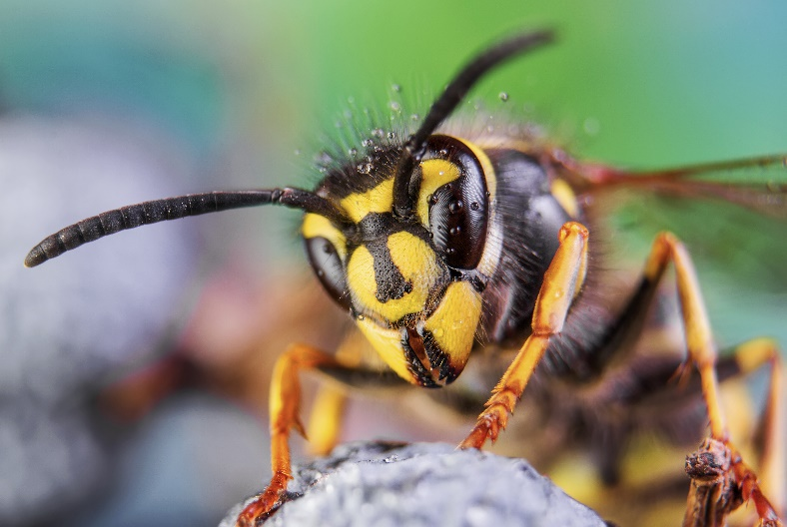
Facility Manager Key Points
Previous lesson:
Lead implementation of IPM policy and plan
Oversee pest sighting and pesticide application logs
Supervise contractors
Program evaluation and adjustment
This lesson:
Pest entry points
Proper storage procedures
Sanitation
Timely work order follow-up

Slide 4
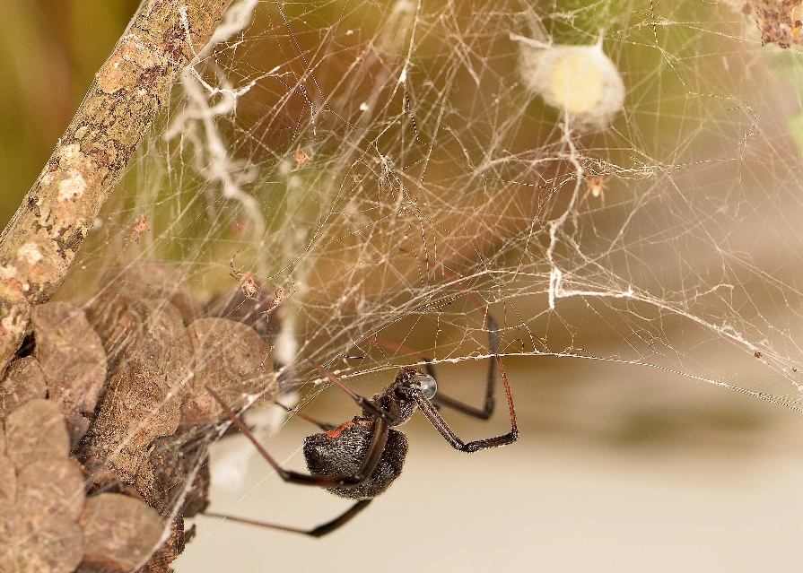
Learn to Recognize Pest Entry Points
Find a pest? Search for possible points of entry
  Broken/torn wire-mesh screen covers of windows
  Dry P-traps in drains
  Worn out door-sweeps/weather stripping
Hitchhikers in deliveries
  Check for signs of
  pests
You do not need to see the
spider to know what built the web

Slide 5
Proper Storage Procedures
Proper storage of supplies/materials can prevent pest-conducive conditions
To permit proper cleaning and inspection:
  Avoid storing boxes and items up against the walls
  Leave 18-inch gaps under the lowest shelf so the floor can be cleaned underneath
  Avoid using wooden pallets, milk crates, etc. to store things on

Slide 6
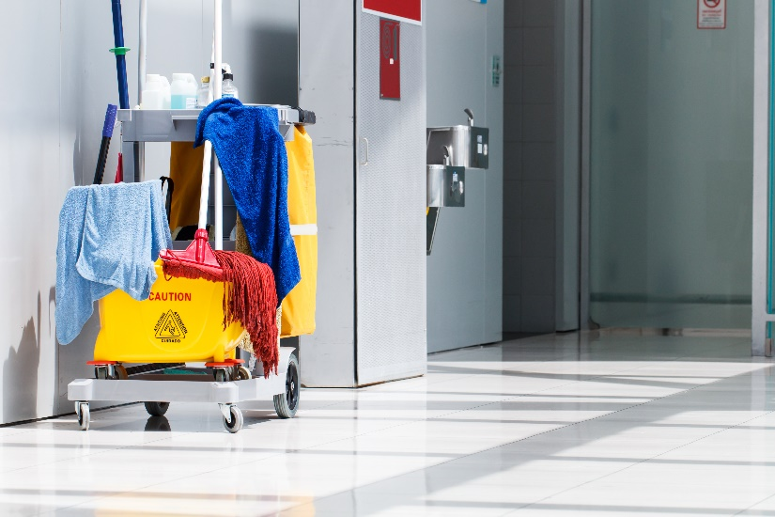
Sanitation in Storage Areas
Storage areas are pest-vulnerable areas
Good sanitation practices:
  Corner clean
  Clean then store cleaning equipment
  Clean trash cans regularly
  Keep areas clean and
  as dry

Slide 7
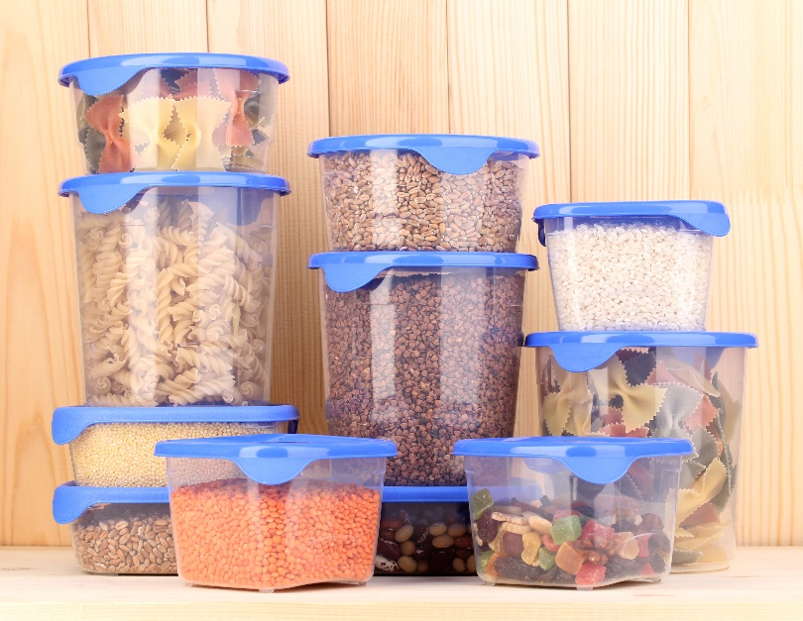
Pest Exclusion Strategies/Tactics
Avoid propping doors open
Close gaps that provide access to pests
Avoid storing cardboard
Avoid clutter
Keep food and water in sealed containers

Slide 8
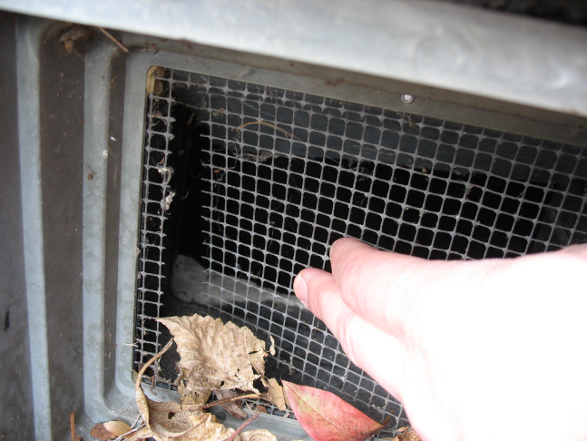
Pest Exclusion Tools
Replace worn door-sweeps
Seal or fill gaps, cracks and crevices
Cover windows and vents with wire mesh
Torn wire mesh on a vent – Jerry Jochim, Monroe County Community School Corporation

Slide 9
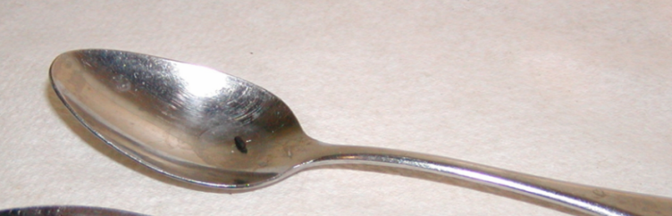
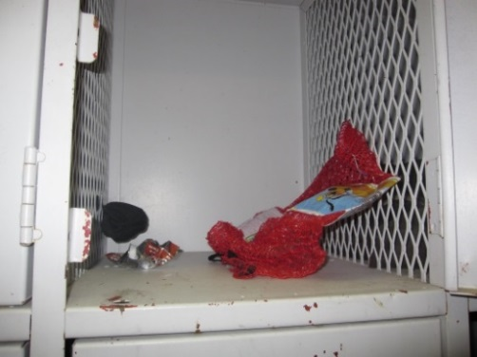
Key Elements of Inspection and Monitoring
What to look for:
Pests
Signs of pests
Pest-conducive
conditions
Mouse dropping on a spoon
Dawn H. Gouge, University of Arizona
Wrappers and decomposing food in athletic locker
Notes:
What to look for:
Pests
Signs of pests
Pest conducive conditions - pest opportunities inviting pests for food, water, and harborage.

Slide 10
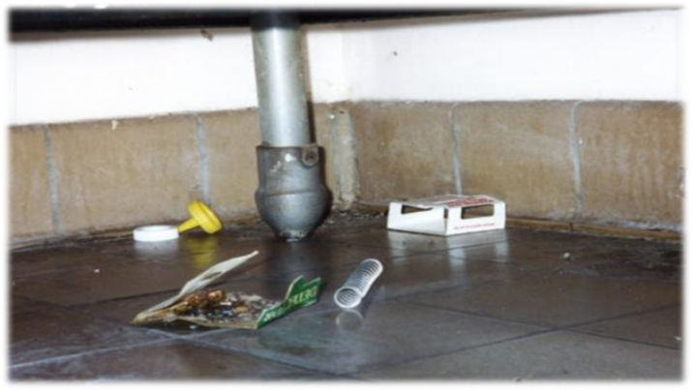
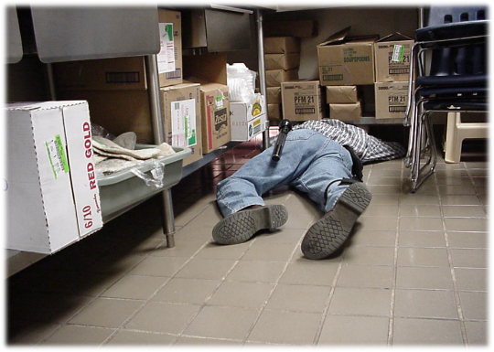
2.
Key Elements of Inspection and Monitoring
Where to look:
Dark corners
Hard-to-reach areas
Undisturbed places
Warm or wet places
Food storage and
preparation
areas
Waste collection containers
Suspended ceilings
Regular, careful inspection helps to keep pests and pest-conducive conditions under control rapidly and efficiently – Dawn H. Gouge, University of Arizona

Slide 11
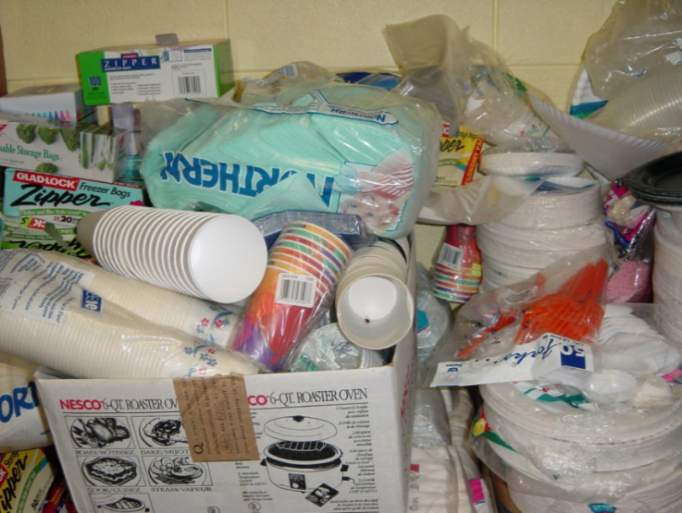
2.
Key Elements of Inspection and Monitoring
Where to look:
Warm walls with penetrations
Compressor motor
voids in equipment
Unsealed floors and
floor to wall junctures
Undisturbed containers
Cardboard boxes
Clutter
Booster club storage – Dawn H. Gouge, University of Arizona

Slide 12
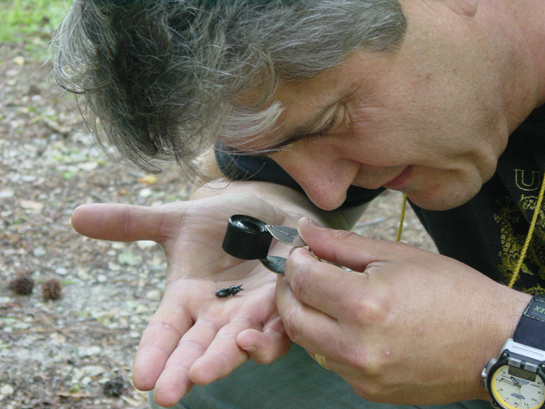
2.
Key Elements of Inspection and Monitoring
Tools:
Monitoring traps
Bright flashlight
Hand lens
Marc Lame identifying an insect – Jerry Jochim, Monroe County Community School Corporation

Slide 13

3.
Key Elements of Inspection and Monitoring
Communicate in writing to IPM Coordinators and others about pest issues
Record date, time, location and:
Pests
Signs of pests
Pest-conducive
conditions
If you do not have a work order system, develop pest sighting logs – Dawn H. Gouge, University of Arizona

Slide 14

Facility Manager Checklist
Facility managers have many responsibilities
A checklist can help make sure duties are completed in a timely manner

Slide 15
Example Inspection Checklist
8.
1.BUILDING MAINTENANCE SUPPLIES | Yes | No | N/A
1a. Developed appropriate procedures and stocked supplies for spill control
1b. Reviewed supply labels
1c. Ensured that air from chemical and trash storage areas vents to the outdoors
1d. Stored chemical products and supplies in sealed, clearly labeled containers
1e. Researched and selected the safest products available
1f. Ensured that supplies are being used according to manufacturers’ instructions
1g. Ensured that chemicals, chemical-containing wastes, and containers are disposed of according to manufacturers’ instructions
1h. Substituted less- or non-hazardous materials (where possible)
1i. Scheduled work involving odorous or hazardous chemicals for periods when the school is unoccupied
1j. Ventilated affected areas during and after the use of odorous or hazardous chemicals

Slide 16
Example Inspection Checklist
8.
2. GROUNDS MAINTENANCE SUPPLIES | Yes | No | N/A
2a. Stored grounds maintenance supplies in appropriate area(s)
2b. Ensured that supplies are used and stored according to manufacturers’ instructions
2c. Established and followed procedures to minimize exposure to fumes from supplies
2d. Reviewed and followed manufacturers’ guidelines for maintenance
2e. Replaced portable gas cans with low-emission cans
2f. Stored chemical products and supplies in sealed, clearly-labeled containers
2g. Ensured that chemicals, chemical-containing wastes, and containers are disposed of according to manufacturers’ instructions

Slide 17
Example Inspection Checklist
3. DUST CONTROL | Yes | No | N/A
3a. Installed and maintained barrier mats for entrances
3b. Used high efficiency vacuum bags
3c. Used proper dusting techniques
3d. Wrapped feather dusters with a dust cloth
3e. Cleaned air return grilles and air supply vents
4. FLOOR CLEANING | Yes | No | N/A
4a. Established and followed schedule for vacuuming and mopping floors
4b. Cleaned spills on floors promptly
4c. Performed restorative maintenance (as necessary)
5. DRAIN TRAPS | Yes | No | N/A
5a. Poured water down floor drains once per week (about 1 quart of water)
5b. Ran water in sinks at least once per week (about 2 cups of water)
5c. Flushed toilets once each week (if not used regularly)

Slide 18
Example Inspection Checklist
6. MOISTURE, LEAKS, AND SPILLS | Yes | No | N/A
6a. Checked for moldy odors
6b. Inspected ceiling tiles, floors, and walls for leaks or discoloration (may indicate periodic leaks)
6c. Checked areas where moisture is commonly generated (e.g., kitchens, locker rooms, and bathrooms)
6d. Checked that windows, windowsills, and window frames are free of condensate
6e. Checked that indoor surfaces of exterior walls and cold water pipes are free of condensate
6f. Ensured the following areas are free from signs of leaks and water damage:
Indoor areas near known roof or wall leaks
Walls around leaky or broken windows
Floors and ceilings under plumbing
Duct interiors near humidifiers, cooling coils, and outdoor air intakes

Slide 19
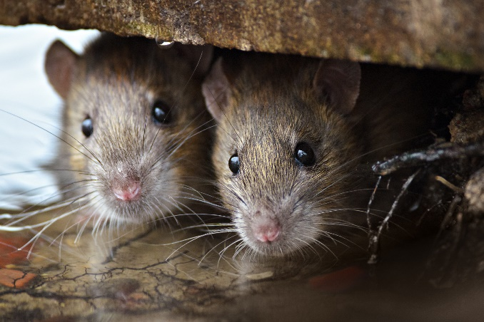
Example Inspection Checklist
7. COMBUSTION APPLIANCES | Yes | No | N/A
7a. Checked for odors from combustion appliances
7b. Checked appliances for back drafting (using chemical smoke)
7c. Inspected exhaust components for leaks, disconnections, or deterioration
7d. Inspected flue components for corrosion and soot
8. PEST CONTROL | Yes | No | N/A
8a. Completed the Integrated Pest Management Checklist

Slide 20
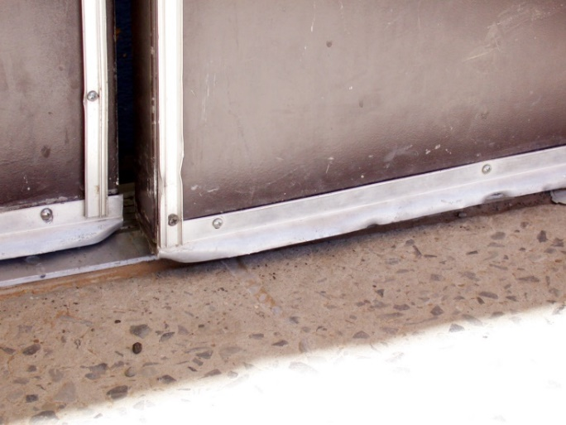
Timely Work Order Follow-Up
Enforce timely responses to priority pest problems related repairs
A small fix can avoid a
big problem
When ever possible
centralize reports
and track resolution
Use existing
work-order systems
Ensure doors close completely to keep pests out – Dawn H. Gouge, University of Arizona

Slide 21

Effective Ways to Educate Staff
Educate
  Staff
  Students
  Contractors
  Parents and guardians
Inform parents annually
about the IPM policy
Communications to
improve pest awareness
are of great benefit to the community

Slide 22

Effective Ways to Educate Lead Staff
Training is one of the most essential elements of the IPM plan
Identify the individual(s)
providing the training
and who will
receive the training

Slide 23
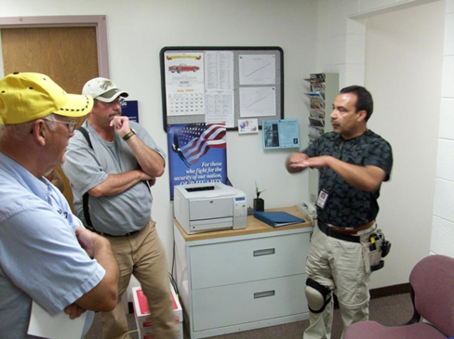
Effective communication
Get to know your lead front-line staff and contractors
Communicate
Respond to their
recommendations
and direction
Ricardo Zubiate teaching Salt Lake City School District Staff - Marc Lame, Indiana University

Slide 24
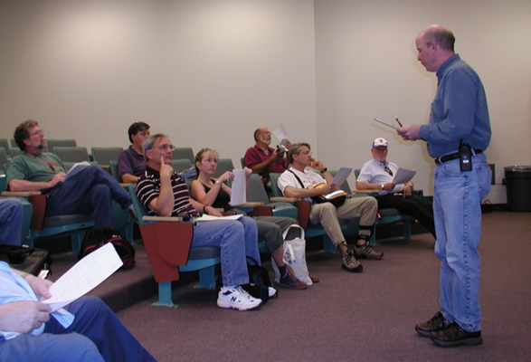
2.
Effective communication
Learn more about IPM from experts
Ask questions
Consider discussing IPM and its advantages with your entire community
Implementing IPM is easier with group support
Set an example
Dr. Robert Corrigan, RMC Pest Management Consulting teaching - Mary Grisier, EPA Region 9

Slide 25

Methods of Tracking Facility Costs and
IPM-Related Cost Savings
The IPM Cost Calculator
http://schoolipm.tamu.edu/forms/ipm-cost-calculator/

Slide 26
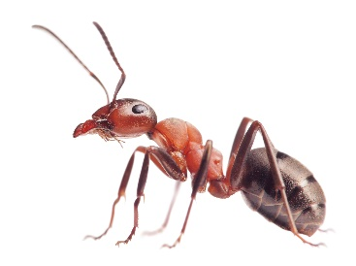
Methods of Tracking Facility Costs and
IPM-Related Cost Savings
13.
The IPM Cost Calculator (assesses risk)
Using information
  Location
  Presence of pests
  Condition of your school
Create your own
budget and reduce
risk

Slide 27

How to start an IPM program at your school!
Leverage support from district administration
Discuss IPM with your school staff (nurse, food service managers, lead custodian, pest manager, and principals) and environmental health committee
Evaluate your current pest
management method

Slide 28

How to start an IPM program at your school!
Explain the benefits of IPM
Discuss how to start an IPM program and who might serve as the district IPM Coordinator

Slide 29


How to start an IPM program at your school!
Identify state, Extension service and/or local resources
State services may provide pest identification, run educational events, facilitate the transition from calendar based programs to IPM, evaluate pest management options, etc.

Slide 30
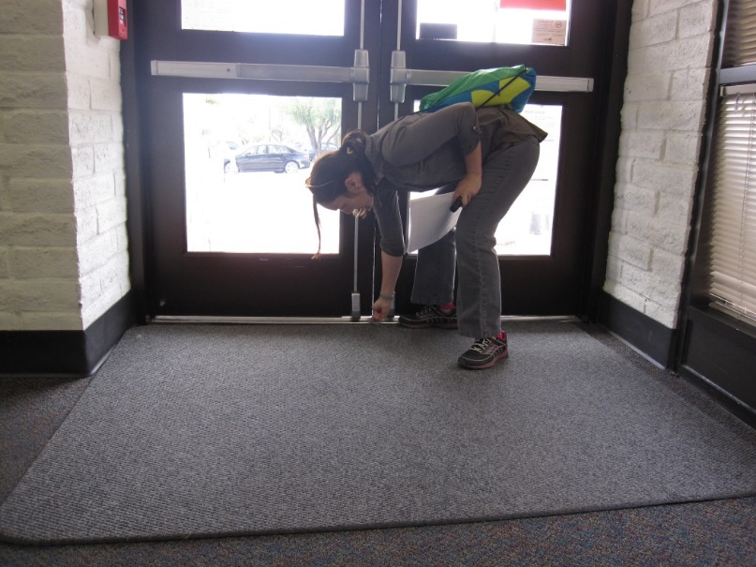
How to start an IPM program at your school!
Coordinate an initial IPM
inspection and site
evaluation
Inspection of doors which may need door sweeps – Shaku Nair, University of Arizona

Slide 31
How to start an IPM program at your school!
Use inspections as fact-finding exercises as well as educational opportunities for staff
Prioritize remediation actions to focus on those that will make the biggest difference quickly
You may introduce the idea of pest sighting logs, a monitoring program and pest management record keeping system as you inspect

Slide 32
Check In!
In this lesson you learned
The importance of pest entry points, proper storage procedure, sanitation, timely work order follow-up
Effective ways to educate lead staff about IPM practices
Methods of tracking facility costs and IPM-related cost savings
How to start an IPM program at your school
Next you will learn about key exterior and landscape pest groups!

Slide 33
Resources
Bayer Environmental Science. (2010). Ant Identification Guide. http://www.backedbybayer.com/system/product_guide/asset_file/3/Ant-ID-Guide.pdf
Green, T.A., D.H. Gouge, J.A. Hurley, M.L. Lame and M.D. Snyder. (2014). School IPM 2020: A Strategic Plan for Integrated Pest Management in Schools in the United States.
How to Develop an Integrated Pest Management (IPM) Policy and Plan for Your School District. PENN STATE. Retrieved from http://extension.psu.edu/pests/ipm/schools/facilitiesmanagers/resourcespaschools/faq/ipmschoolplan
How to Do… IPM at School A How to Manual for New Jersey schools. New Jersey Department of Environmental Protection Pesticide Control Program http://www.state.nj.us/dep/enforcement/pcp/bpc/ipm/How_to_Do_IPM.pdf
National Center for Environmental Health. (2009). Healthy Housing Reference Manual. Retrieved from http://www.cdc.gov/nceh/publications/books/housing/figure_cha04.htm
New Jersey Department of Environmental Protection Pesticide Control Program. How to Do… IPM at School A How to Manual for New Jersey Schools. Retrieved from http://www.state.nj.us/dep/enforcement/pcp/bpc/ipm/How_to_Do_IPM.pdf

