Slide 1
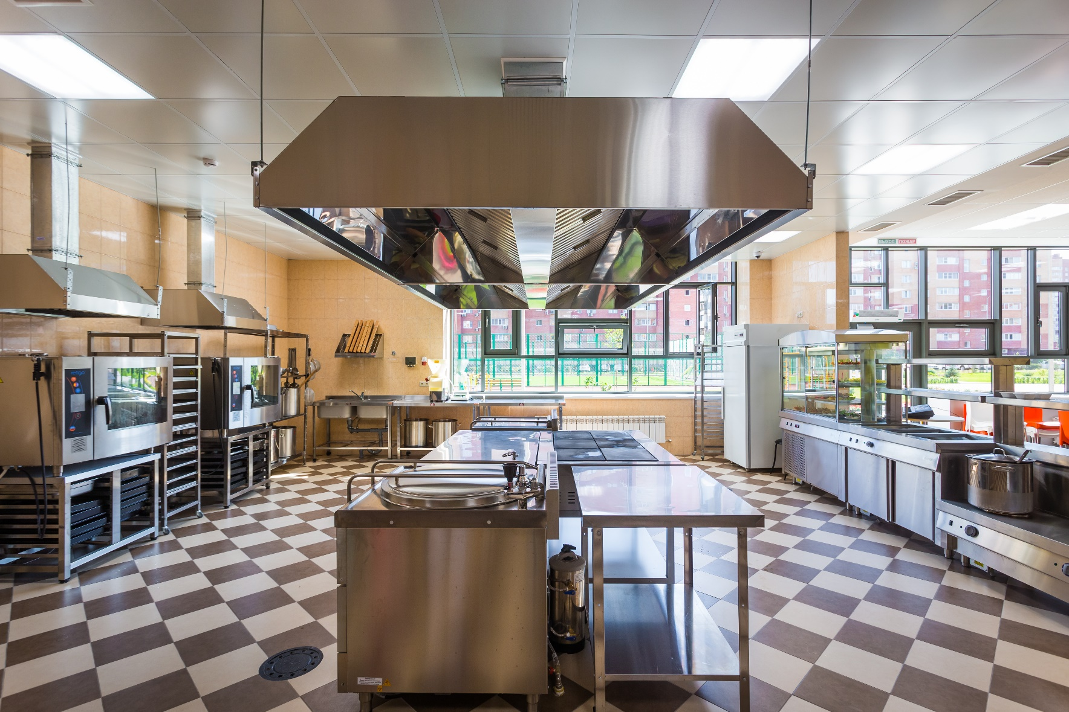
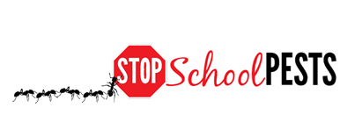
IPM FOR food service staff
In-Person Education Module
Lesson 2 of 2

Slide 2
Learning Objectives
Describe key elements of inspection and monitoring
    What to look for
    Where to look
    Tools used
    Frequency
Describe key elements of sanitation and exclusion
    Strategies
    Tactics
    Tools

Slide 3
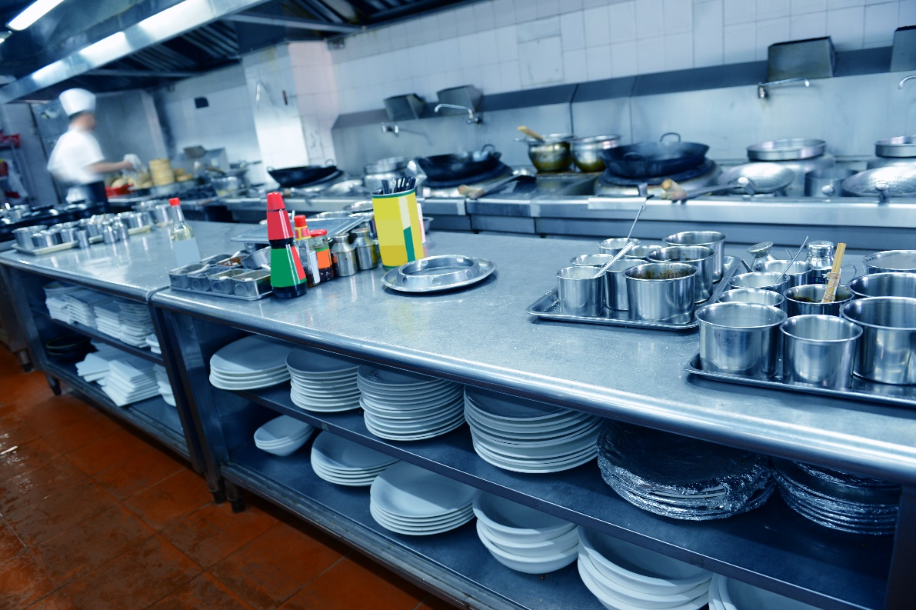
Learning Objectives
Describe proper and thorough cleaning procedures for:
    Drain areas
    Floors
    Corners
    Beneath
    equipment
    Floor joints

Slide 4

Learning Objectives
Explain the importance of effective communication, education and cooperation between
    Food service staff
    Custodial staff
    Maintenance staff
    Facility managers
    Administrators

Slide 5
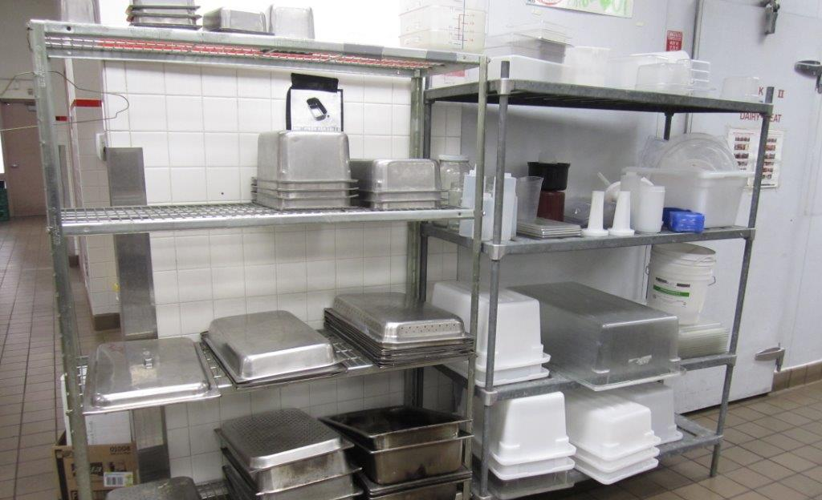
Food Service Staff and IPM
In the previous lesson, you learned how to identify common pests in kitchens and pantries
In this lesson, you will learn how to keep pests under control using a combination of techniques that you already
use in your daily
work!
Cleaned, dried dishes ready for the next mealtime – Shujuan Li, University of Arizona

Slide 6
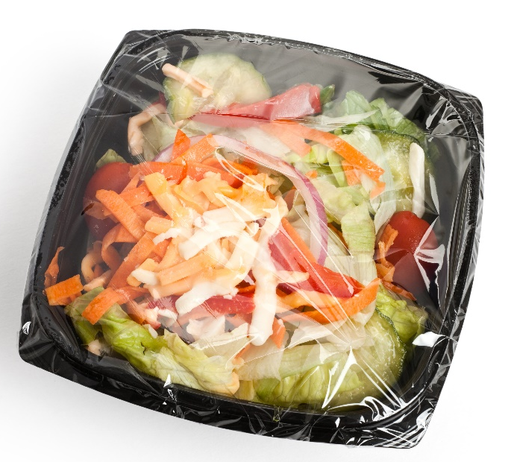
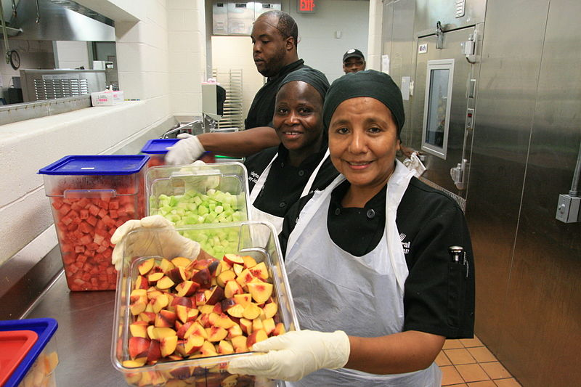
Do What You Already Do, Just Think About Pests!
Food service staff influence school staff and students on how to avoid pest-conducive conditions
Prepared food is kept covered till serving time
Food service professionals show clean handling of cut fruit using gloves and covered containers
- DC Central Kitchen

Slide 7
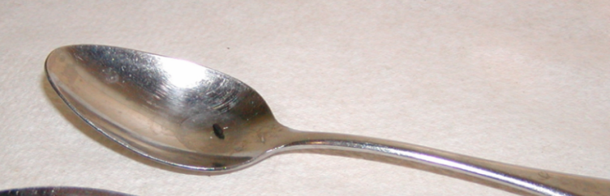
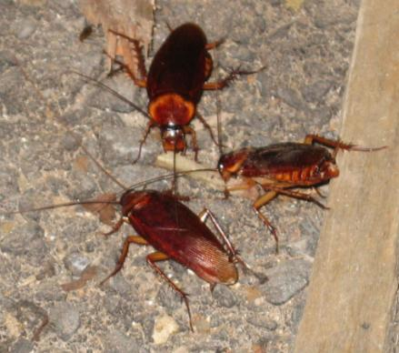
Key Elements of Inspection and Monitoring
Inspection and monitoring
What to look for:
Pests
Signs of pests
Pest conducive conditions - pest opportunities inviting pests for food, water, and harborage
Mouse poop on a spoon
Dawn H. Gouge, University of Arizona
Cockroaches feeding on crumbs

Slide 8
Key Elements of Inspection and Monitoring
Where to look:
Dark shadowy corners
Hard to reach areas
Undisturbed places/ under
and behind stationary items
Warm and/or wet places
Food storage and/or preparation areas
Waste collection containers and areas
Dropped ceilings
Tiles in drop ceiling indicating roof or plumbing leak - Dawn H. Gouge, University of Arizona

Slide 9
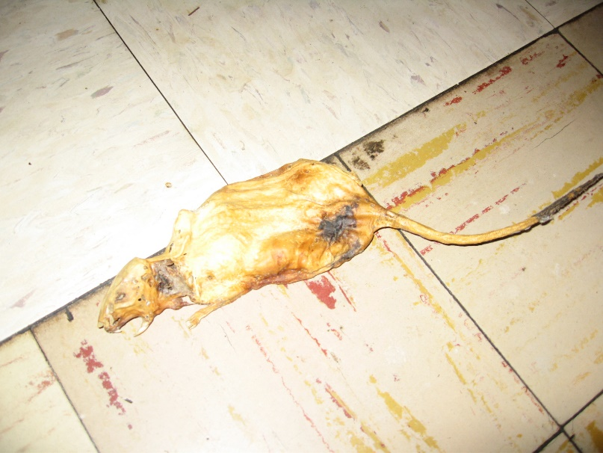
Key Elements of Inspection and Monitoring
Where to look:
Warm walls with penetrations
Compressor motor voids in equipment
Unsealed floors and
floor to wall junctures
Undisturbed containers
Cardboard boxes
Clutter
Under fixed equipment
Dead rat found under fixed kitchen equipment – Dawn H. Gouge, University of Arizona

Slide 10
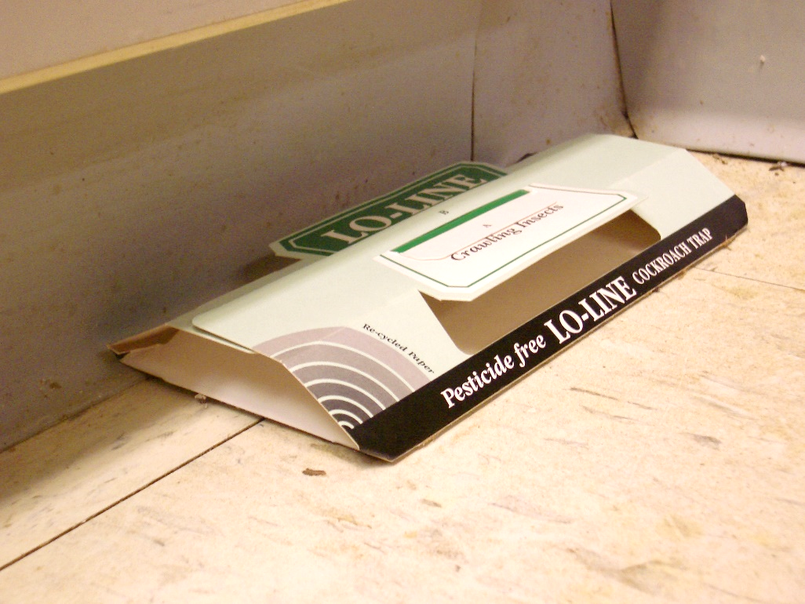

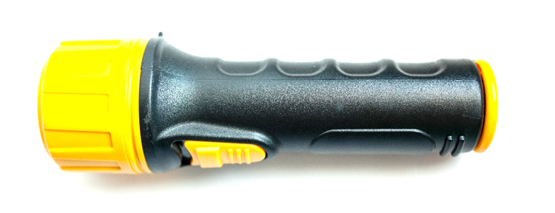
Key Elements of Inspection and Monitoring
Tools:
Monitoring traps
Bright flashlight
Hand lens
Insect monitoring trap – Dawn H. Gouge, University of Arizona

Slide 11
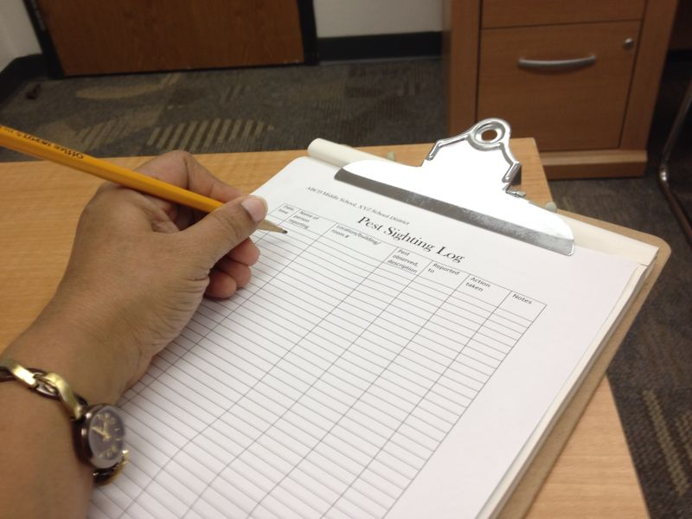
Key Elements of Inspection and Monitoring
Document your observations
Use a Pest Log Sheet and consider recording:
Pests
Signs of pests
Pest-conducive
conditions
Frequency: as and when
required during daily
duties
Insect monitoring trap – Shaku Nair, University of Arizona

Slide 12
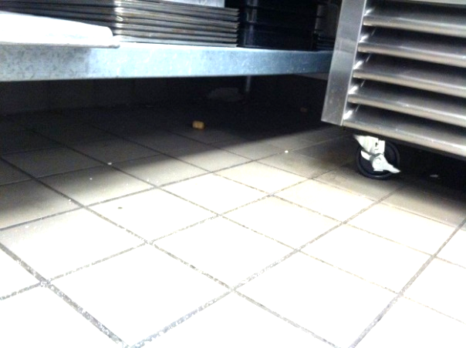
Key Elements of Sanitation and Exclusion
Sanitation and exclusion are basic steps in IPM
Good sanitation practices:
  Make sure all food-preparation
  areas, work surfaces, dishes,
  utensils and tools are completely
  clean of food residue
  Clean corners and
  hard-to-reach areas
Hard-to-reach places
in kitchens – Shujuan Li, University of Arizona

Slide 13
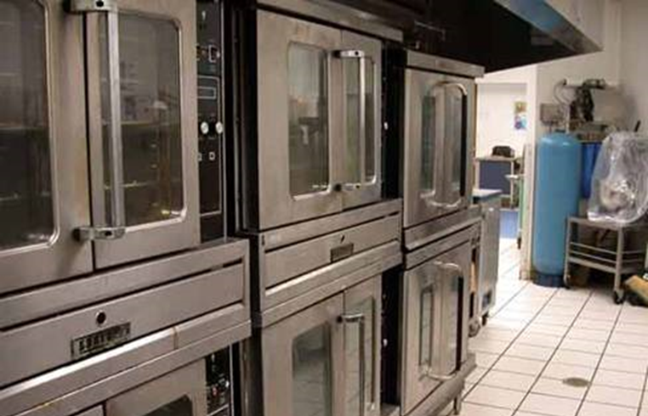
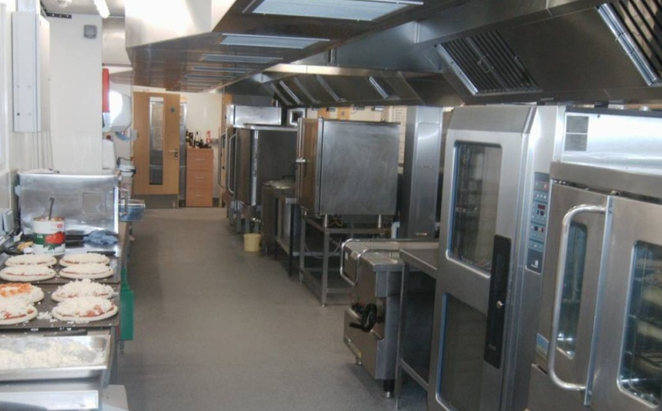
Hard-to-Reach Locations
Hard-to-reach locations are often
  Dark
  Concealed places
  Covered
  Difficult to mop
Food and debris readily accumulate in difficult-to-reach locations
Large, unwieldy and fixed equipment create hard-to-reach locations for cleaning or inspection - Dawn H. Gouge, University of Arizona

Slide 14
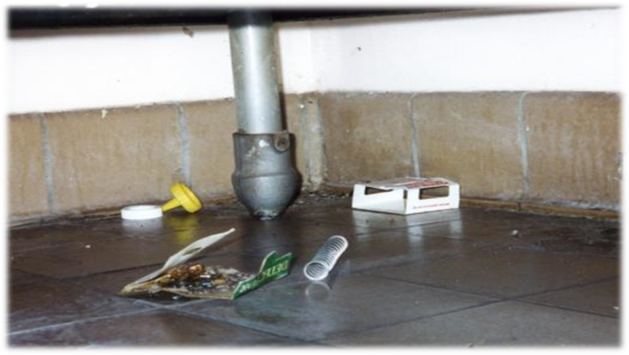
Hard-to-Reach Locations
Corners where walls and floors meet, especially under and behind equipment or furniture
One of the hardest
places to clean is
the “back-leg zone”
The “back-leg zone” - Dawn H. Gouge, University of Arizona

Slide 15
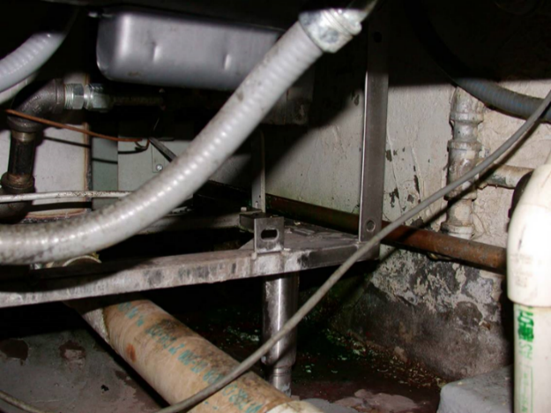
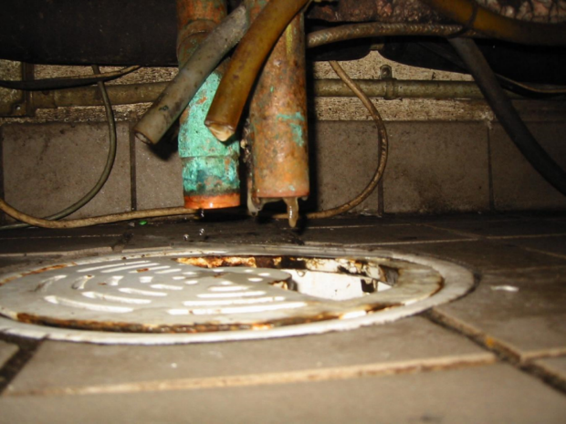
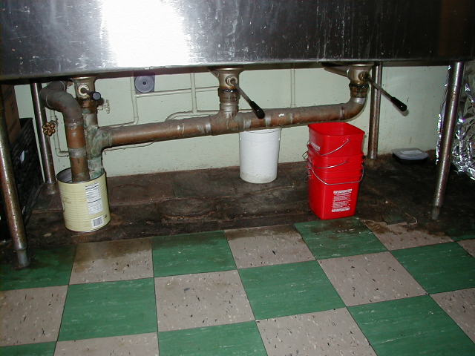
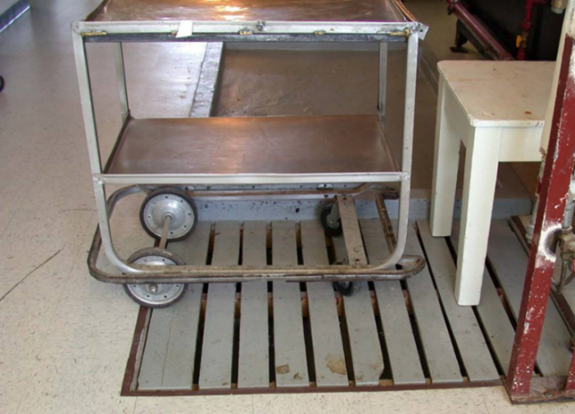
More Hard-to-Reach Locations
Under serving tables
Under stoves and cooking ranges
Dawn H. Gouge, University of Arizona
Drains under fixed equipment
Under sinks
Under covered floor drains

Slide 16
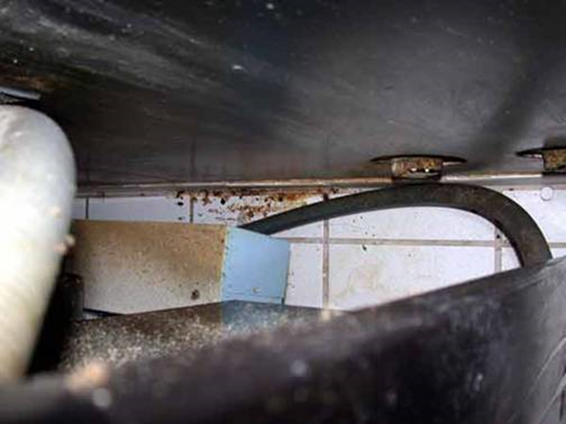
1.
Hard-to-Reach Locations
Look for:
  Dark
  Damp
  Warm
  Undisturbed or out-of-reach
Food debris accumulates where pests go unnoticed
No matter how challenging, the areas must be monitored and maintained
A hose behind fixed
equipment creates a trap for
debris and an area where
grease and grime build up – Dawn H. Gouge, University of Arizona

Slide 17
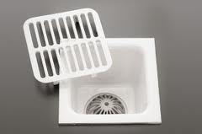
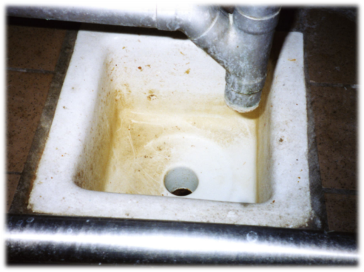
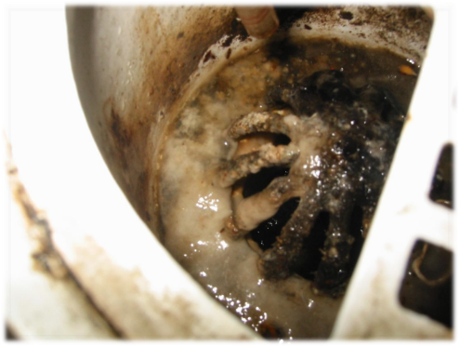
1.
Floor Drains and Floor Sinks
Dawn H. Gouge, University of Arizona
Organic matter builds up and moth fly maggots breed in the matter that lines the drain
Often, food service staff clean from the floor up, and may not have the tools or training to clean floor drains
Drains must be maintained, so find out who is responsible
Clean!
Not good
Just horrible!

Slide 18
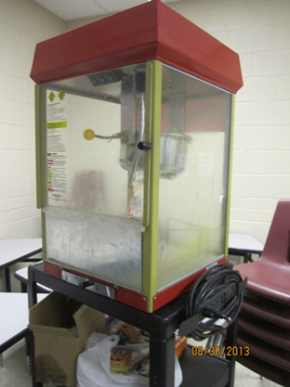
Occasional use equipment
Equipment that is used on special occasions may not be cleaned out regularly
These can be especially vulnerable to pests because they contain food residues
Popcorn machines have layers of grease on their walls and are difficult to clean – Dawn H. Gouge, University of Arizona

Slide 19
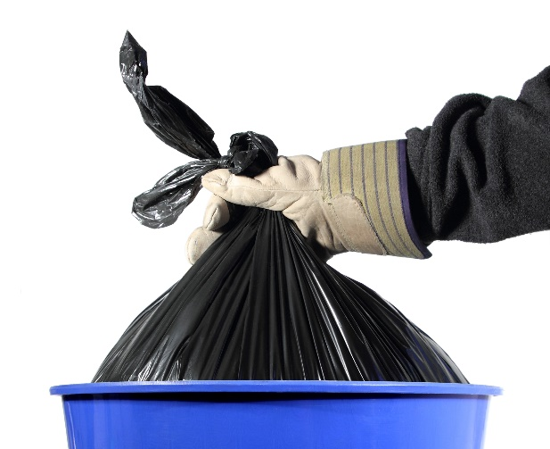
Key Elements of Sanitation and Exclusion
Waste management is pest management:
  Good quality trash cans
  Keep insides and undersides of
  trash cans clean – clean away from
  food preparation areas
  Use good quality trash bags
  Consider freezing food remains that cannot be disposed of the same day
  If internal trash bins are on rollers, make sure the rollers and platform are also clean
Good quality
trash bins and bags

Slide 20
Key Elements of Sanitation and Exclusion
  Anything with food remains should be:
    Bagged
    Placed in trash cans
    Taken to outside dumpsters before the end of each day
Avoid accumulating filled trash bags indoors - Jerry Jochim, Monroe County Community School Corporation

Slide 21
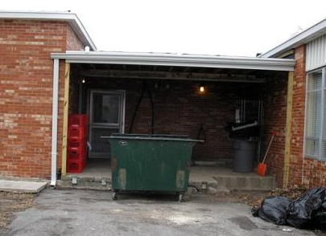
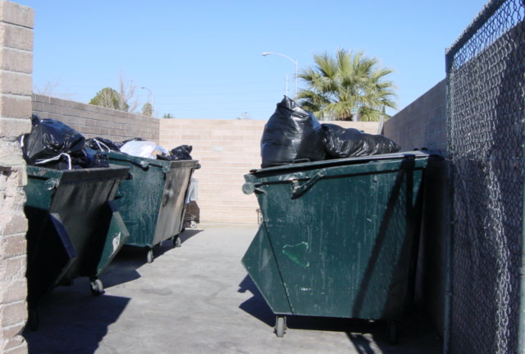
1.
Key Elements of Sanitation and Exclusion
  Keep dumpsters clean, covered and well-maintained
    Place dumpsters on concrete or asphalt surface 30-50 feet away from building entryways
    Keep the area around the dumpster free of debris that can shelter pests
Dawn H. Gouge, University of Arizona
Good placement of dumpsters, in separate enclosed area, but lids should be closed
This dumpster is way too close
to the kitchen entryway

Slide 22
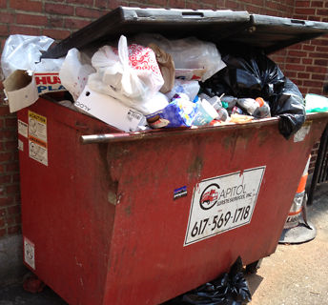
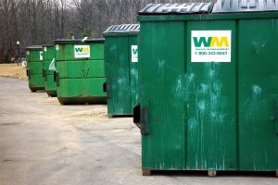
Key Elements of Sanitation and Exclusion
Marc Lame, Indiana University
Left: Over-full dumpster - request a larger capacity dumpster
Right: All trash is secured in tied trash bags with no overflow, the lid will be closed at the end of the work day

Slide 23
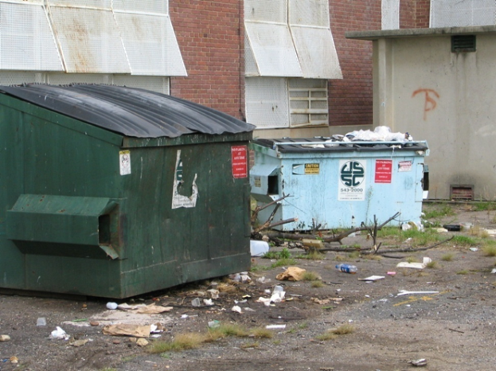
1.
Key Elements of Sanitation and Exclusion
Dumpsters should be rotated for clean ones
Lids should be kept closed at the end of the day
Your dumpster capacity should be sufficient
Discourage administrators
from getting huge containers
that are emptied less often
Weekly collection is good,
twice-weekly is better
Poorly managed dumpsters – Marc Lame, Indiana University
Notes:
Objective 1

Slide 24
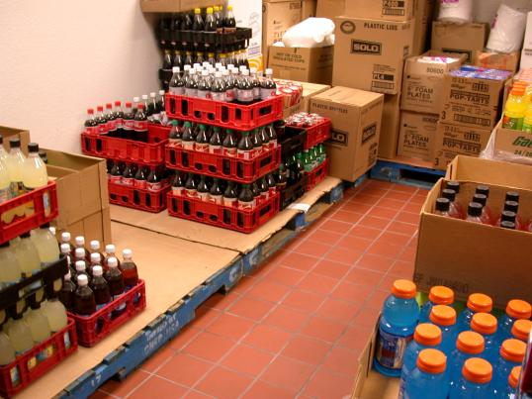
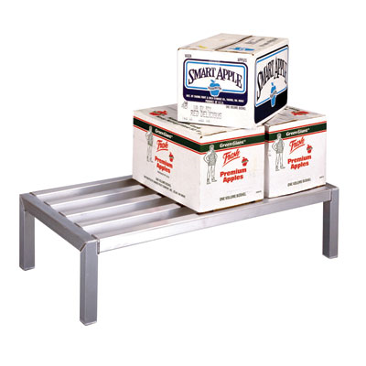
Key Elements of Sanitation and Exclusion
Sanitation also involves proper storage of supplies/materials, this helps to:
Prevent pest-conducive conditions
Permit proper cleaning and inspection
Dawn H. Gouge, University of Arizona
Inspect, date, and organize supplies as they arrive
Cardboard covered wooden pallets are prone to support pests
Aluminum dunnage racks (left) are ideal, as you can see and clean beneath them

Slide 25
Key Elements of Sanitation and Exclusion
  Proper storage practices
  Inspect deliveries for pests or signs of pests
  Inspect for broken or leaking bags, containers, or cartons of food supplies
  Avoid storing boxes and items up against walls
  Leave 18-inch gaps under the lowest shelf so the floor can be cleaned underneath – 6 inches are mandatory
  Avoid using wooden pallets, milk crates, etc. to store things on for extended time

Slide 26
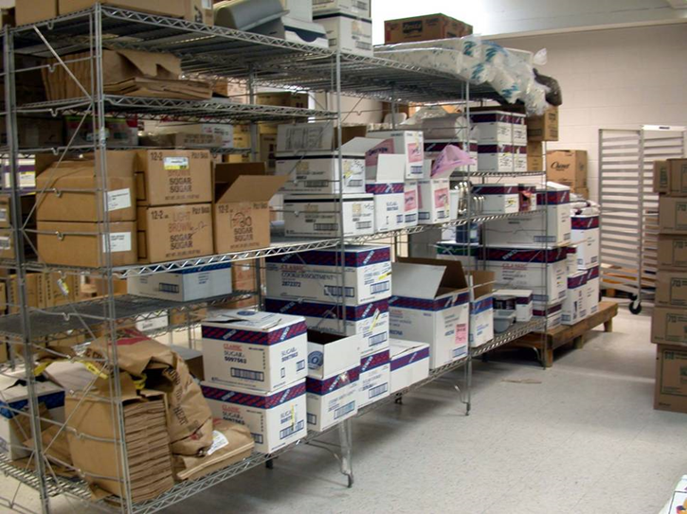
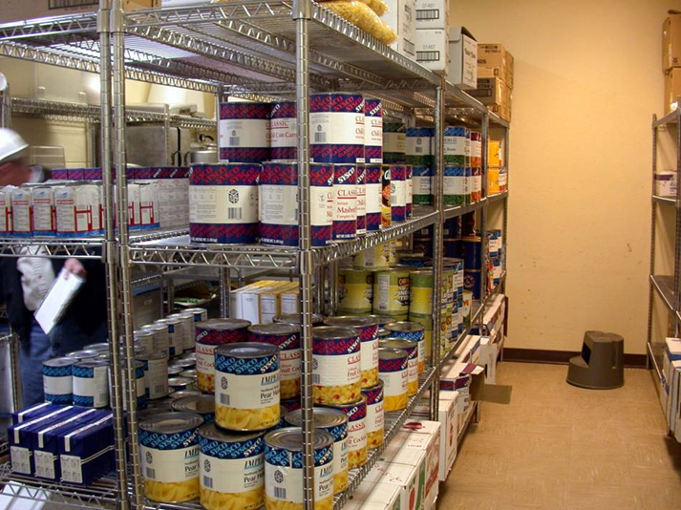
Proper storage
Jerry Jochim, Monroe County Community School Corporation
Corrugations in cardboard boxes provide excellent harborage for cockroaches
Problematic
Excellent

Slide 27
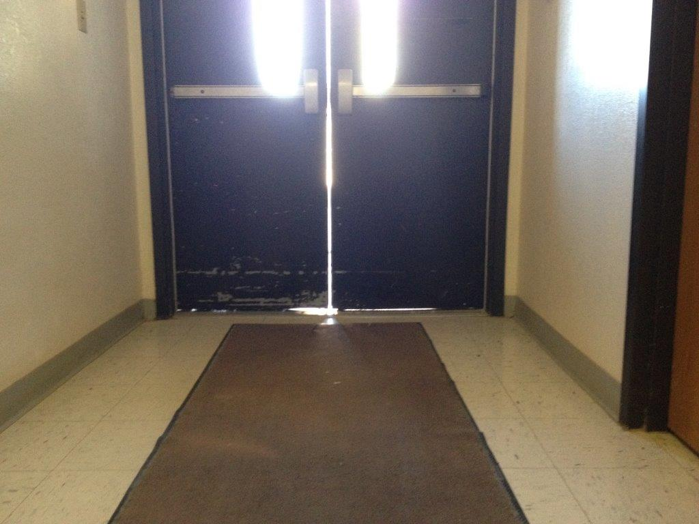
Pest exclusion involves denying entryway to pests
Key Elements of Sanitation and Exclusion
Any sign of a pest should trigger
a search for points of entry
Broken/torn wire-mesh screen
covers of windows
Dry P-traps in drains
Worn out door-sweeps/
weather stripping
Hitchhikers in deliveries
  Check for signs of pest presence
This door needs new door sweeps and weather stripping – Dawn H. Gouge, University of Arizona

Slide 28
Pest Exclusion Strategies/Tactics
Avoid propping doors open
Close gaps that provide access to pests
  Young mice - a dime
  Young rats – a
  nickel-sized gaps
  American cockroaches
  - width of a quarter
This door should be closed - Jerry Jochim, Monroe County Community School Corporation

Slide 29
Pest Exclusion Strategies/Tactics
Avoid clutter, both inside your kitchen and outside by external doorways
Keep food in sealed
containers as
much as possible
This space needs de-cluttering! - Jerry Jochim, Monroe County Community School Corporation

Slide 30
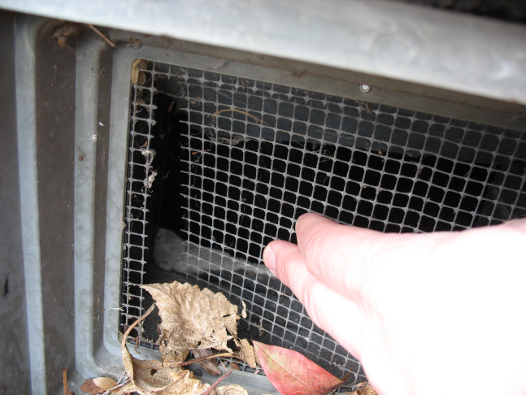
Pest Exclusion Strategies/Tactics
Replace worn door sweeps
Seal gaps, cracks and crevices with suitable sealants
Cover windows and vents with wire mesh and replace with new wire mesh when broken
Torn wire-mesh on a vent – Dawn H. Gouge, University of Arizona

Slide 31
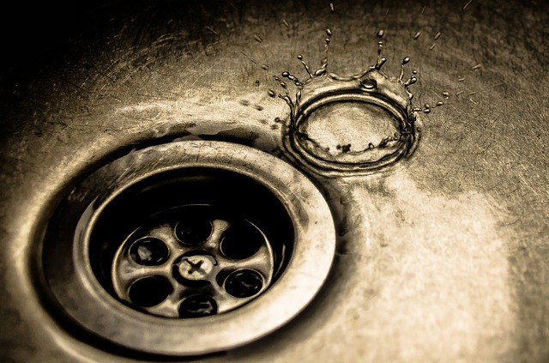
Pest Exclusion Tools
P-traps in drains prevent gases, odors and insects from entering buildings
Keep them filled with water
Dry P-traps create access to your building from the sewer for American cockroaches
Inspect drains periodically to prevent P-traps from drying out

Slide 32
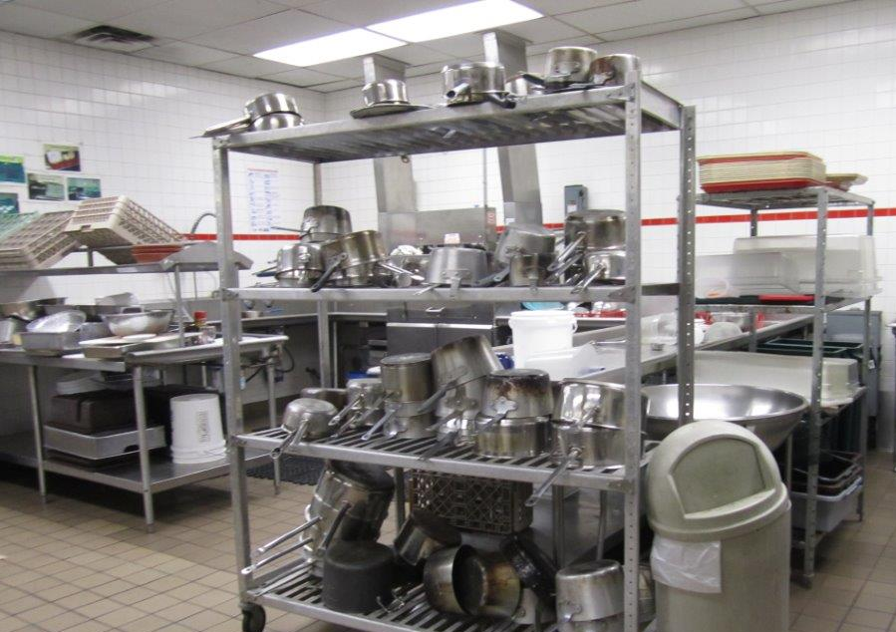
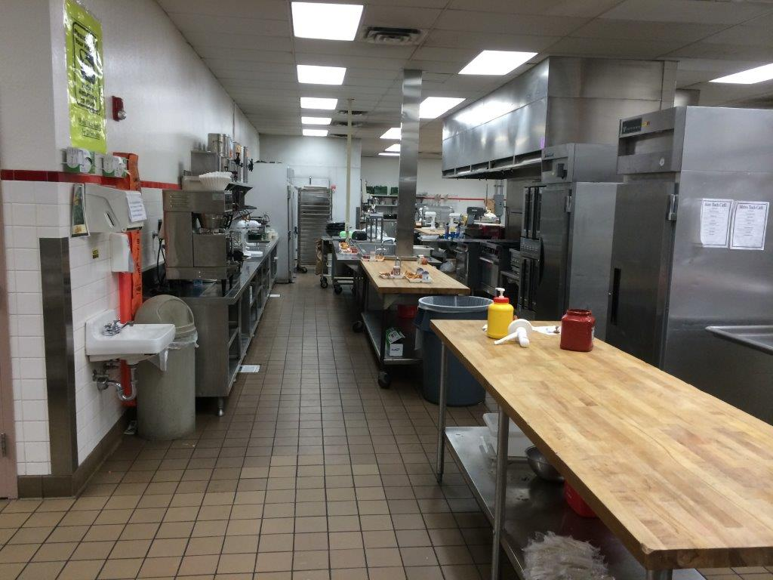
Thorough Cleaning Procedures
Most food service areas have fixed protocols for cleaning dishes and utensils, equipment, and work surfaces
However, there are some places that often get neglected
Shujuan Li, University of Arizona

Slide 33
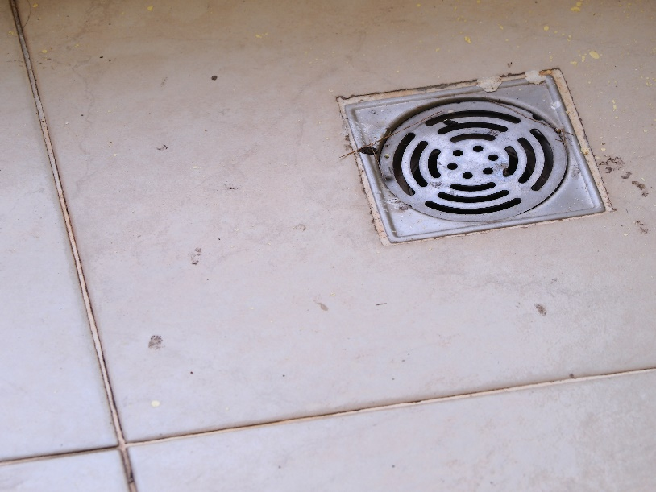
Thorough Cleaning Procedures
Drains
Organic matter builds up in drains can be scraped out physically
Do this only after food has been put away, and before food preparation surfaces and equipment are sanitized
Regular maintenance with
an enzyme or biological
cleaner every month

Slide 34
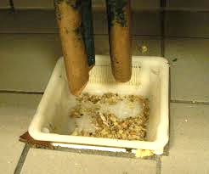
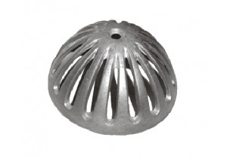
Thorough Cleaning Procedures
Floor sink nets or dome strainers should be cleaned
Floor drain strainer full of food
Clean floor drain dome strainer
Dawn H. Gouge, University of Arizona

Slide 35
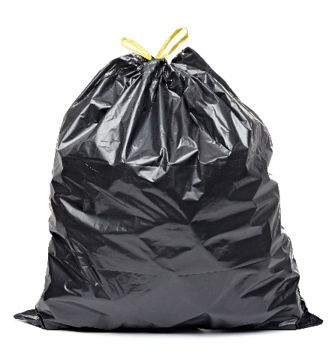
Thorough Cleaning Procedures
Floors
Remove debris
Never dry sweep in areas where food is on display or people are eating
A damp mop may be used to contain spilled liquids
Place food residues in garbage containers lined with good quality plastic liners
Tie plastic bags shut

Slide 36
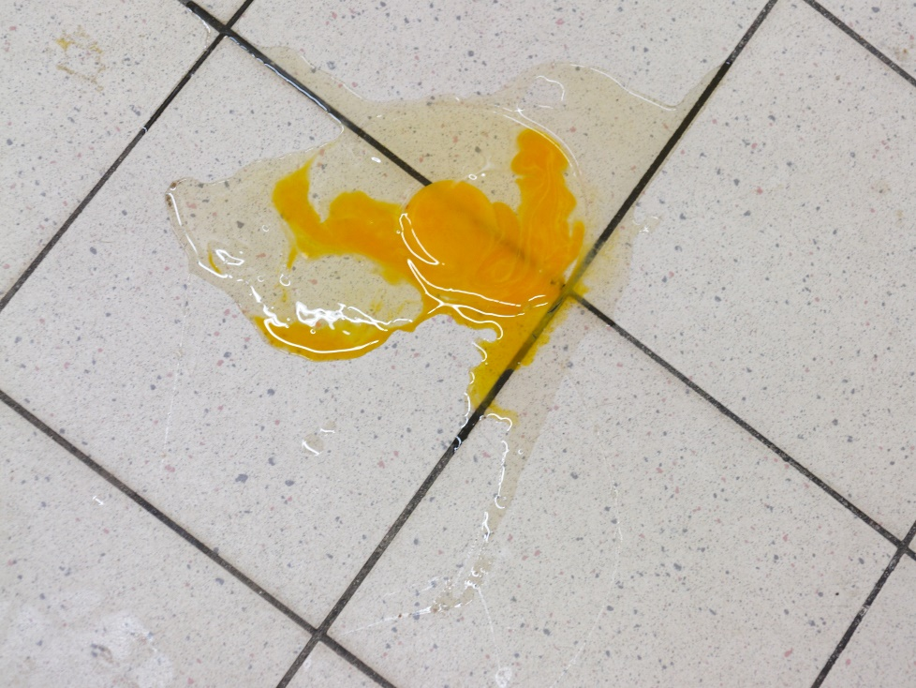
Thorough Cleaning Procedures
Floors
Avoid spraying water directly on motors and other electrical equipment
Do not allow moisture to come in contact with stored dry goods
Physically remove
food debris

Slide 37
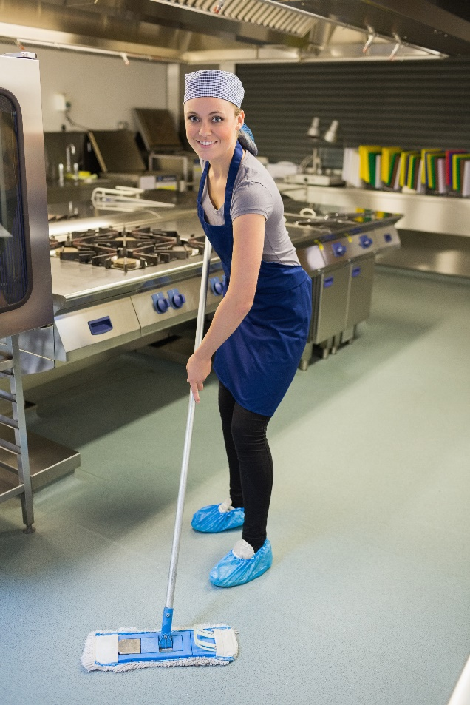
Thorough Cleaning Procedures
Floors
Detergents are manufactured to do specific jobs
  The type of dirt to be removed
  The type of surface
  to be cleaned
  Water quality
  Cleaning method
  Cost

Slide 38
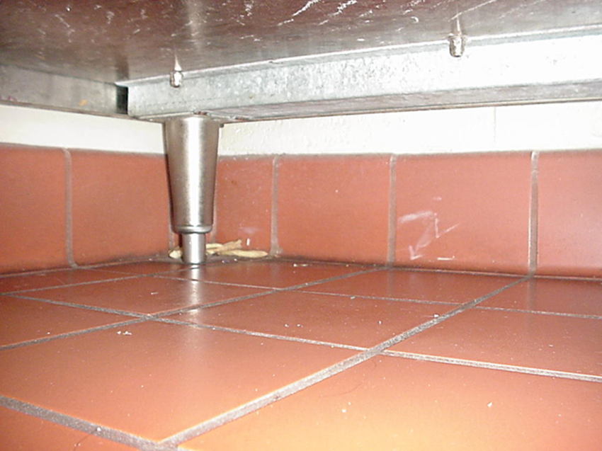
Thorough cleaning procedures
Floors
After applying detergent, rinse with clean potable water
It is important to remove all detergent residue
Pay special attention to corners, floor joints
and under equipment – Dawn H. Gouge, University of Arizona

Slide 39
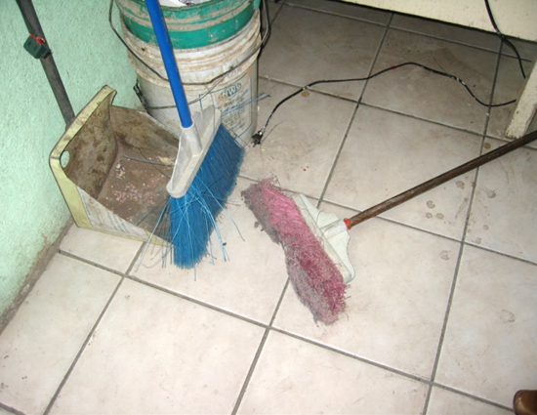
Thorough cleaning procedures
Keep cleaning equipment clean
Food residues can accumulate in all of the following:
  Garbage receptacles
  Pans
  Brooms, dusters and
  brushes
  Mops and buckets
    Vacuum cleaners,
    polishers, scrubbers
These cleaning tools are filthy and need replacing – Dawn H. Gouge, University of Arizona

Slide 40
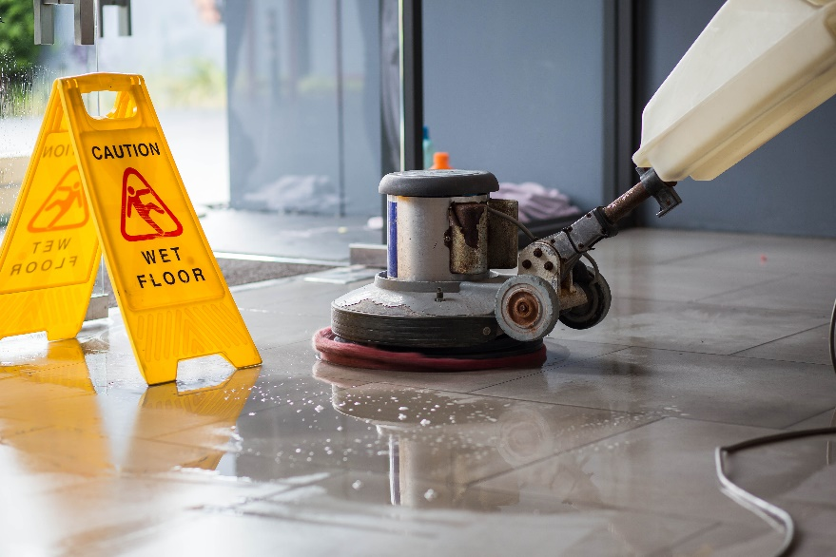
Cleaning Equipment Maintenance and Storage
Emptying
Vacuum cleaners, floor scrubbers and other pieces of equipment usually need to be emptied before they are stored
Wiping Down, Washing and Rinsing
Washed and rinsed

Slide 41
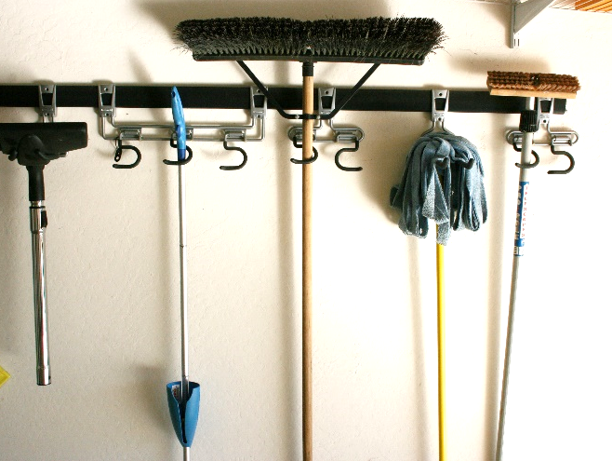
Cleaning Equipment Maintenance and Storage
Storage
Store brooms, mops and other tools off-the-floor
Clean and dry mop heads may be stored in transparent plastic totes or on wire shelving
Avoid heaping mop heads
on the floor or on solid
shelving
Store equipment off the floor and in a
manner that will allow it to dry rapidly - Dawn H. Gouge, University of Arizona

Slide 42
Thorough cleaning procedures
Keep yourself clean and hygienic
If you physically remove a pest or article contacted by pests
  Double bag it
  Place in an outdoor garbage receptacle
Wash hands thoroughly after cleaning up, always before handling food and as you transition from task
to task

Slide 43

Thorough cleaning procedures
Wash hands in designated handwashing sinks
Handwashing station
  Sink with hot water supply (at least 100ºF)
  Handwashing soap
  Single-use paper towels for hand drying
  Trashcan for paper
  towels, disposable
  gloves, etc.
Nail brush,
hand sanitizer,
disposable gloves

Slide 44

Thorough cleaning procedures
Handwashing tips
  Rinse hands and arms up to the elbows
  Apply soap and lather for at least 15 seconds – clean hands, arms, paying carful attention to finger nails
  Dry with paper towel
  Apply hand sanitizer
  to completely dry hands
  Put gloves on completely
  dry hands

Slide 45

2.
Effective Communication
Learn more about IPM from experts
Ask questions, read IPM newsletters and participate in
environmental health committee meetings
Discuss IPM with colleagues, principals and parents of students
Group support
Demonstrate your
success with IPM

Slide 46

Food Service Staff and IPM
Dedicated food service staff automatically implement IPM as they go about their daily duties!
You are
already an
expert
Clean serving area at a Middle School, Washington DC
- DC Central Kitchen

Slide 47

Check In!
In this lesson you learned:
Key elements of sanitation and
exclusion, including strategies, tactics and tools
Key elements of inspection and monitoring, including what and where to look, tools and frequency
Proper and thorough cleaning procedures for specific areas including drains, floors, corners, and hard-to-reach areas
Importance of effective communication and cooperation between food service staff and other school personnel
Congratulations, you have completed the School IPM for Food Service Staff Module!

Slide 48

Resources
Food Service Checklist. IPM Institute of North America. http://www.ipminstitute.org/school_ipm_2015/foodservicechecklist.doc
Food Service IPM. Texas Cooperative Extension, Southwest Technical Resource Center http://schoolipm.tamu.edu/files/2010/11/Food_Service_IPMSmall.pdf
Get Tough on Pests in Food Service Areas. NC State University Cooperative Extension. http://schoolipm.ncsu.edu/documents/IPMforFoodserviceemployees.pdf
School IPM for Kitchen Staff. IPM Institute of North America. http://www.ipminstitute.org/School_IPM_Toolbox/School_IPM_for_kitchen_high_res_Aug_07.ppt
Safer Pest Control Project: IPM in Action http://www.spcpweb.org/factsheets/IPM_Picture_Tour_w_cover.pdf
Management of Ants in Childcare Settings. EPA. http://www2.epa.gov/sites/production/files/documents/Module09.pdf
Managing Mice and Rats In and Around Childcare. EPA. http://www2.epa.gov/sites/production/files/documents/Module05.pdf

