Slide 1


Cultural turf management practices
Lesson 2 of 4
Self-Guided Educational Module

Slide 2

Learning Objectives
Understand cultural turf management practices including:
  Mowing
  Fertilization
  Irrigation
  Soil Analysis
  Aeration
  Overseeding

Slide 3
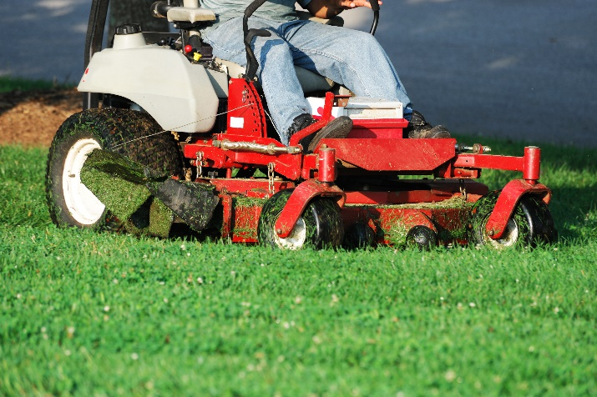
Mowing
Keep mower blades sharp to provide a clean cut, this minimizes disease
Minimize scalping and soil compaction and rutting of playfields by rotating the direction of mowing each time the lawn is clipped
Keep mowers in good repair; leaking oil, gasoline fuel, leaky hydraulic
lines and grease can damage
or kill turf

Slide 4
Mowing
The One-Third Rule
To sustain vigorous turf, remove no more than one-third of height of the grass from soil level at any one mowing event
Mowing height
Mow tall to encourage deeper rooting, which will improve tolerance to environmental stress and reduce the need for fertilizer and pesticides
Most non-athletic turfgrasses used on school lawns can be mowed at a height of 2 ½ -3 inches (there are exceptions) For example, bentgrass grown west of the Cascades should be mowed at less than 1 inch

Slide 5
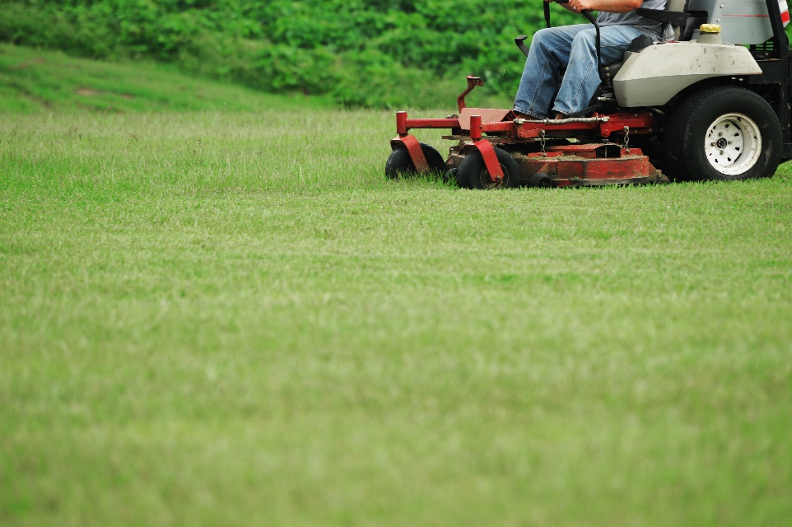
Mowing
  To adhere to the 1/3 rule, mow your turf at least once a week
  If possible mow high priority areas such as athletic fields twice a week during periods of heavy growth
  Increased mowing
  frequency will increase
  turf density, wear
  tolerance and decrease
  weed encroachment

Slide 6
Mowing
The one-third rule
6”
4.5”
4”
Height prior to mowing
3”
3”
Height after mowing
2”
1.5”
1”
Alec Kowaleski, Oregon State University
Notes:
Use this if you like… it is my graphic.

Slide 7
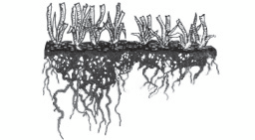
Mowing
High Cut
Low Cut
The picture depicts the effect of mowing height on root growth
A lower cut produces shorter roots, less stress tolerance and allows more weed invasion

Slide 8
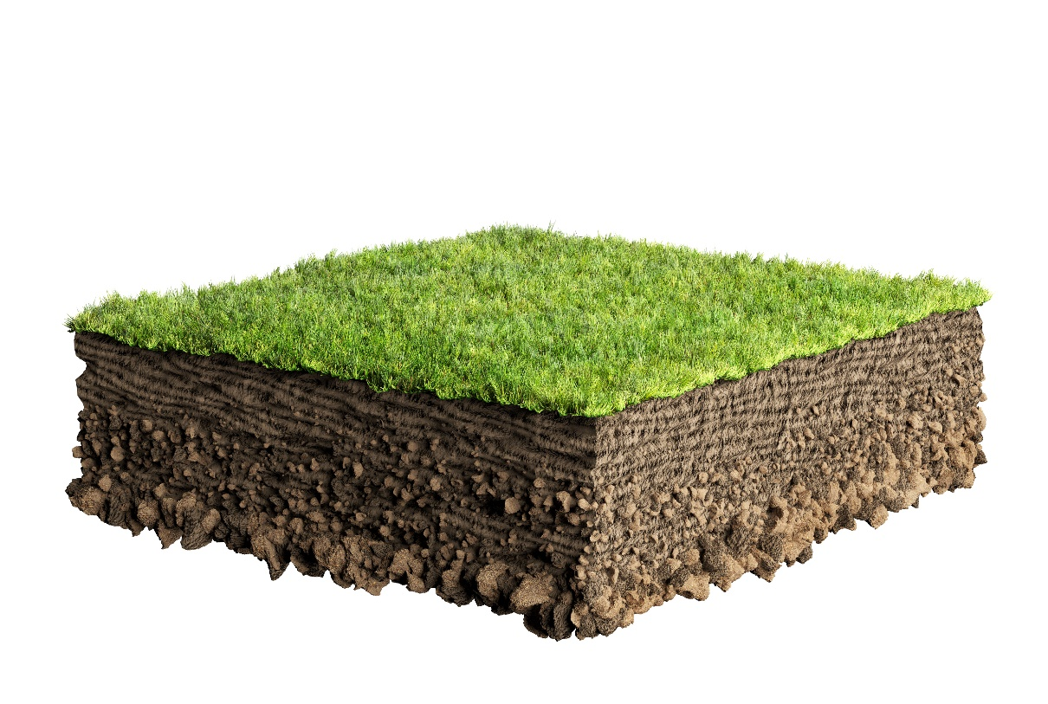
When to Mow
Mow when the lawn is dry to minimize the chance of spreading diseases
Dry clippings almost never need to be removed from turf
Clippings do not
contribute to thatch
Clippings return
nutrients to the
soil decreasing fertility requirements

Slide 9
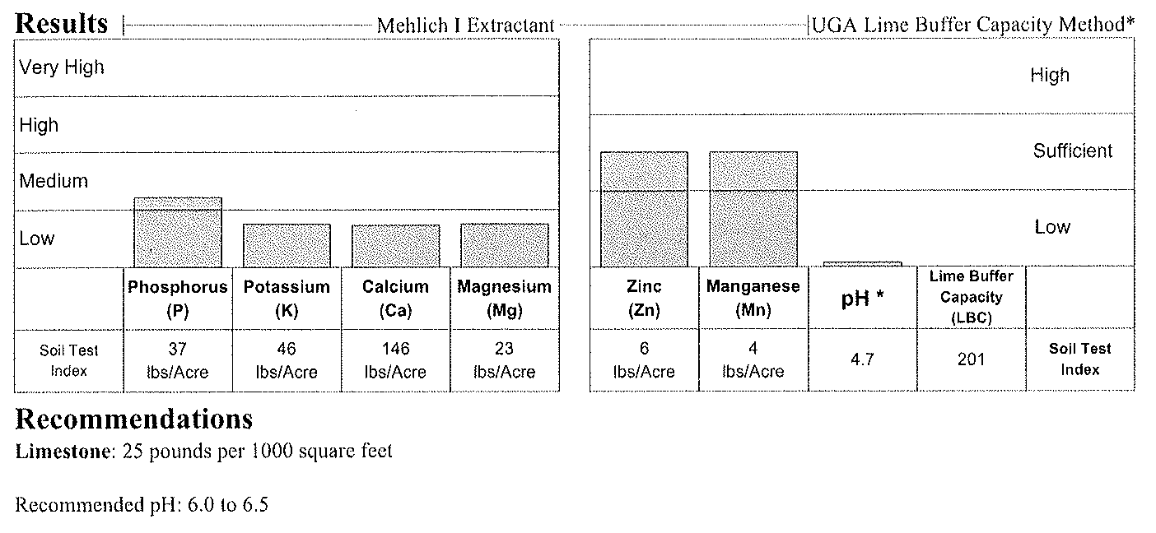
Fertilization
A basic soil test will identify the soil pH/lime requirements, as well as phosphorus, potassium and secondary nutrient deficiencies
Soil test labs may provide recommendations
Alec Kowaleski, Oregon State University

Slide 10
Fertilization
1.
All grasses require certain nutrients, including nitrogen (N), phosphorus (P) and potassium (K)
There are no generic N fertilization recommendations that apply to all situations
Fertilizing with P should be based on a soil test Fertilizing with N should be based on turfgrasses present, site and use of turf
Use a fertilizer that supplies a higher concentration of nitrogen and low concentration of phosphorus, or approximately a 3:2:1 ratio of nitrogen to phosphorus to potassium

Slide 11
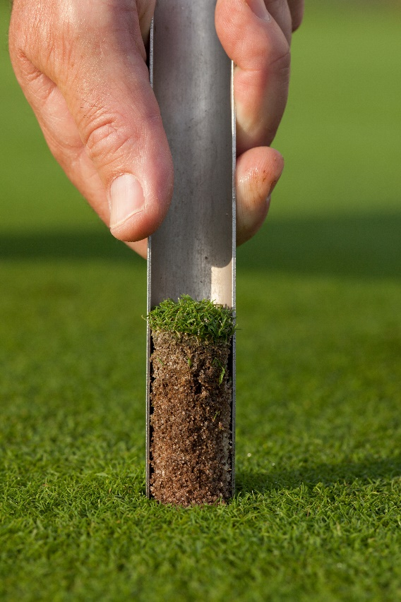
Fertilization
In several states (WA, MN, WI and others), fertilizers containing phosphorus cannot be applied unless a soil test documents a deficiency, to protect lakes,
rivers and streams
Soil test results will provide
specifics on the phosphorus
rates

Slide 12
Fertilization
There are two basic forms of nitrogen contained in fertilizer products
  Water-soluble nitrogen (WSN) which is readily available to the plant
  Slow-release nitrogen (SRN) which is available in the form of water-insoluble nitrogen (WIN) or controlled-release nitrogen
  Manufactured turf fertilizers are often formulated with a mixture of WSN and SRN

Slide 13
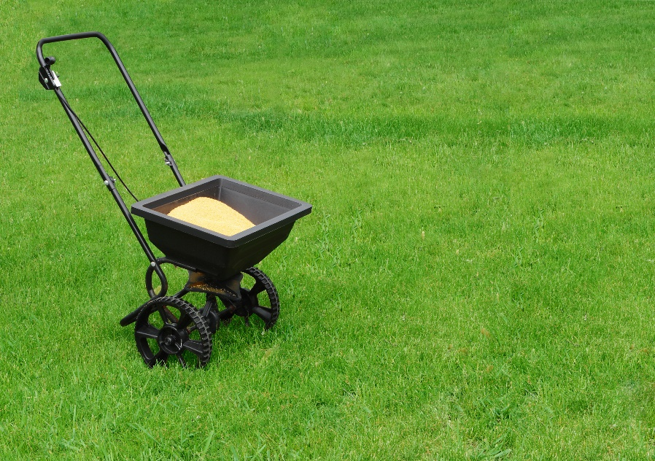
Fertilization
The percentages of WSN and SRN in a fertilizer product will affect the N-release rate, price and other factors
Characteristics of WSN and SRN sources may be considered either advantageous or disadvantageous
depending on the
specific management
situation

Slide 14
Fertilization
Use the lowest product rate possible that will meet your expectations for growth, appearance, and produce healthy turf
Slow-release fertilizers will:
  Prolong the availability of nutrients throughout the growing season
  Reduce the risk of water pollution
  Compost, depending on the parent materials, can also be a source of P and should be factored into the fertilization program

Slide 15
When to Use Fertilizer
Timing and rate of fertilizer applications depend on:
  The requirements of the turfgrass species
  Your expectations for turf quality and turf density
  Seasonal limitations and the use of the area
  Application rates range from 0.5 to 1.5 lbs N per 1,000 ft², split applications so that no more than ¼ lb of water-soluble N is applied in any one application
A soil test should be the basis for planning fertilization schedules
In high maintenance areas, testing every year will save money on fertilizer, time and other amendments

Slide 16
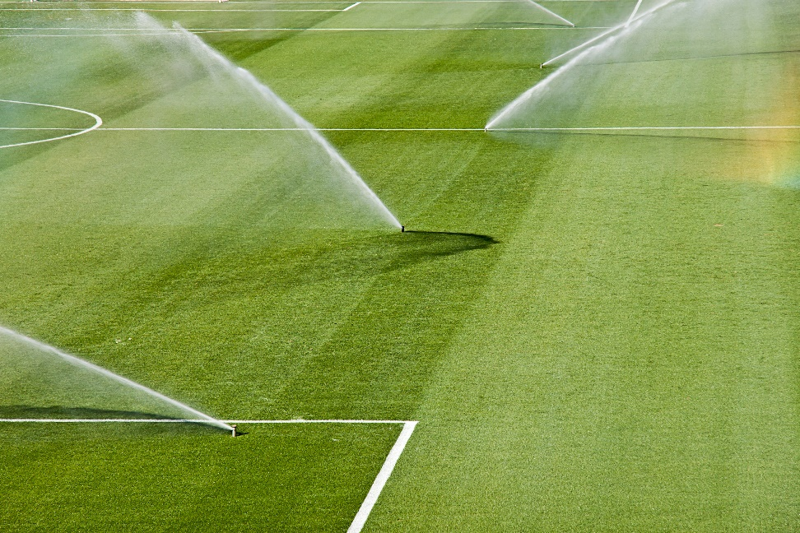
Irrigation Frequency
Water deeply but infrequently, based on need, to encourage a deep root system
How frequently you irrigate depends on the soil type, weather conditions, species of grass and the mowing height
and use of the turf
Delay irrigation in the
spring to encourage
roots to grow deeper
to seek moisture

Slide 17
Irrigation Amount
Supplement rainfall to provide a total of one inch of water per week
It takes 620 gallons of water to apply one inch of water to 1000 ft² of turf, it’s best applied in several applications to avoid runoff and saturation
Overwatering reduces root growth, promotes compaction and disease activity and decreases overall wear tolerance

Slide 18
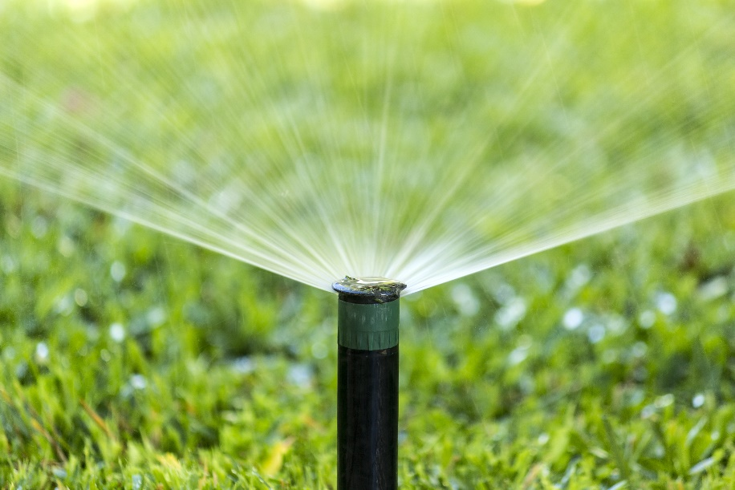
Irrigation Timing
1.
Water turf just before it begins to wilt, signs of wilting include:
  A bluish-green or purplish color to the grass
  Rolling or folding blades of grass
  Footprints that remain on the lawn for several
  minutes after passage
  Soil that is dry at the
  soil surface; penetration
  with a screwdriver is
  tough

Slide 19
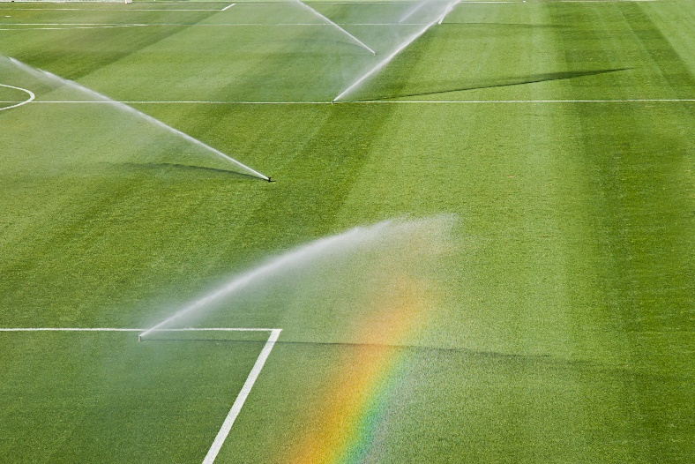
Irrigation Timing Continued
Water turf very early in the morning, this can limit evaporation and reduces disease problems
Extended periods of leaf wetness caused by high humidity, excessive watering and standing water encourages fungal diseases
All areas of the lawn should
receive adequate coverage
and low spots should be
leveled or drained to
avoid waterlogged soils

Slide 20
Soil Analysis
An uninformed approach to soil and nutrient management is neither economically viable nor environmentally responsible
Basic soil test results can dictate approaches to soil management, assessment of overall plant health, refinement of a fertility program, prevention of nutrient losses to the environment and other aspects of management
Notes:
What kind of tests?

Slide 21

Soil Analysis
Sample soil and conduct chemical and physical soils analysis prior to establishment, renovation or at the beginning of assuming management responsibility for a site where limited history is available
Notes:
What kind of tests?

Slide 22
Soil Analysis
Soil Chemical Properties | Soil Physical Properties
E.g., pH, fertility, nutrient reserves, heavy metals, salinity | E.g., texture, particle size distribution, percent organic matter
Provides information about the growing conditions plants will be exposed to Determines fertilizer and pH adjustment needs | Provides information about soil health Helps indicate drainage characteristics and the compatibility of amendments
Notes:
What is liming?

Slide 23
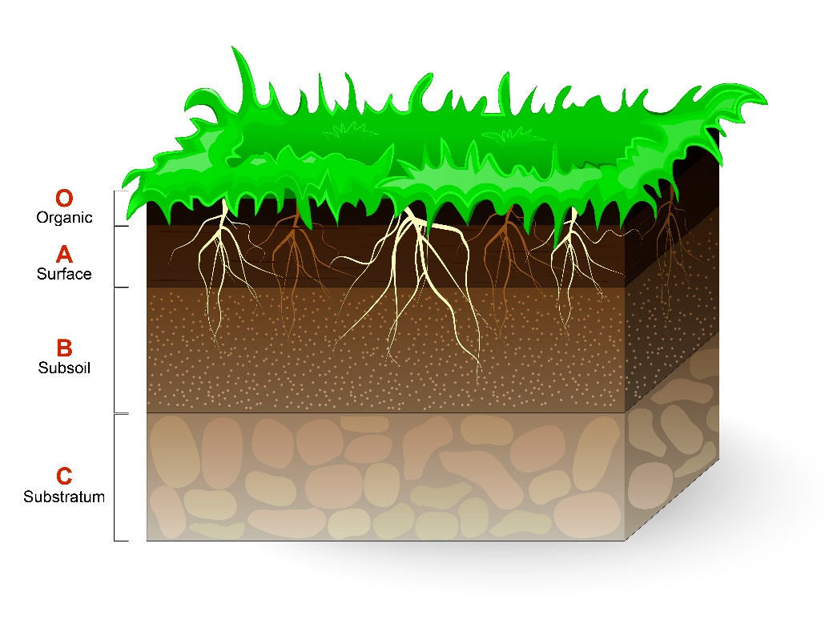
Soil Analysis
For established, healthy turf, conduct soil chemical analyses at least every three years and monitor pH annually
Test soil conditioners,
topdressing materials,
composts and other
turf amendments
separately
to ensure suitability
for use
Soil profile

Slide 24
Soil Analysis
Learn how to correctly interpret soil test results
Soil test results are of little value without an appropriate interpretation
As the soil test level for a nutrient increases, plant growth increases to a point where the nutrient is no longer limiting; this point is known as the critical soil test level
The critical soil test level is defined as the extractable nutrient concentration in soil above which improved plant growth or performance is unlikely

Slide 25

Soil Analysis
Nutrient levels are considered sufficient when the concentration is just above the critical soil test level
This is known as the optimum soil test range

Slide 26
Soil Analysis
When levels are below the optimum range (very low or low), the addition of more nutrients will usually improve turf performance
When soil test levels are in the optimum range turf response to application of that nutrient is unlikely, but some amount may be recommended to maintain soil levels over time
There are do-it-yourself soil test kits or soil test services available

Slide 27
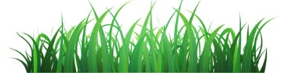
Soil Analysis
Factors other than nutrients may limit turfgrass growth, and simply adding more nutrients may not improve turf performance
To optimize turf performance and maximize response to fertilizer, sound management practices must be used including cultivar selection, establishment, irrigation management and pest and stress management

Slide 28
Interpretation of Soil Test Categories
Categories | Interpretation
Very Low | Substantial amounts of additional nutrients required to achieve optimum growth Fertilizer rates should be based on plant response and are designed to gradually increase soil nutrient levels to the optimum range over several years
Low | Moderate amounts of additional nutrients needed to achieve optimum growth Recommendations based on plant response and are intended to gradually increase soil nutrient levels to the optimum range
Optimum | Most desirable soil test range on economic and environmental basis To maintain this range for successive years, nutrients must be retained in the system, or those nutrients lost or consumed must be replaced
Above optimum | The nutrient is considered more than adequate and will not limit the plants At the top end of this range, there is the possibility of a negative impact on the turf if nutrients are added
Excessive | This soil test level is independent of plant response and, due to environmental concerns, is only defined for soil test phosphorus (P) No P should be applied and steps should be taken to minimize losses from leaching and runoff

Slide 29
Aeration
Aeration is the process of making holes in the turf to improve air exchange, help water penetrate and drain and decrease the soil density and organic matter
Soil compaction occurs when lawns are used heavily and the pore spaces that allow water and air to pass through the soil collapse, creating poor conditions for root growth
Aeration promotes growth, helps manage thatch buildup and relieves soil compaction

Slide 30
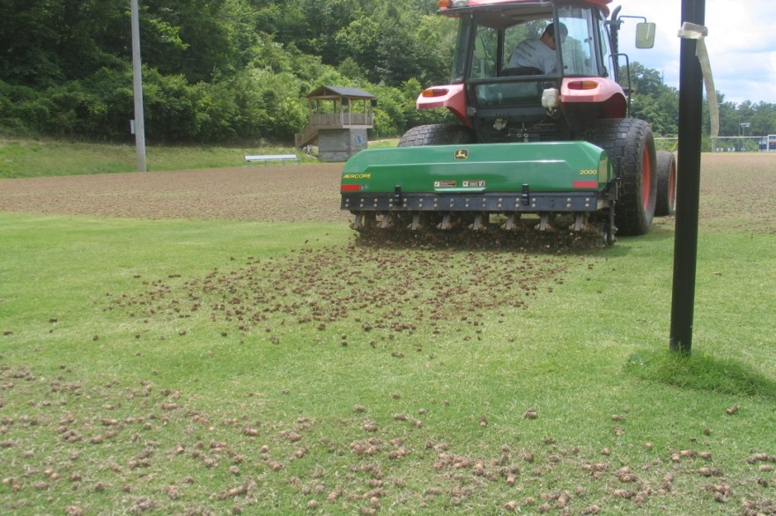
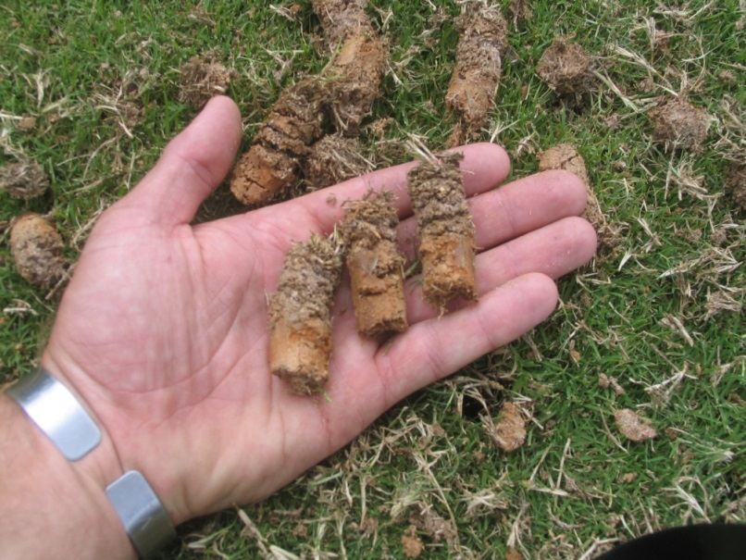
Aeration
Hollow tine core cultivation
Unlike other aerification methods, this method improves drainage, reduces organic matter and relieves compaction by pulling cores from soil
Aeration of turf - David Kopec, University of Arizona
Notes:
Please use these pictures – they are mine.

Slide 31

Aeration
Pulverize and distribute the cores over the field with a steel drag mat to distribute the soil, this is a great time to overseed
Top dressing with compost
(ideally over aeration holes)
and rotating mowing patterns
also helps relieve soil
compaction

Slide 32
When to Aerate
The soil must be moist enough to allow good penetration but not too moist that machinery will rut or compact the soil
Irrigate area at least one day before aerating and check depth and amount of soil moisture
Time aeration efforts to avoid periods when weeds are producing seed or when the grass will not recuperate quickly such as in high heat conditions

Slide 33
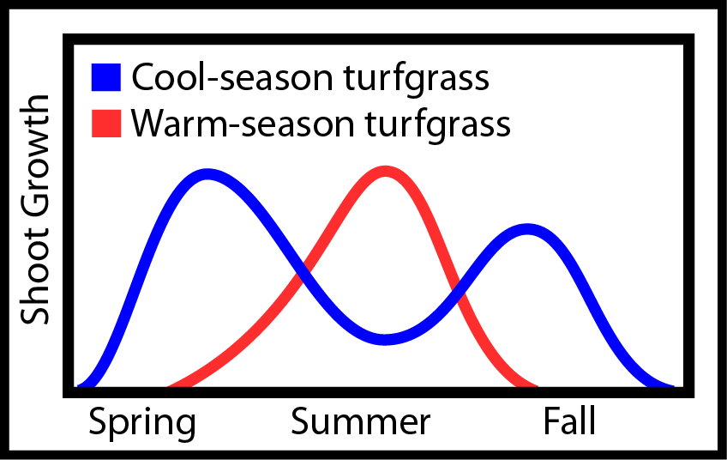
When to Aerate
Practice fields should be aerated one to three times a year
Lawns should be aerated one time a year or less depending on use
Heavily used turf may require aeration up to four times a year
Turf shoot growth - Alec Kowaleski, Oregon State University

Slide 34
Overseeding
1.
Overseeding generally means:
  Introducing more seed of the same grass type into the established turf
  or
  Spreading seed of a different type as environmental conditions change
    For example, when cool-season turf is seeded into warm-season turf during the winter

Slide 35
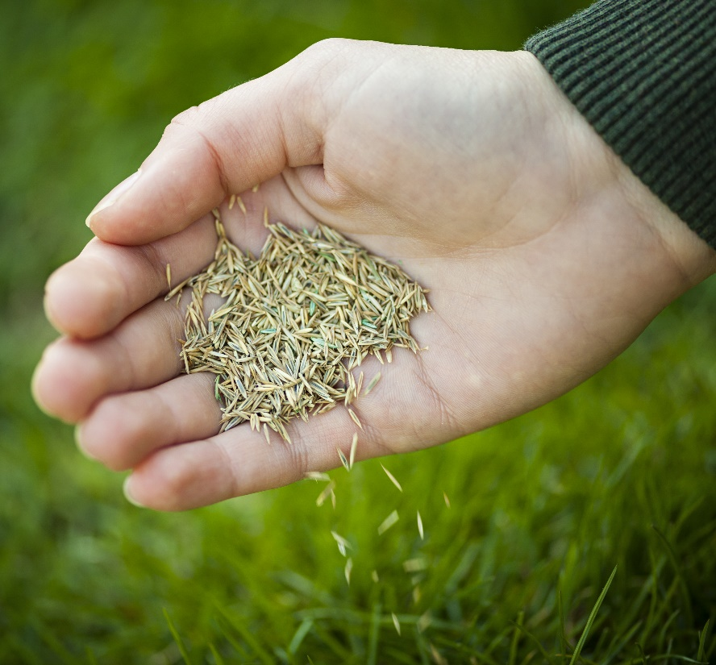
Overseeding
1.
Overseeding helps:
  Thicken the turf stand
  Avoid excessive
  compaction
  Minimize soil erosion
  Prevent weed seed germination
Overseeding is usually performed using a spreader which may be a drop or rotary design

Slide 36
Overseeding
Slit seeding or drilling places the seed directly in the soil
Usually a single pass is sufficient, but bare areas require multiple passes in two to three directions to provide sufficient seed
Spot seeding with a fast germinating turf should be done any time there is an open area caused by weed control, turf removal or winter damage, grubs, etc.
Broadcast seeding is performed a variety of ways and may be combined with aeration
Spikers, hollow-tine aerifiers or vertical mowers may also be used to expose soil to aid seedling establishment

Slide 37
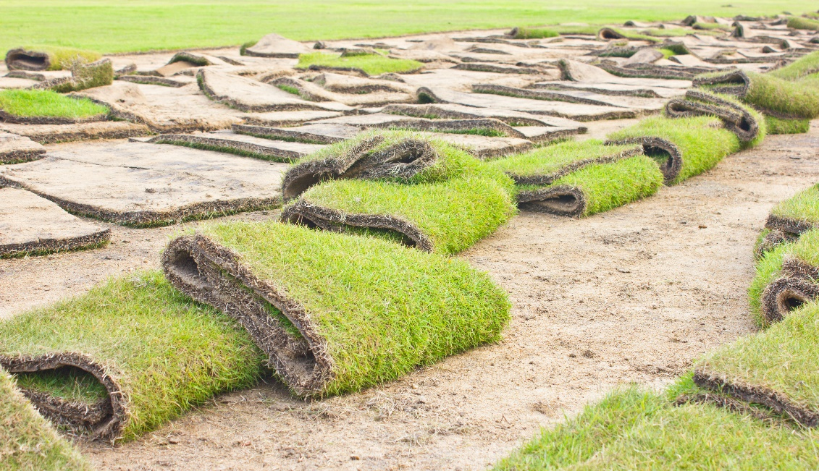
Check In!
This lesson you learned:
Cultural turf management practices including:
  Mowing
  Fertilization
  Irrigation
  Soil Analysis
  Aeration
  Overseeding
Next you will learn more about common turfgrass weeds and insects!

Slide 38
Resource List
Iowa State University. (2010). Plant and Insect Diagnostic Clinic. http://www.ipm.iastate.edu/ipm/info/plant-diseases/turf-grass-rust
Maine Department of Agriculture, Conservation and Forestry. School IPM. http://www.maine.gov/dacf/php/integrated_pest_management/school/index.shtml
Rutgers Cooperative Extension. IPM Report Card for School Grounds: General Requirements. http://entomology.osu.edu/schoolipm/IPMfiles/ReportCardGeneral.pdf
Texas A&M Agrilife Extension. Landscape IPM Module 6. http://schoolipm.tamu.edu/videodvd/
Umass Extension Center for Agriculture. Best Management Practices For Lawn and Landscape Turf. http://extension.umass.edu/turf/sites/turf/files/pdf-doc-ppt/lawn_landscape_BMP_2013_opt.pdf
University of California Agricultural and Natural Resources. (2009). How to Manage Pests. http://www.ipm.ucdavis.edu/PMG/r785100411.html

