Slide 1
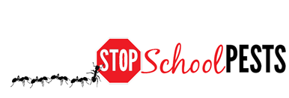
School IPM FOR Nurses
Nurse Gloria
Dielshneider
In-Person Education Module
Lesson 2 of 2

Slide 2
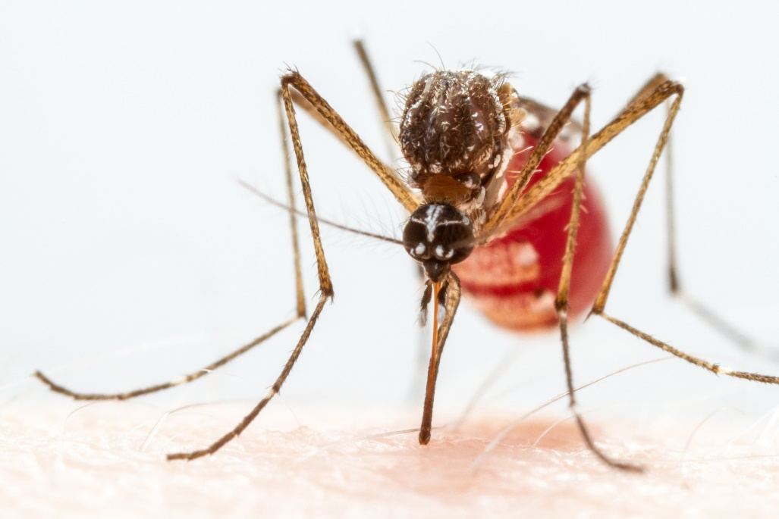
Learning Objectives – Learning Lesson 1
Identify health risks associated with common pests:
    Bed bugs
    Head lice
    Scabies mites
    Fleas
    Honey bees
    Stinging wasps
    Fire ants
    Spider and scorpions
    Mosquitoes
    Bats and rabies
    Ticks
    Stinging caterpillars
    Ringworm
    Venomous snakes
    Commensal rodents
Yellow fever
mosquito

Slide 3
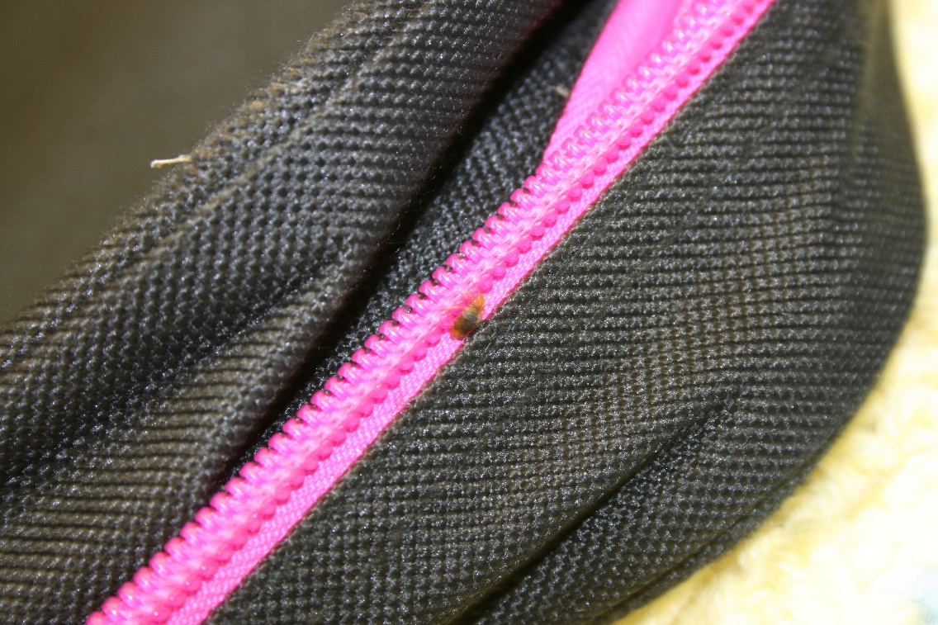
Learning Objectives – Learning Lesson 2
Reducing the spread of: bed bugs, head lice, scabies mites, ringworm
Common pesticide poisoning symptoms
Bed bug on backpack –
Dawn H. Gouge, University of Arizona

Slide 4
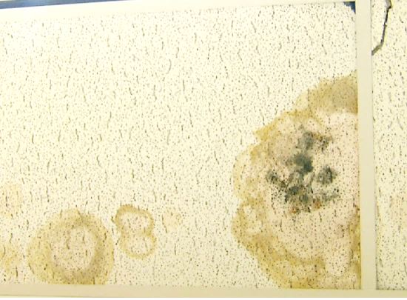
Learning Objectives - Learning Lesson 2
Identify allergy and asthma triggers in classrooms:
    Mice
    Class pets
    Mold
    Cockroaches
    Chemical
    sensitivity
Mold on ceiling tile - Dawn H. Gouge, University of Arizona

Slide 5

Learning Objectives - Learning Lesson 2
Emergency hotlines and resources
Notifying parents about bed bugs
Preventing encounters with mosquitoes, ticks
Sanitation
measures
for norovirus
and flu

Slide 6
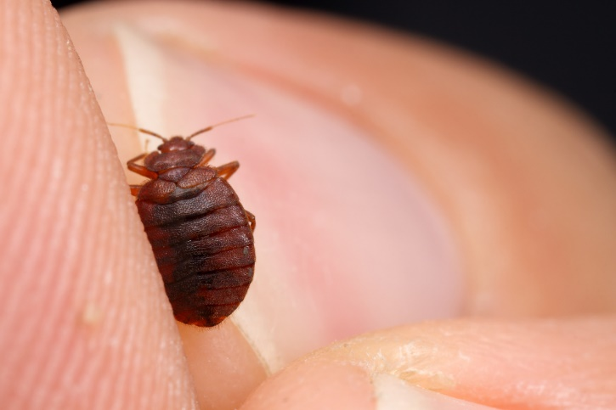
1. 1. 1.
Hygiene and Sanitation
Bed bugs, head lice,
scabies mites, and ringworm are
communicable
Bed bugs
  Students with bed bugs should not be excluded from school
  Takes months to control, some families do not have the resources to ever eradicate them
Bed bug – Alex Wild,
alexanderwild.com

Slide 7
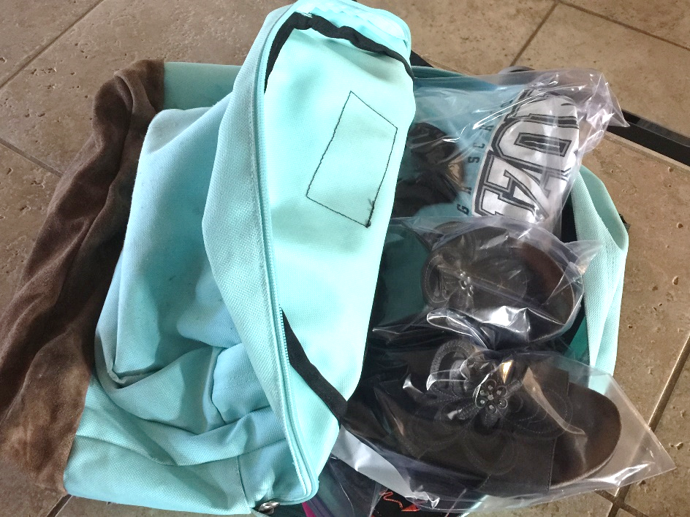
1. 1. 1.
Hygiene and Sanitation
Student brings bagged clothes and
shoes to school to change into
– Robert LaMorte, University of Arizona
  Students may bring or be provided with clean clothing and a back-pack for use in school
  Items from home should be double-bagged, or in large capacity zip-lock bags or similar air-tight containers

Slide 8
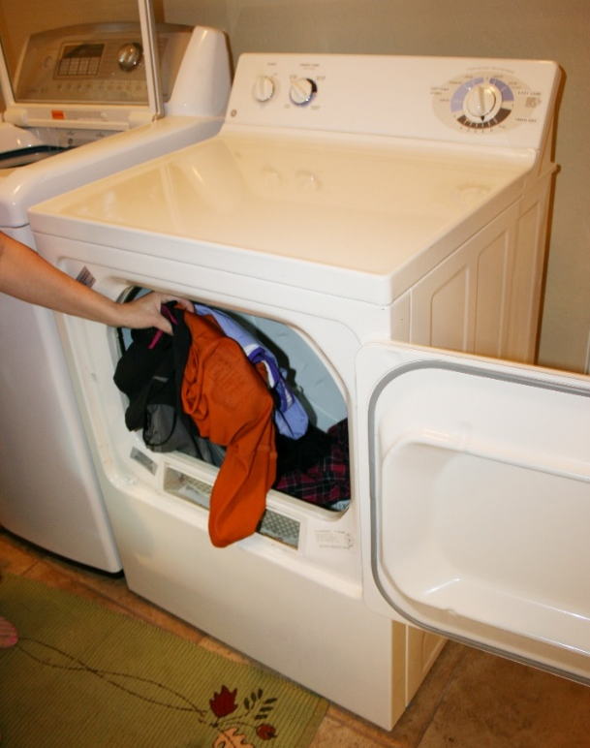
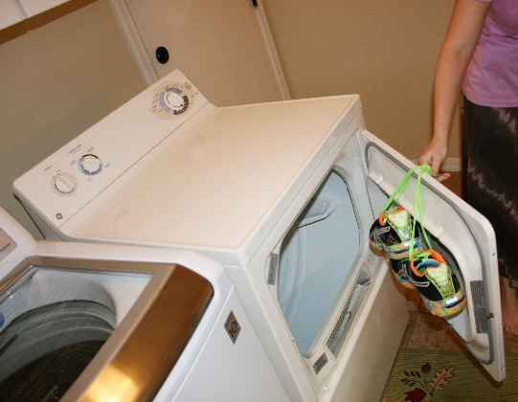
Hygiene and Sanitation
  Discourage bedding and articles
  from home
  Students change at school in
  an area that is cleaned daily
  Washing does not kill bed bugs
  Drying in a clothes dryer does
  Items can be placed in a freezer
  for 4 days
  Hard surface cleaning and
  vacuuming
Bed bugs, head lice
and scabies mites are
all killed in a clothes dryer
– Robert LaMorte,
University of Arizona

Slide 9

1. 1. 1.
Hygiene and Sanitation
Head lice
  Students with head lice should
  not be excluded from school
  Transfer occurs through
  head-to-head contact
  No-nit policies are pointless
  Head-checks are valuable opportunities for the nurse to interact with students
Nurse checking for head lice

Slide 10
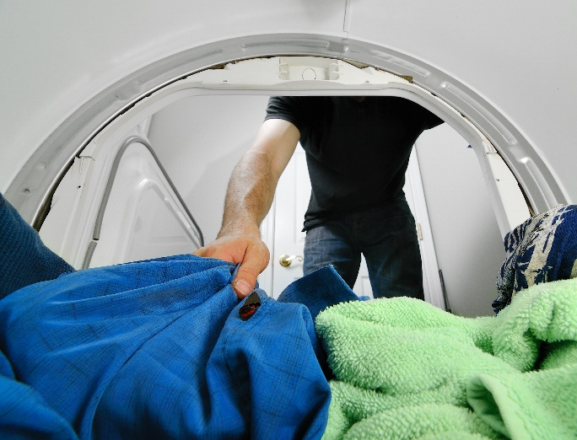
1. 1. 1.
Hygiene and Sanitation
  Students with head lice should not share cots or bedding
  Chronic infestations can be a sign of neglect
  Clothes dryers kill lice
  Lice die in <2 days off a host
  Hard surface cleaning and
  vacuuming should be
  undertaken
Clothes dryers kill lice

Slide 11
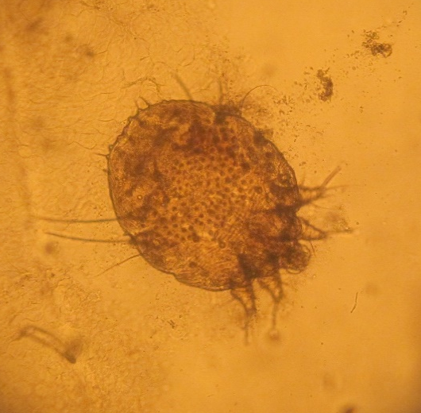
Hygiene and Sanitation
Scabies mite
Scabies mites
  Students with suspected scabies - refer to a doctor
  Contracted through prolonged skin-to-skin contact
  After initial treatment, students can return
  Off a host scabies mites die <72 hours
  If a room is left unoccupied, but unheated in the winter, mites can remain viable for longer

Slide 12
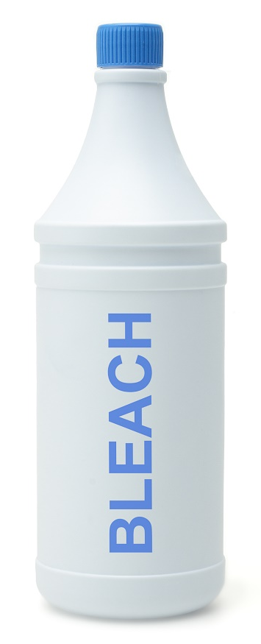
1. 1. 1.
Hygiene and Sanitation
  Clothes drying will kill mites
  Immunocompromised individuals should not be around anyone with scabies
  A person with crusted (Norwegian) scabies should not be in school
  Hard surface cleaning and
  vacuuming should be undertaken

Slide 13
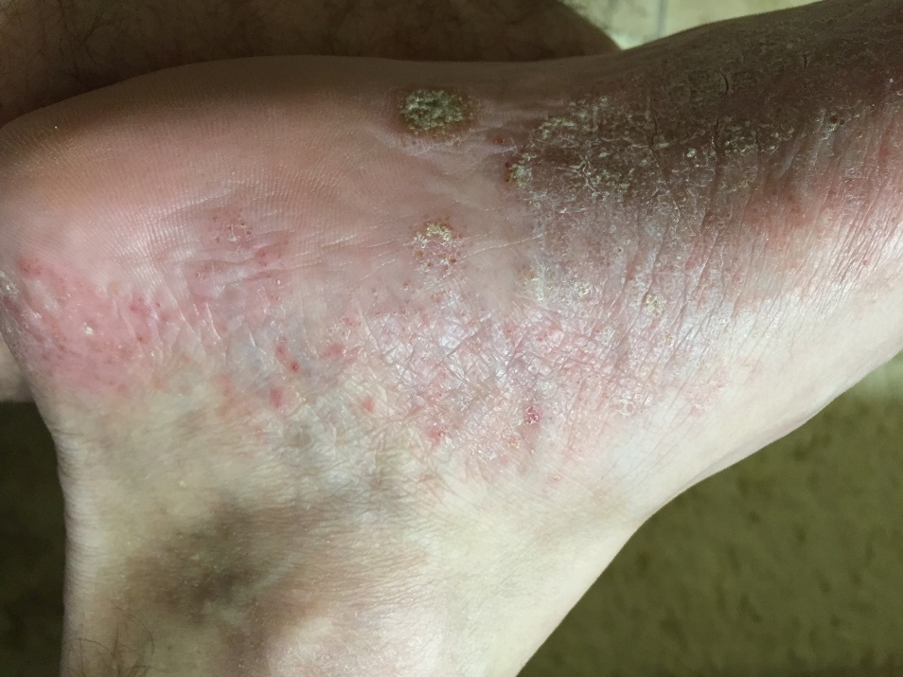
1. 1. 1.
Hygiene and Sanitation
Ringworm
  Students should be referred to a doctor
  Fungal ringworm can
  persist on skin, hard
  surfaces, and on items
  such as clothing,
  towels, furniture and
  bedding
  Fungal spores can
  survive >year
Ringworm infection –
Dawn H. Gouge, University of Arizona

Slide 14

Hygiene and Sanitation
  Contracted by contact with an infected person and contact via fomites
  Students should not participate in contact sports until treated
  Spores remain viable on
  hard surfaces
  Wear sandals or slides in
  showers and locker rooms
  Discourage sharing towels
  and clothing

Slide 15
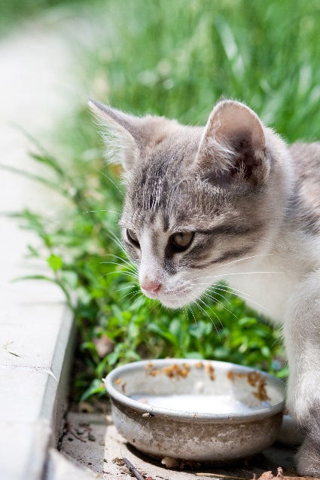
1. 1. 1.
Hygiene and Sanitation
  Treat infections with topical
  over-the-counter medications or
  systemic antifungal therapy
  Affected animals should be
  removed
  Feeding and housing of unmaintained feral cats or dogs should not be tolerated
  Campus animals must be spayed/neutered, vaccinated and maintained in good health

Slide 16
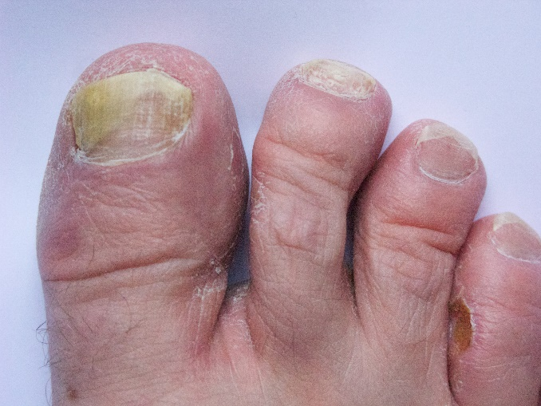
1. 1. 1.
Hygiene and Sanitation
  Immunocompromised individuals should not be around ringworm
  Spores can be killed with common disinfectants
  Hard surfaces should be cleaned and carpeted areas vacuumed
Infected toe nails

Slide 17

1. 1. 1.
Pesticide Poisoning Symptoms
If a person is exposed to a pesticide:
  Call 911
  Remove the person from the source quickly
  Remove contaminated personal protective equipment and clothing
  Rinse or shower
  Ask for information about what the person was using and how they were exposed e.g., inhalation, ingestion, etc.

Slide 18
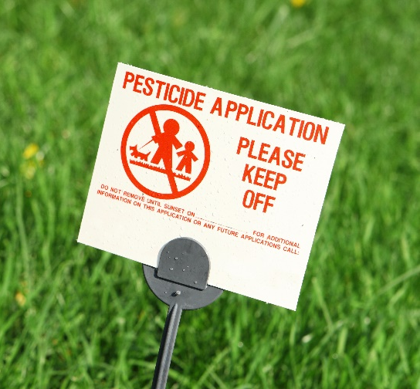
1. 1. 1.
Pesticide Poisoning Symptoms
A pesticide exposure - a
pesticide gets on or in a person
  Oral
  Inhalation
  Ocular
  Dermal

Slide 19
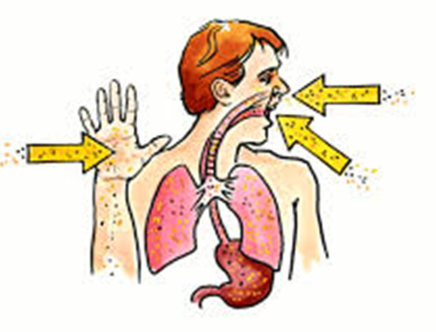
Pesticide Poisoning Symptoms
97% of all exposure is via skin
If the skin or eyes are exposed, flood with clean, lukewarm water for >15 minutes
Remove contaminated clothing
Shower or immerse body in clean water
Gently wash with mild detergent
Dry and loosely dress in clean
clothing
Cover skin burns in loose,
dry cloth or bandages
Pesticide routs of exposure – NPIC,
http://npic.orst.edu/capro/exposure.html

Slide 20
Pesticide Poisoning Symptoms
Pesticide in mouth or swallowed - rinse mouth with water, drink large amounts of water or milk up to 1 quart
Induce vomiting only if the pesticide label instructions indicate the need
If pesticide is inhaled - get to fresh air
Gather labeling, Safety Data Sheet (SDS) and additional information about the pesticide or pesticides involved (applicators are required to carry documents)
Warn people about the risk

Slide 21

Pesticide Poisoning Symptoms
An individuals susceptibility is unique and affected by
  Health condition
  Age
  Body weight
  Lifestyle choices

Slide 22
Pesticide Poisoning Symptoms
Acute
  Single dose of pesticide
  Effects sudden and dramatic
  May be delayed and less obvious
Chronic poisoning results from repeated, doses of a pesticide over a long time
  Nervousness/anxiety, slowed reflexes, irritability, decline in health

Slide 23
Pesticide Poisoning Symptoms
Pesticide poisoning symptoms can be similar to other illnesses
The pesticide applicator should provide pesticide labeling and SDS documents
Each chemical family can attack the human body in a different way
The most commonly used pesticides on school campuses are pyrethroids
A full occupational and exposure history will aid in diagnosing pesticide poisonings

Slide 24

Pesticide Poisoning Symptoms
Mild Poisoning or Early Symptoms of Acute Poisoning headache, fatigue, weakness, dizziness, restlessness, nervousness, perspiration, nausea, diarrhea, loss of appetite, loss of weight, thirst, moodiness, soreness in joints, skin
irritation, eye irritation,
irritation of the nose
and throat

Slide 25

Pesticide Poisoning Symptoms
Moderate Poisoning or Early Symptoms of Acute Poisoning nausea, diarrhea, excessive saliva, stomach cramps, excessive perspiration, trembling, no muscle coordination,
muscle twitches, extreme weakness,
mental confusion, blurred vision,
difficulty breathing, cough,
rapid pulse, flushed or yellow skin,
weeping

Slide 26

Pesticide Poisoning Symptoms
Severe or Acute Poisoning fever, intense thirst, increased rate of breathing, vomiting, uncontrollable muscle twitches, pinpoint pupils, convulsions, inability to breathe, unconsciousness
Death can result
Pinpoint eye pupil

Slide 27
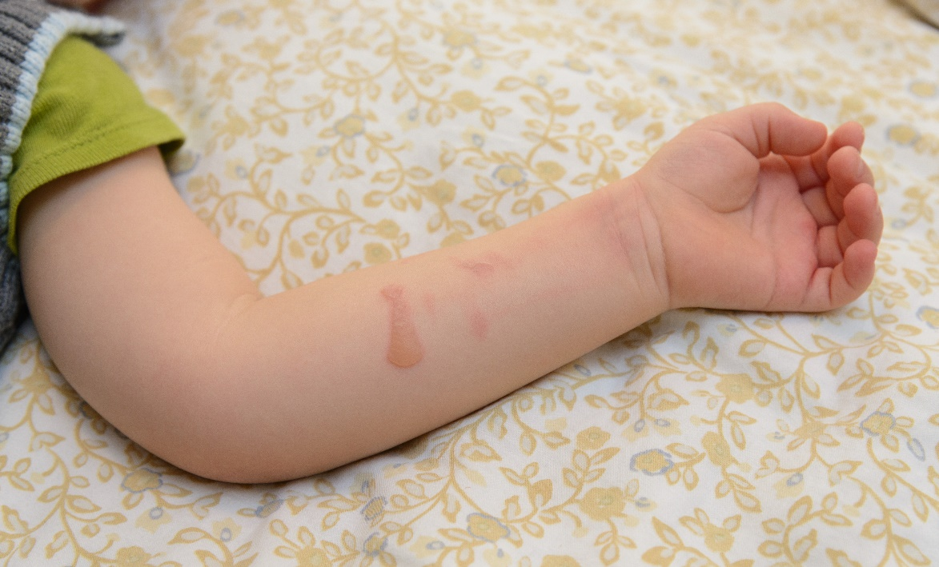
Pesticide Poisoning Symptoms
External irritants may cause redness, blisters, rash, and/or burns on skin, and swelling, a stinging sensation, and/or burns in eyes, nose, mouth and throat
Chemical burns on
a child’s arm

Slide 28

Pesticide Poisoning Symptoms
Anaphylactic shock Call 911
A serious, potentially life-threatening allergic response
Often begins with severe itching of the eyes or face, within minutes, progress to more serious symptoms
Symptoms include swelling, hives, breathing difficulties, abdominal pain, cramps, vomiting, diarrhea, lowered blood pressure, shock, and ultimately unconsciousness and death
Seek emergency medical attention immediately

Slide 29
Pesticide Poisoning Symptoms
Pyrethrin and pyrethroid pesticides are very common; exposure to liquid forms of these pesticides can cause the following symptoms:
  Skin and/or eye irritation
  Sensitivity to sound and touch
  Abnormal facial sensations and skin sensations of prickling, tingling or creeping on skin and numbness
  Headache
  Dizziness
  Nausea and vomiting
  Diarrhea
  Hypersalivation
  Fatigue
  Fatigue
  Pulmonary edema
  Muscle twitching
  Seizures
  This is not a fully comprehensive list
Notes:
Pyrethrins are naturally occurring compounds extracted from chrysanthemum plants and used to make pesticides. Pyrethroids have the same basic chemical make-up as pyrethrins but are not naturally occurring. Pyrethroids are a man-made product that are also used as pesticides.

Slide 30
Pesticide Poisoning Symptoms –Parts of the Body Absorb Chemicals Differently
Scalp 32%
Forehead 36%
Armpit 64%
Ear Canal 40%
Forearm 9%
Abdomen 18%
Palm 12%
Back of Hand 21%
Genital Area 100%
Percent parathion dose
absorbed through skin
after 24 hours
Maibach 1974
Ball of Foot 13%

Slide 31
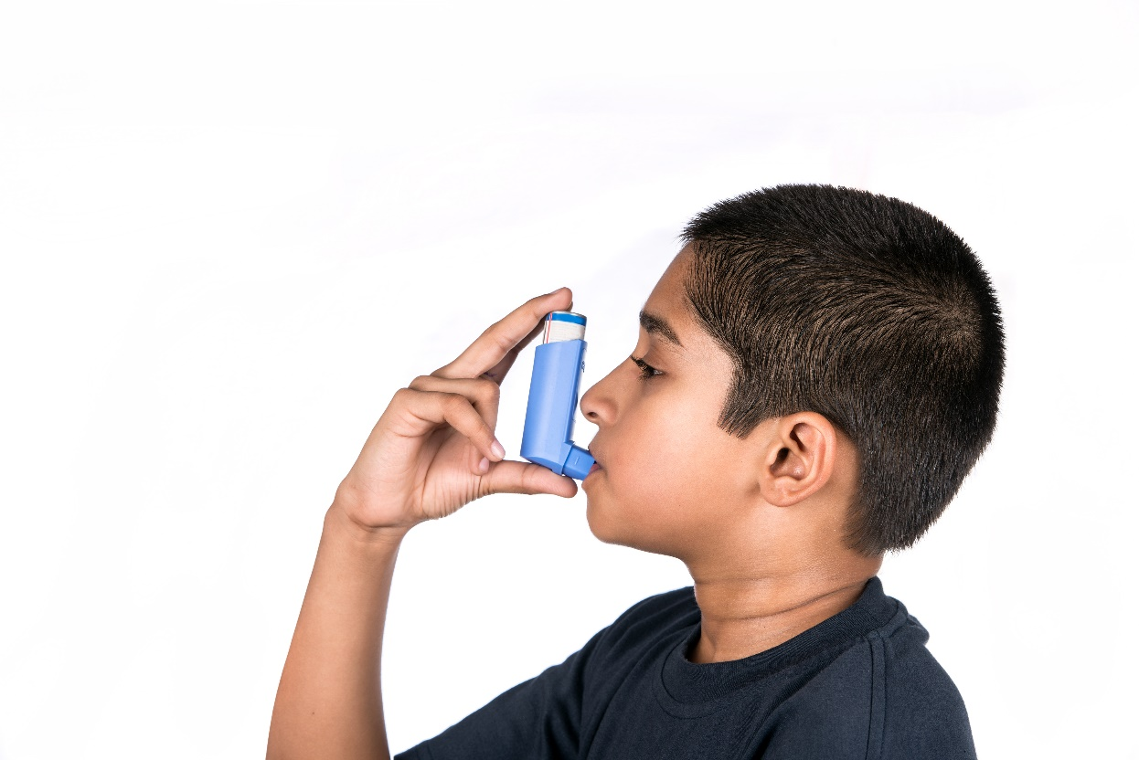
Allergy and Asthma Triggers
6 out of 10 asthmatics have allergic asthma triggered by exposure to allergens in the air
Asthma is the leading cause of school absences
Students sensitive to the allergens are significantly impacted
Identify and eliminate
allergen sources
Asthmatic child using
rescue inhaler

Slide 32

1. 1. 1.
Allergy and Asthma Triggers
Animal dander (birds, cats, dogs, other small mammals)
  20-30% asthmatics have pet dander allergies
  Feral animals should not be allowed into classrooms
  If animals are brought in,
  rooms should be cleaned
  before students with
  allergies are present
  (using HEPA vacuum filters)

Slide 33
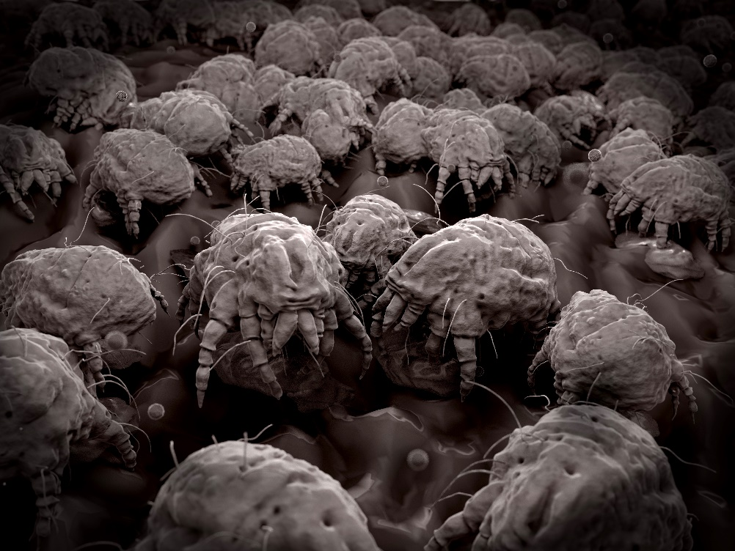
1. 1. 1.
Allergy and Asthma Triggers
Dust mites
  >85% of asthmatics are sensitive to dust mite allergens
  Eliminate or reduce
  carpeting
  Reduce clutter
  Indoor humidity
  should remain
  lower than 50%
Dust mites

Slide 34

1. 1. 1.
Allergy and Asthma Triggers
Mice
  Mouse urine is a source of allergens
  35% of asthmatics are sensitive to mouse allergens
  School nurses can advocate for:
    Prompt reporting of moisture problems and leaks
    Buildings to be pest-proofed
    Continuous rodent monitoring
    Prompt reporting of rodent signs
    Trapped rodent removal
    Deep-cleaning
House mouse

Slide 35
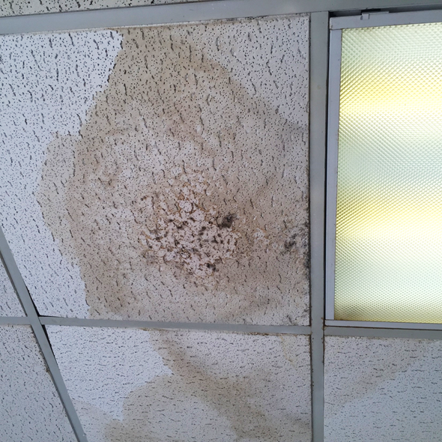
1. 1. 1.
Allergy and Asthma Triggers
Some molds cause allergic reactions
School nurses can
advocate for:
  Indoor humidity
  below 45 percent
  Prompt reporting of
  mold
Mold on ceiling tile –
Dawn H. Gouge, University of Arizona

Slide 36
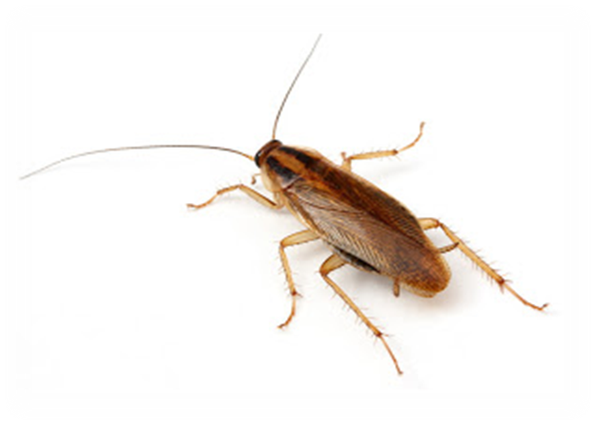
1. 1. 1.
Allergy and Asthma Triggers
German cockroach - most prevalent indoor cockroach
23-60% of asthmatics are sensitive to German cockroach allergens
8 units of allergen is sufficient to trigger an asthma attack, 1 female
can produce
>1500 units per day
German cockroach

Slide 37

1. 1. 1.
Allergy and Asthma Triggers
School nurses can advocate for:
  Food and garbage in containers with tight lids
  Clean up food
  crumbs and
  spilled drinks
  Keep counters,
  sinks, stove,
  tables, microwaves,
  floors clean

Slide 38
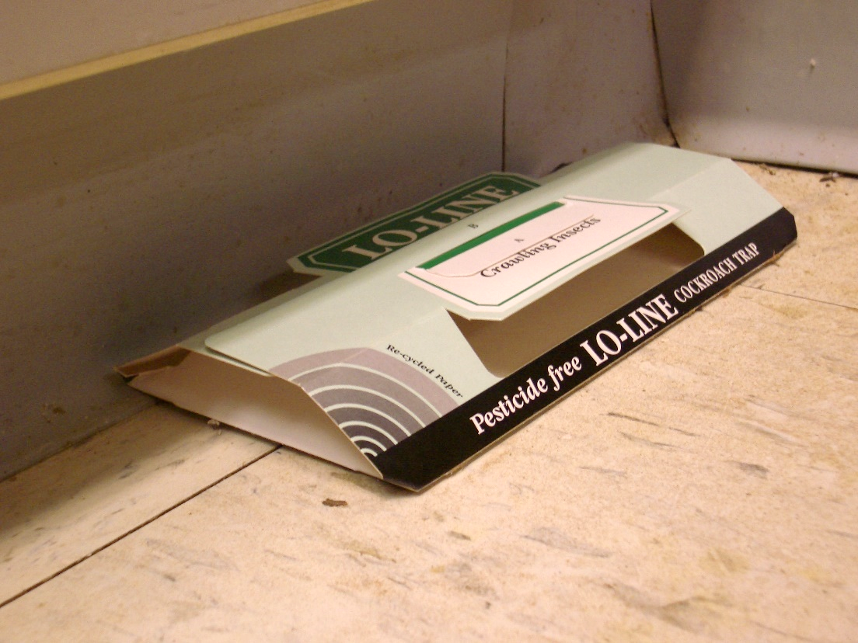
1. 1. 1.
Allergy and Asthma Triggers
  Vacuum or mop floors after food
  Fix leaky faucets, drain pipes, and other moisture problems
  Reduce clutter
  Get rid of cardboard
  Plug up cracks and
  crevices, where
  cockroaches
  can harbor
  Promote insect
  monitoring
Insect monitoring trap –
Dawn H. Gouge, University of Arizona

Slide 39

1. 1. 1.
Allergy and Asthma Triggers
Class pets can trigger symptoms
Allergy sensitivities to pet bedding, media, and food items can
also pose risks
Class bunny eating Timothy grass

Slide 40

1. 1. 1.
Allergy and Asthma Triggers
Districts should have a class pet policy
  Pets are to be cleaned out by the responsible teacher
  School nurse consulted prior to housing an animal in a classroom
Class chick embryology study

Slide 41
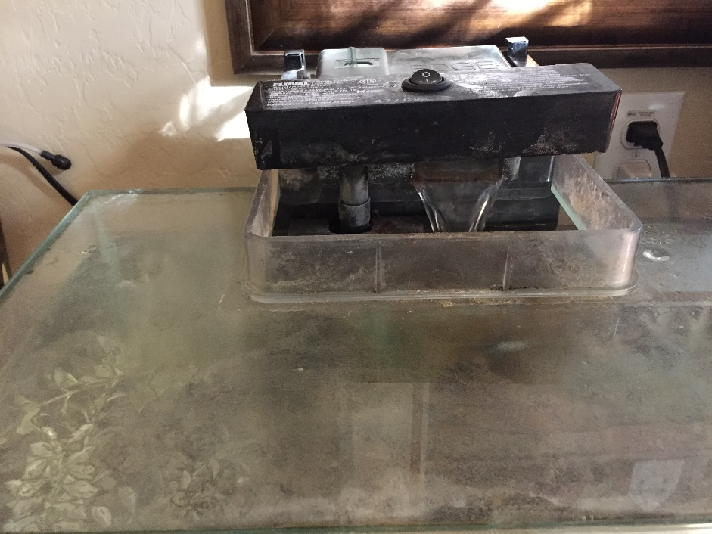
1. 1. 1.
Allergy and Asthma Triggers
Fish tanks and aquatic habitats can support mold
Pet foods stored incorrectly (out of air-tight containers) can serve
as pest food as
opposed to pet food
White fungal growth on a fish tank
– Dawn H. Gouge, University of Arizona

Slide 42

1. 1. 1.
Chemical Sensitivity
Defined as an adverse reaction(s) to ambient doses of toxic chemicals contained in air, food, and water
The sensitive person presents with multi-system complaints

Slide 43

1. 1. 1.
Chemical Sensitivity
Multiple chemical sensitivity (MCS) is a medical condition and recognized as a disabling condition by the Social Security Administration and the Department of Housing and Urban Development
MCS is covered under the
Americans with Disabilities Act
Schools must
provide reasonable
accommodations

Slide 44
Chemical Sensitivity
This is not a comprehensive list
Most sufferers complain of at least several of the following:
  Burning, stinging eyes
  Wheezing, breathlessness nausea
  Poor memory and concentration
  Sensitivity to light and noise
  Extreme fatigue
  Headaches
  Migraine
  Vertigo
  Dizziness
  Rhinitis
  Sore throat
  Cough
  Sinus problems
  Skin rashes
  Pruritus
  Sleeping problems
  Digestive upset
  Muscle and joint pain

Slide 45

Chemical Sensitivity
The main mechanism for chemical sensitivity is the failure of the body’s enzyme detoxification pathways to adequately clear chemical compounds
The rise in asthma, chronic fatigue syndrome, Attention Deficit Disorder,
second-hand smoke lung
disease are all examples
of chemical sensitivity
Notes:
http://accessnewage.com/articles/health/chemical.htm

Slide 46


1. 1. 1.
Emergency Hotlines and Resources
American Association of Poison
Control Center (AAPCC)
  In the U.S. call 1-800-222-1222
  http://www.aapcc.org
National Pesticide Information Center (NPIC)
  http://npic.orst.edu
  npic@ace.orst.edu
  1-800-858-7378
  Information in English
  and Spanish

Slide 47
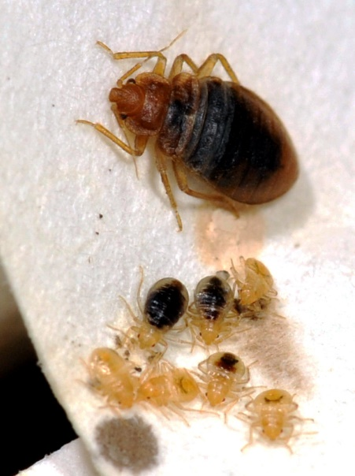
1. 1. 1.
Best Practices for Notifying and Educating Parents About Bed Bugs
Bed bugs show up in schools
Parents and school staff panic
less if they are informed about
bed bugs
Increasing number of families
battling bed bugs at home
Bed bug policy
Communicate instructions on
how to send students to
school free of bed bugs
Bed bugs
– Alex Yelich, University of Arizona

Slide 48
1. 1. 1.
Best Practices for Notifying and Educating Parents About Bed Bugs
  Some states require notification of parents and staff
  Roving bed bugs are commonly found
  Bed bug training presentation http://www2.epa.gov/sites/production/files/documents/BB_in_Schools_May_2012.pdf
  Action Plan for schools http://www.vdacs.virginia.gov/pesticides/pdffiles/bb-schools1.pdf
  Bed bug resources for schools http://www.maine.gov/dhhs/mecdc/infectious-disease/epi/bedbugs/
  Bed bug information kit for schools http://www.uft.org/files/attachments/doe-bed-bug-info-kit-feb-2011.pdf

Slide 49
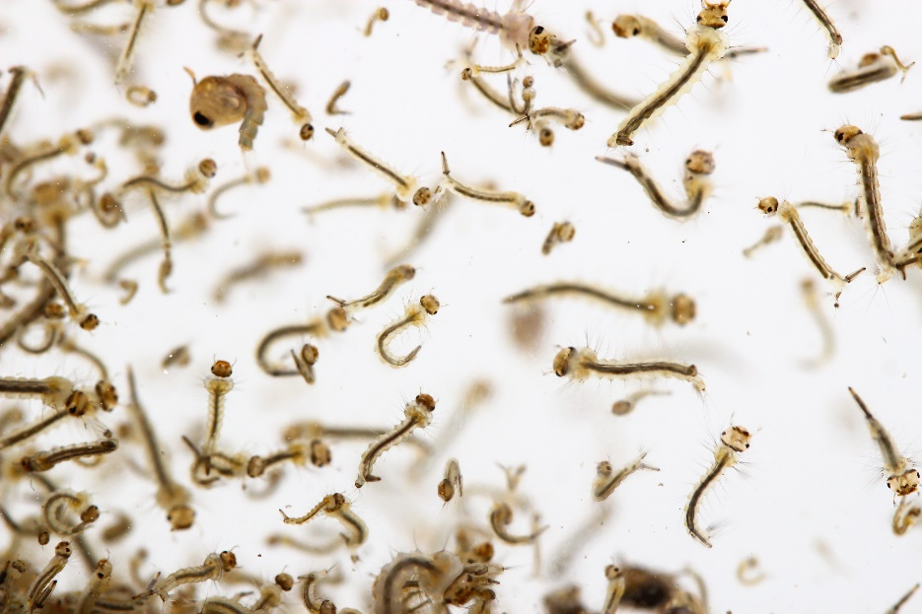
1. 1. 1.
Reducing Encounters with Disease Vectors on School Grounds
Mosquitoes develop in water
Mosquitoes
  Report standing water >4 days
  Wear light colored clothing with
  loose fitting long-sleeves, long pants and socks
  Insect repellant
  For help selecting an insect or tick repellant go to the EPA search page: https://www.epa.gov/insect-repellents/find-insect-repellent-right-you#searchform

Slide 50
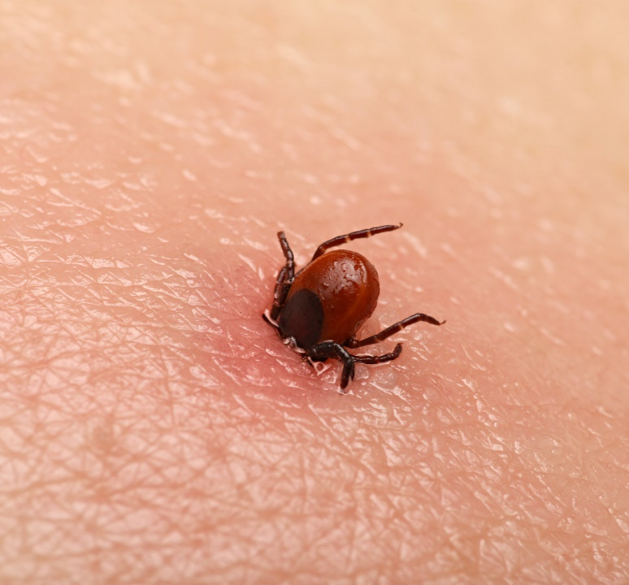
1. 1. 1.
Reducing Encounters with Disease
Vectors on School Grounds
Remove ticks immediately
Ticks
  Remove ticks immediately
  Wear protective clothing
  Information on tick species distribution, diseases, life cycle and best practices can be found at: https://www.ncipmc.org/action/alerts/ticks.pdf
  IPM tick action plans can be found at: http://www.extension.org/pages/24666/ipm-action-plan-for-eastern-us-ticks#.VPJe9o05Cos

Slide 51
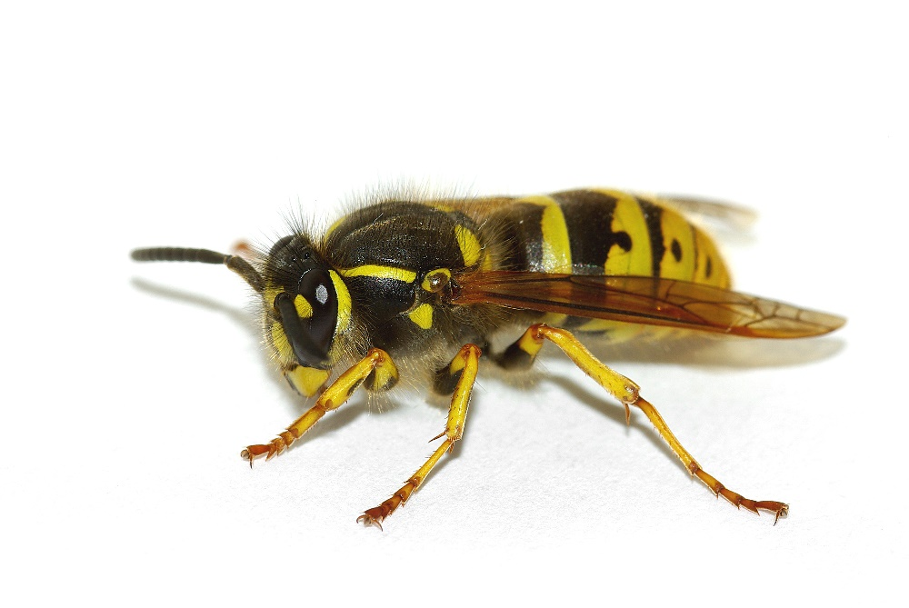
1. 1. 1.
Reducing Encounters with Stinging Insects on School Grounds
Some stinging insects require urgent attention
Stinging insects
  Strongly scented products attract
  Strong sweat smells agitate
  Sting sensitive students wear light colored clothing, with long
  sleeves and long plants
German yellowjacket

Slide 52
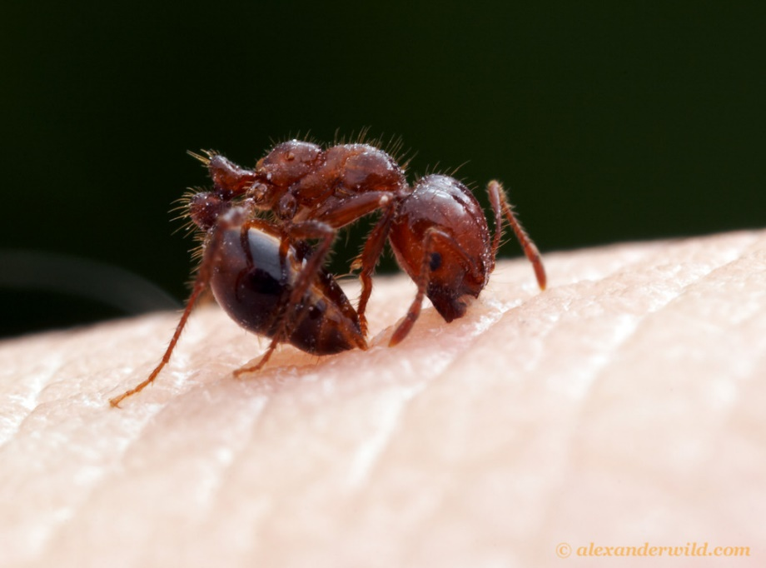
1. 1. 1.
Reducing Encounters with Stinging Insects on School Grounds
  Avoid soda and sugary drinks outside
  Outside keep food and drinks containerized
  Consume carefully
  Wrap waste up
  before disposing
  No bare feet
Red imported fire ant
– Alexanderwild.com

Slide 53

1. 1. 1.
Sanitation Measures for Norovirus and Flu
Cleaning removes pathogens, dirt
Disinfecting kills pathogens
Sanitizing lowers the number of pathogens to a safe level

Slide 54

1. 1. 1.
Sanitation and Antimicrobials
Sanitation reduces the number of disease-causing organisms to non-threatening levels
Disinfection destroys microorganisms, does not kill all pathogens
Sterilization kills
all disease-causing
pathogens

Slide 55

Sanitation Measures for Norovirus and Flu
Influenza virus can survive on surfaces 2 - 8 hours
Influenza virus destroyed by heat (167-212°F), chemical germicides: chlorine, hydrogen peroxide, detergents, iodophors, alcohols
Concentration and length of
time

Slide 56

1. 1. 1.
Sanitation Measures for Norovirus and Flu
Alcohol wipes and gels
Virus transfer from objects to person
Droplets from a cough or sneeze move through the air

Slide 57

1. 1. 1.
Sanitation Measures for Norovirus and Flu
Tissues thrown in trash or bagged
Persons cleaning classrooms or emptying trash - wear gloves, then wash hands
Surface cleaning with disinfectants
according to label directions

Slide 58
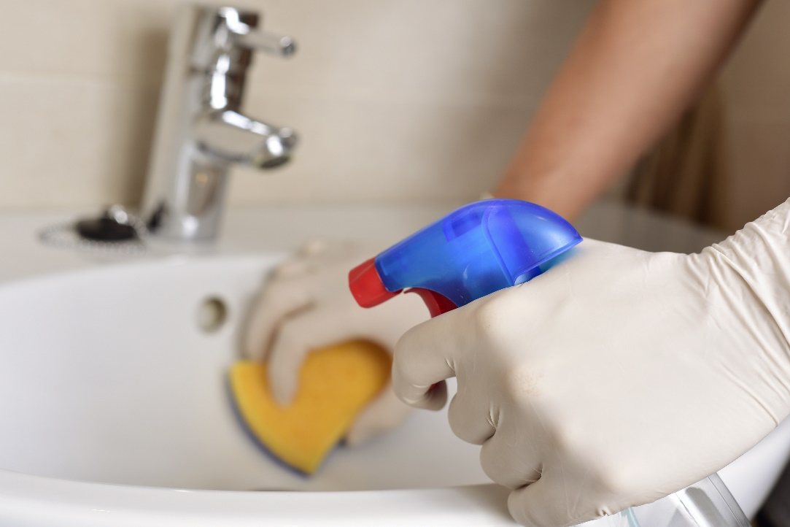
1. 1. 1.
Sanitation Measures for Norovirus and Flu
Wash surfaces with general cleaner to remove dirt and organic matter before disinfecting
Always follow label directions
Rinse with water if
instructed
Approved
EPA-registered
disinfectants

Slide 59
1. 1. 1.
Sanitation Measures for Norovirus and Flu
There are a variety of hydrogen peroxide options, including Clorox Healthcare, that are effective at killing Norovirus
These products can be used as a substitute for bleach-based products
EPA Registered Antimicrobial Products Effective Against Norovirus: https://www.epa.gov/sites/production/files/2016-06/documents/list_g_norovirus.pdf

Slide 60
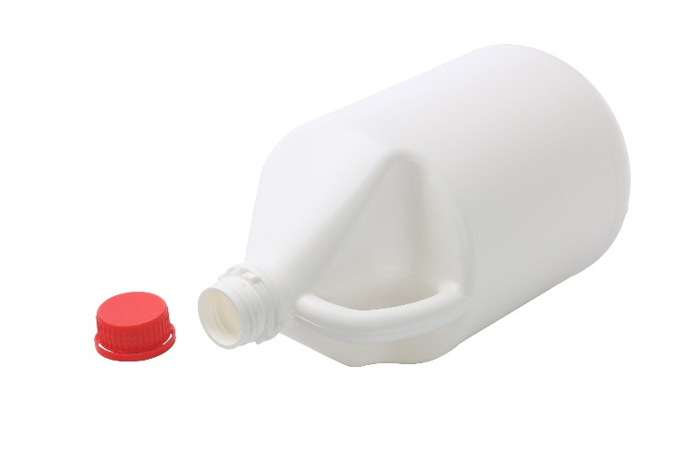
1. 1. 1.
Sanitation Measures for Norovirus and Flu
If an EPA-registered disinfectant is not available, use chlorine bleach solution:
  1 tablespoon of bleach to 1 quart (4 cups) of water or ¼ cup of bleach to 1 gallon (16 cups) of water
  Apply solution to surface with a cloth
  Let it stand for 3 to 5 minutes
  Rinse with clean water

Slide 61

1. 1. 1.
Sanitation Measures for Norovirus and Flu
Disinfections require the
product to remain on the surface for a certain period of time
Use wipes on items that are touched often

Slide 62

1. 1. 1.
Sanitation Measures for Norovirus and Flu
Special considerations for norovirus:
  Found in vomit or stool even before a person is sick, and for 2-3 weeks after symptoms abate
  Hand washing is critically important
  Alcohol-based hand
  sanitizers used in
  addition to
  hand washing

Slide 63

1. 1. 1.
Sanitation Measures for Norovirus and Flu
Norovirus is leading cause of food-borne illness
Sick staff or those caring for others who are sick should not prepare food
Infected food workers cause
70% of reported norovirus
outbreaks
Norovirus is very
contagious

Slide 64
1. 1. 1.
Sanitation Measures for Norovirus and Flu
Many disinfectant wipes are registered pesticides designed to kill microbes
  It is inappropriate to ask students to clean desks and surfaces with disinfectant wipes
  If children are allowed to handle disinfectant wipes or breathe in the chemicals, this is a breach of Federal Law
  Surface disinfectant wipes are not hand wipes
Many labels clearly state
“KEEP OUT OF REACH OF CHILDREN”

Slide 65
Check In!
In this lesson you learned to:
Personal hygiene and facility sanitation measures to help limit the spread of communicable pests
Recognize common pesticide poisoning symptoms
Identify pest related allergy and asthma triggers in classrooms
    Give examples of chemical sensitivity issues
Give examples of emergency hotlines and resources
Describe best practices for notifying parents and/or providing them with guidance to minimize the spread of bed bugs
Describe appropriate measures to help prevent and/or reduce encounters with disease vectors and stinging insects
Describe sanitation measures for norovirus and flu

Slide 66
Resources
  Pesticide Safety Education Program (PESP), Cornell University Cooperative Extension. http://psep.cce.cornell.edu/Tutorials/core-tutorial/module09/index.aspx
  http://pest.ca.uky.edu/EXT/ukgh/Exposure.pdf
http://medicine.missouri.edu/ent/uploads/Dustmites-USNEWS.pdf
Pesticideinfo.org See: Recognition and Management of Pesticide Poisonings, 5th edition, U.S. EPA, Chapter 8, page 88 for treatment information
http://accessnewage.com/articles/health/chemical.htm
https://www.health.ny.gov/environmental/workplace/pesticide_poisoning_
registry/pesticide_poisoning_registry_presentation.htm
http://www2.epa.gov/sites/production/files/documents/BB_in_Schools_
May_2012.pdf
Action Plan for schools http://www.vdacs.virginia.gov/pesticides/pdffiles/bb-schools1.pdf
Bed bug resources for schools http://www.maine.gov/dhhs/mecdc/infectious-disease/epi/bedbugs/
Bed bug information kit for schools http://www.uft.org/files/attachments/doe-bed-bug-info-kit-feb-2011.pdf

Slide 67
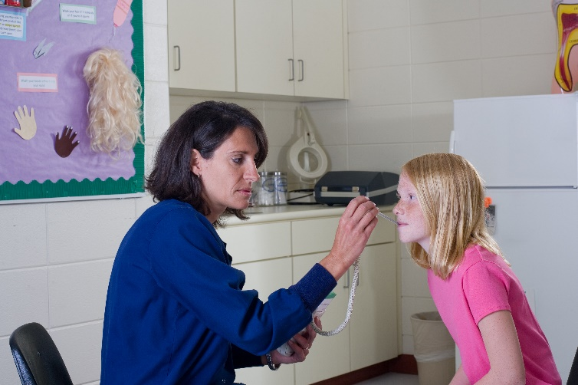
Resources
  Pesticide Safety Education Program (PESP), Cornell University Cooperative Extension. http://psep.cce.cornell.edu/Tutorials/core-tutorial/module09/index.aspx
  http://www.cdc.gov/ticks/avoid/in_the_yard.html
  http://pest.ca.uky.edu/EXT/ukgh/Exposure.pdf
  http://www.webmd.com/asthma/allergic-asthma-treatments
  http://annmreid.hubpages.com/hub/How-to-Avoid-Bee-and-Wasp-Stings
  CDC Novel H1N1 Flu (Swine Flu) and You http://www.cdc.gov/flu/school/cleaning.htm
Thank you for the
important work
you do!

