Slide 1

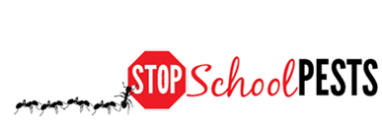
School IPM FOR Teachers
Self-Guided Education Module
Lesson 1 of 2

Slide 2
Learning Objectives
Explain the importance of communicating to parents about health and safety issues associated with pests and pesticides
Explain the importance of removing or eliminating clutter in the classroom
Give examples of proper food storage procedures
Describe proper sanitation methods for pets in the classroom

Slide 3

Learning Objectives
Explain how to manage communicable pests, including those that transmit diseases
Describe students’ roles and responsibilities in
implementing IPM in the classroom
Explain the importance of annual notification/ special notification to parents and students
when pesticide applications are scheduled/made

Slide 4

1.
Teachers and IPM
Teachers and students share the same environment and are exposed to the same risks
Teachers are very important
links in a school IPM program
Teachers have a
chance to influence how
future generations manage
pests in their homes and places of work
Everything a teacher learns about school IPM will help them manage pests in their own homes

Slide 5

Teachers and IPM
Teacher involvement in a school IPM program is important because:
Teachers have the closest contact with students
Teachers have first-hand information on student sensitivities and behaviors
Teachers influence students,
who influence parents, who
change social norms

Slide 6

1.
IPM is Not an Additional Item on Your to-do List
Teachers have one of the most demanding jobs, with little spare time, and considerable personal investment
IPM does not add to your responsibilities
IPM only involves making slight changes in your daily activities at work and home, that will make your life and your teaching
environment healthier
IPM is not your job alone, it is everyone’s job

Slide 7
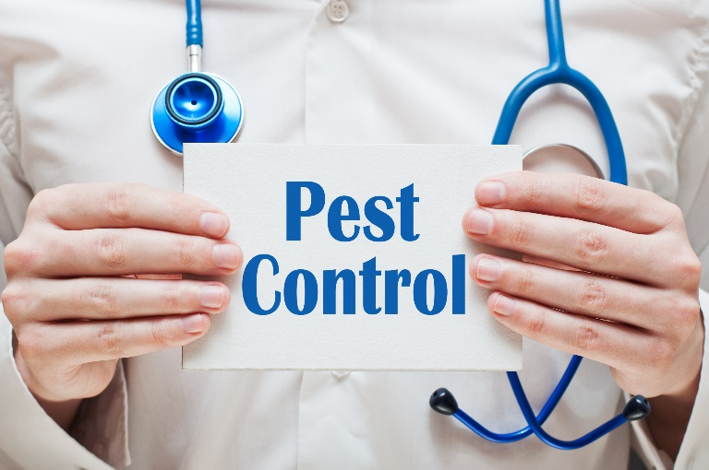
Parents and IPM
Informing parents
As a teacher, you connect the school community to the parents of students
Help them realize their role in keeping their children safe from pests and pesticides
Inform them about IPM practices that you implement in your school
and how it benefits
their children

Slide 8
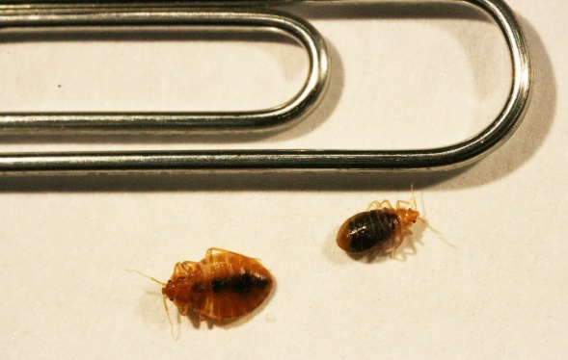
Parents and IPM
Inform parents how pests can be introduced to the classroom from homes on and in student belongings such as backpacks and clothes
Make parents aware of the importance of preventing the spread of pests, especially “panic” pests such as bed bugs
If pests are found hitchhiking into school on students, deal with them discreetly to avoid embarrassment
to parents and students
Make sure “panic” pests are correctly identified, many parents have not seen bed bugs and may confuse them with other pests – Dawn H. Gouge, University of Arizona

Slide 9

Parents and IPM
Separating student belongings reduces the risk of classroom
transition of
pests such as
bed bugs

Slide 10
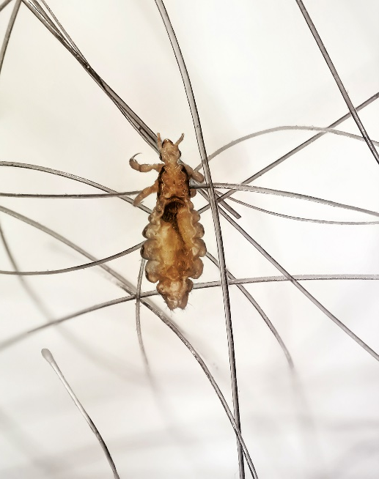
Parents and IPM
Inform parents that schools are very rarely transition locations for head lice
Most children obtain head lice during sleepover parties through shared bedding
There is absolutely no need to
send students home if they have
head lice nits, but be knowledgeable
on the subject of head lice and
encourage corrective action (e.g. using nit combs)
Adult head louse

Slide 11

Parents and IPM
5.
Parents should use IPM practices in their
homes to extend the benefits of IPM
Parent support can motivate and reinforce your efforts to implement IPM in your classroom

Slide 12
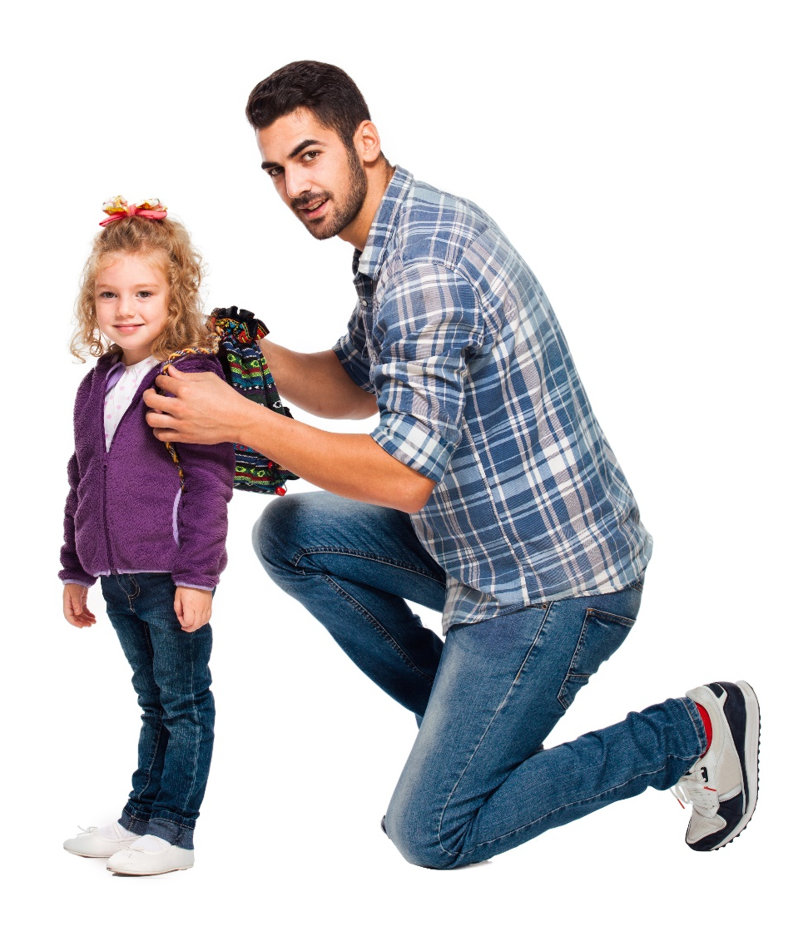
Parents and IPM
5.
Inform parents about the risks associated with pests and pesticides
Inform parents that they should not volunteer to provide or use pesticides on the campus
Inform parents about the rules for pesticide applications in school, including who can apply them and how notifications are communicated

Slide 13

Notification
Facility Management staff will make sure:
All parents and staff are notified prior to any pesticide applications in buildings or on grounds, with the exception of exempt or emergency applications
In some states, notifications must be issued and notifications posted at least three business days prior to applications
Parents may be notified each time a non-exempt pesticide is applied, or given guidance documents when students are enrolled

Slide 14
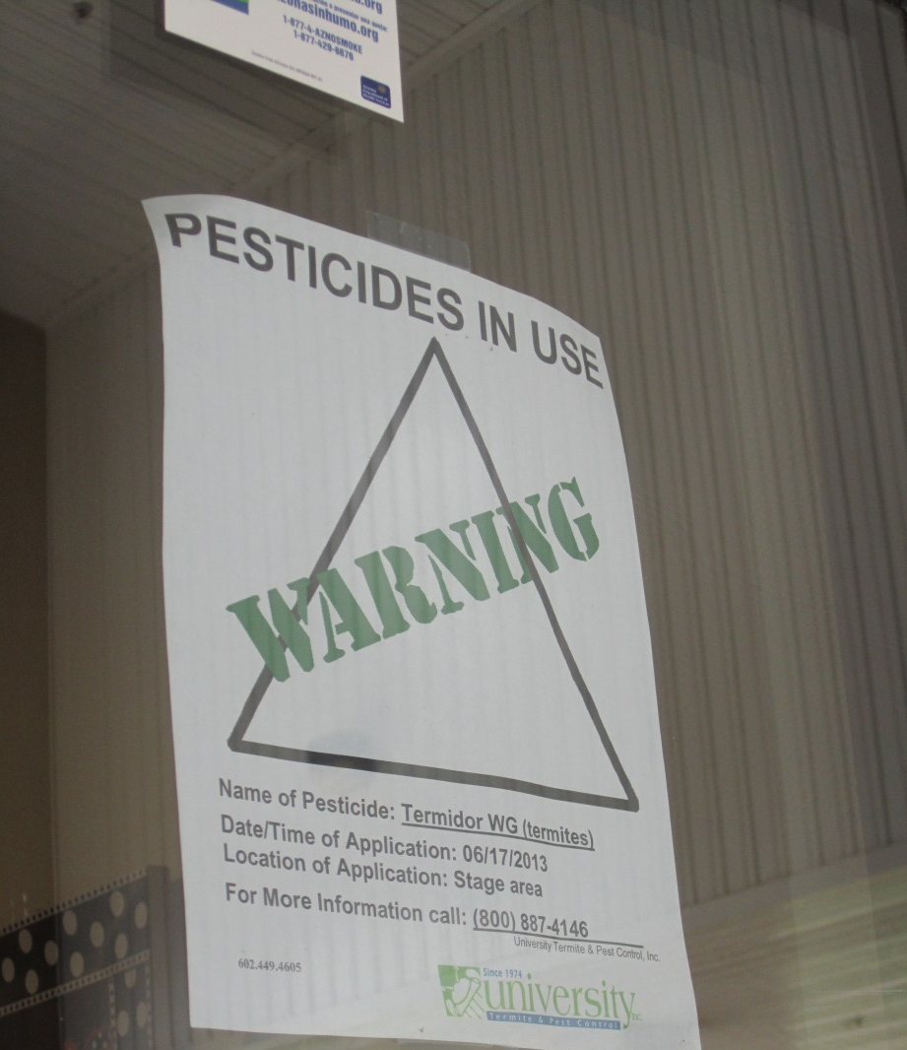
Posting
Notification signs will be posted at the building entrance and near the site of planned applications in advance of pesticide use, or at the time of application if it’s an emergency application
Pesticide application posting
– Dawn H. Gouge, University of Arizona

Slide 15
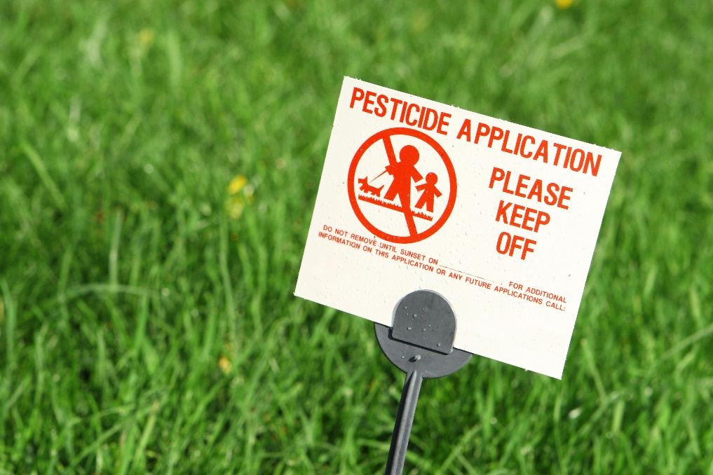
Posting
Outdoor application areas may be cordoned off and flagged
Signs shall remain in place for the legally specified time (which varies by state) after a pesticide application,
or a longer period of
time if specified by
school district policy
Teachers please be
aware of the postings

Slide 16
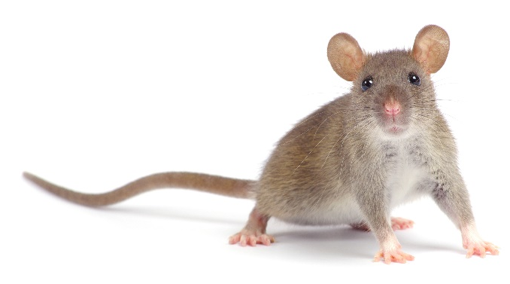
1.
Practicing IPM in Your Classroom
Reduce classroom clutter
Clutter provides pests with ample shelter and makes cleaning, monitoring and control very difficult
Make sure that class supplies are neatly stored and organized after each class activity, with edible items securely stored in air-tight containers – this not only reduces pests but also makes class activities easier and fun! Some pests can get into zip-lock bags
Encourage your students to be good custodians of their classroom environment

Slide 17
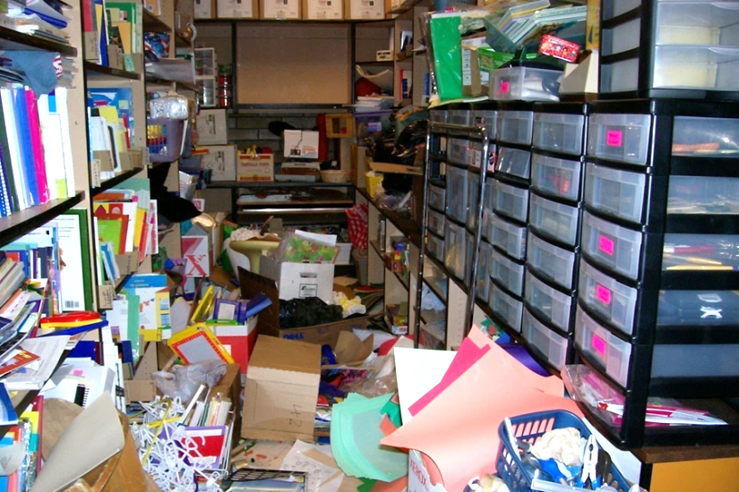
1.
Practicing IPM in Your Classroom
Remember, clutter makes it impossible for cleaning professionals to effectively clean
Clutter can also affect fire safety, allergen reduction and pest prevention
Have regular clutter reduction efforts in your classroom and storage areas
Cluttered store room
– Jerry Jochim, Monroe County Community School Corporation

Slide 18
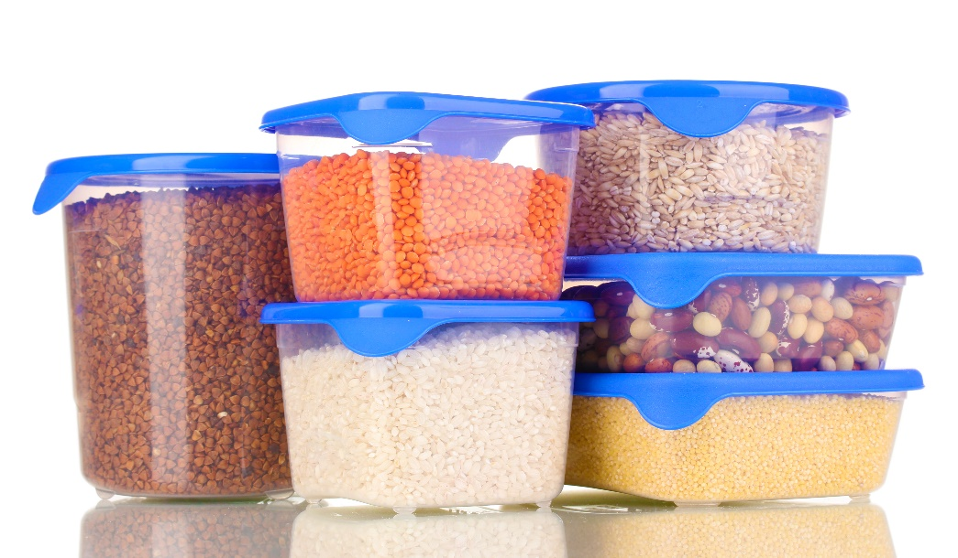
1.
Practicing IPM in Your Classroom
Proper storage
Always keep food (candies, cookies) in closed air-tight containers
Always keep edible supplies
(cereal, pet food, rice, pasta,
etc.) used for class activities in
sealed containers
Avoid storing open
personal food or drink
items in classrooms

Slide 19
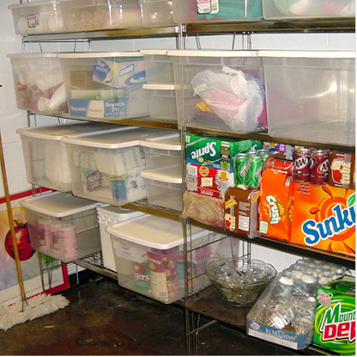
Practicing IPM in Your Classroom
See-through storage totes can reduce and prevent ant and cockroach problems
Some food items come with pests within the packaging - Storing in airtight containers prevents those pests getting out!
Supplies organized in see-through totes
– Jerry Jochim, Monroe County Community School Corporation

Slide 20
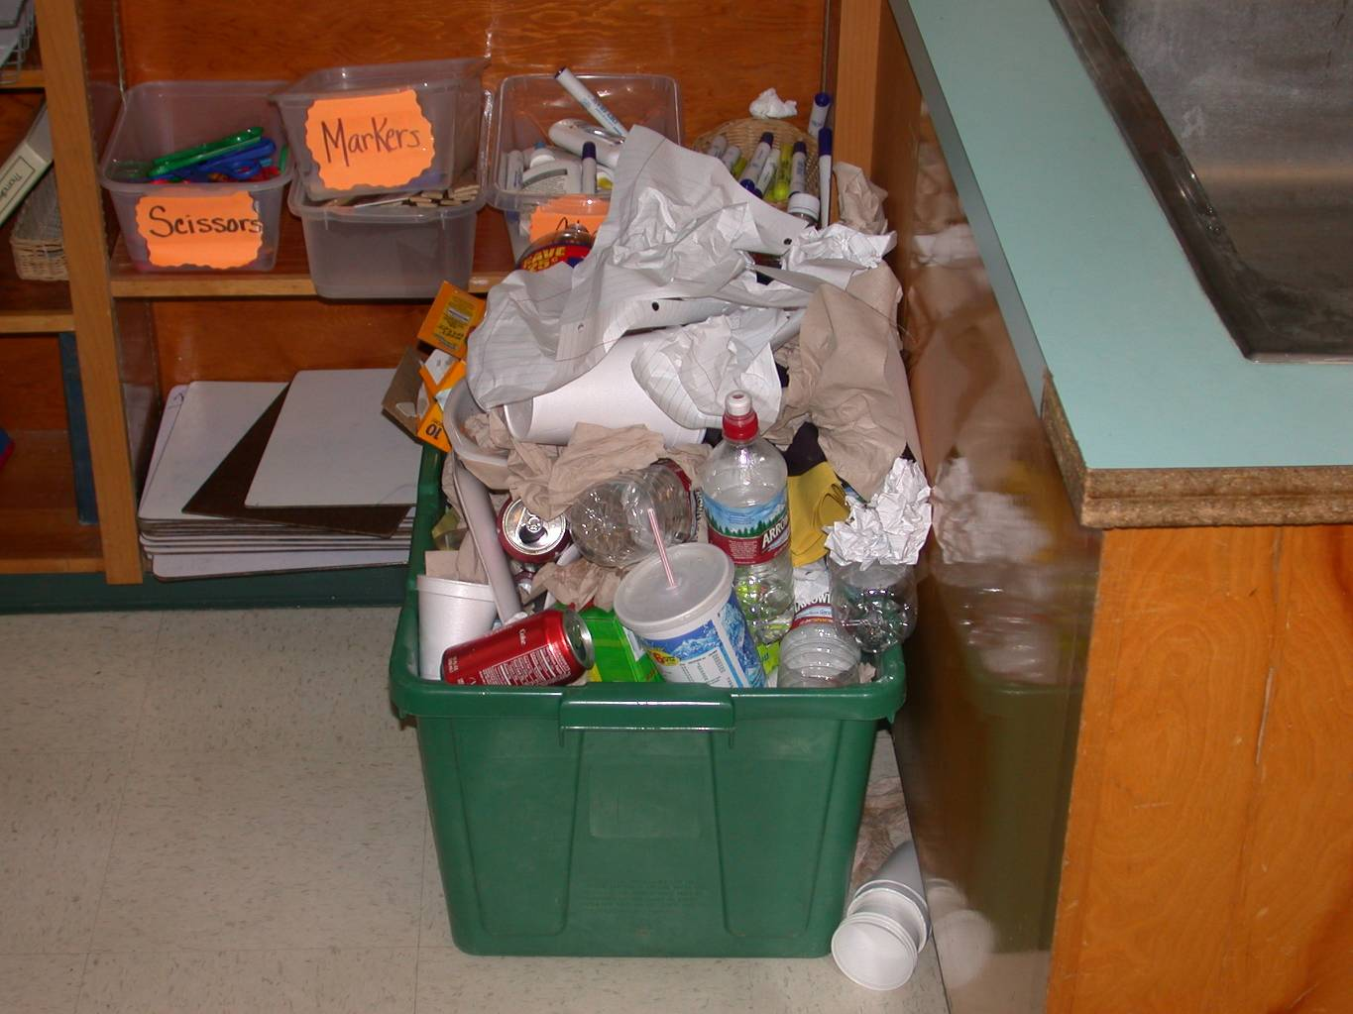
1.
Practicing IPM in Your Classroom
Sanitation
Clean up! Make your classroom the best in the school
Clean up after class activities, especially those involving pet animals or food
Anything with food remains
(used plates and cups,
wrappings, soda cans,
etc.) should be placed in
trash cans, bagged, and
taken to outside dumpsters
before the day ends
Recycling is great, but not if left to fester in a classroom over a 2-week break
– Dawn H. Gouge, University of Arizona

Slide 21
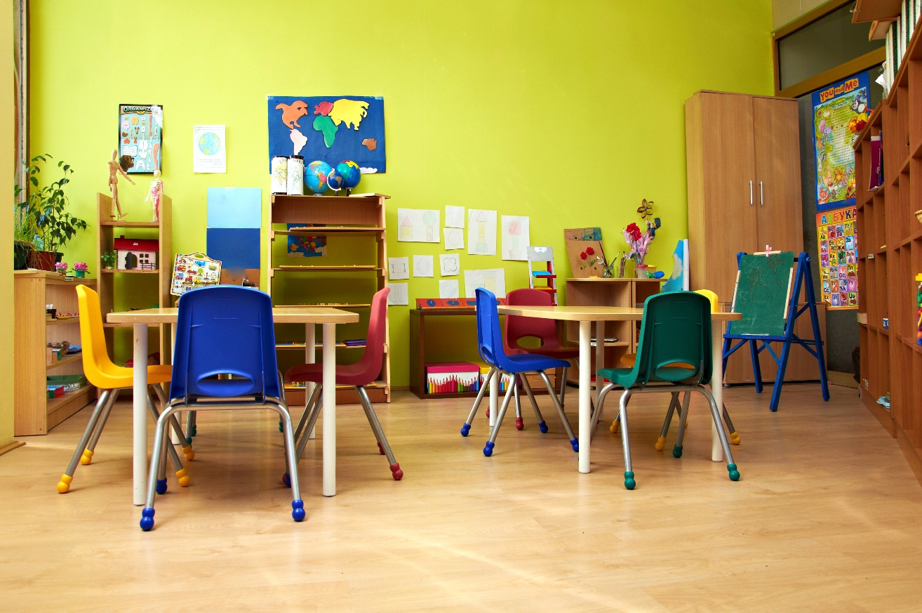
1.
Practicing IPM in Your Classroom
Remember: Cleanliness discourages pests to enter
No food, water, or shelter = No pests

Slide 22
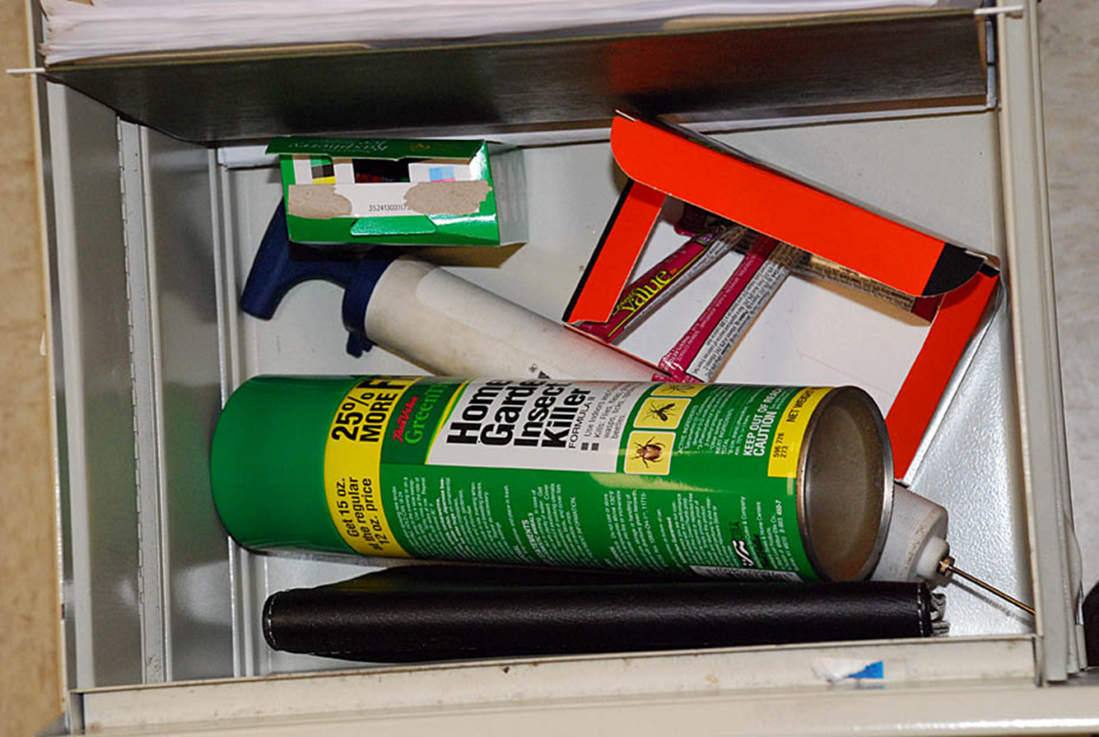
1.
Practicing IPM in Your Classroom
Never bring over-the-counter pesticides or homemade remedies to your classroom
Pesticide aerosol in teacher’s desk
– Marc Lame, Indiana University

Slide 23
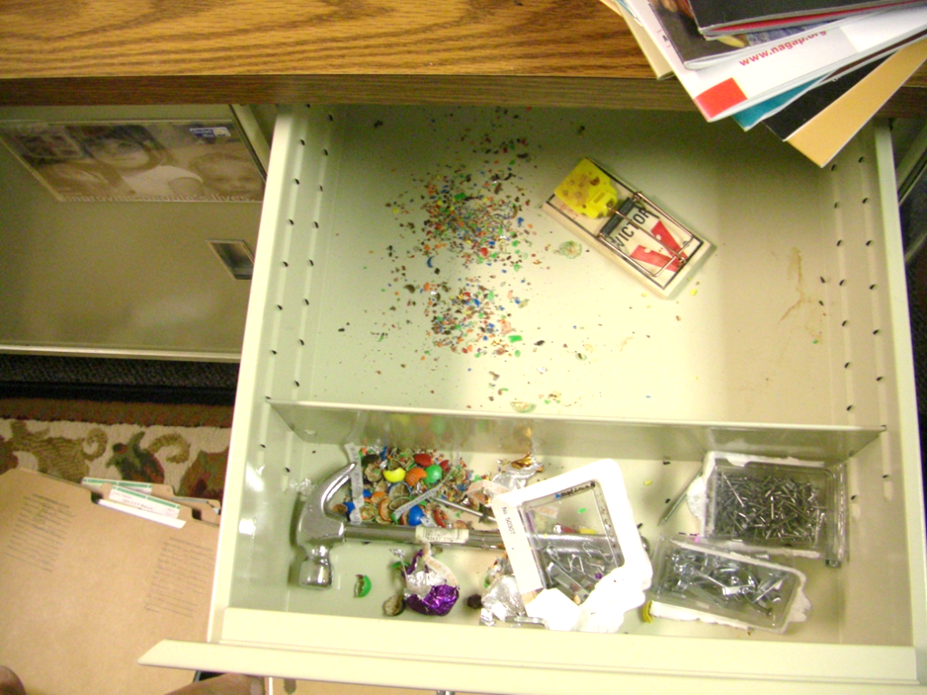
Practicing IPM in Your Classroom
Do not bring in home-made remedies for
pests or other pest management
tools from home
Always keep personal food and drink items in sealed containers
Place snap-traps in places students can not access
Mouse trap in teachers desk drawer (putting students at risk of injury) – Marc Lame, Indiana University

Slide 24
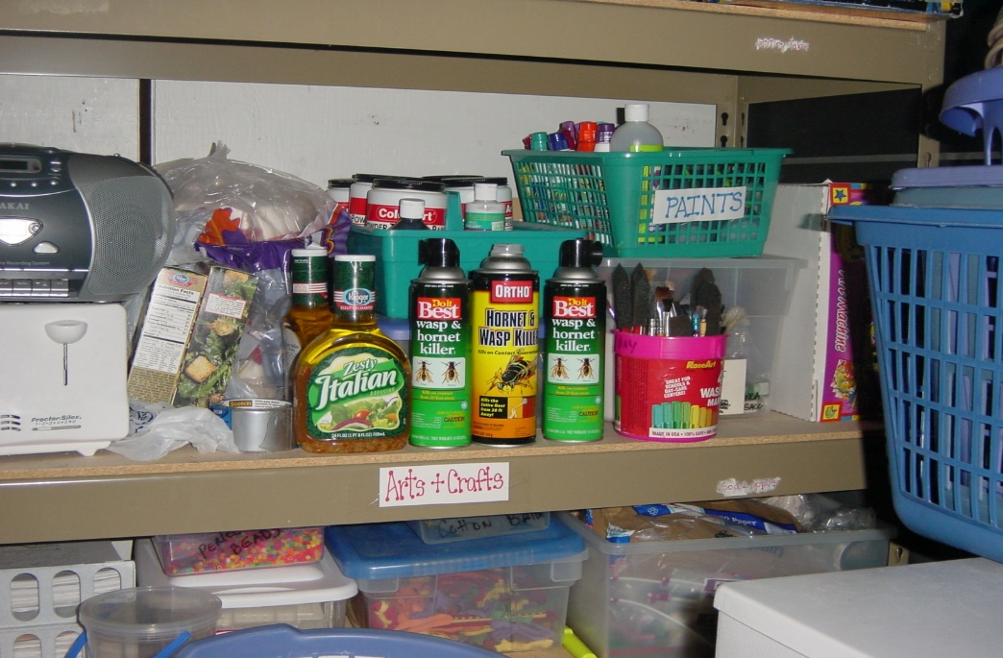
Practicing IPM in Your Classroom
Never leave cleaning materials or pesticides unattended or in open child-accessible places
Pesticide aerosols on arts and crafts storage shelving – Jerry Jochim, Monroe County Community School Corporation

Slide 25
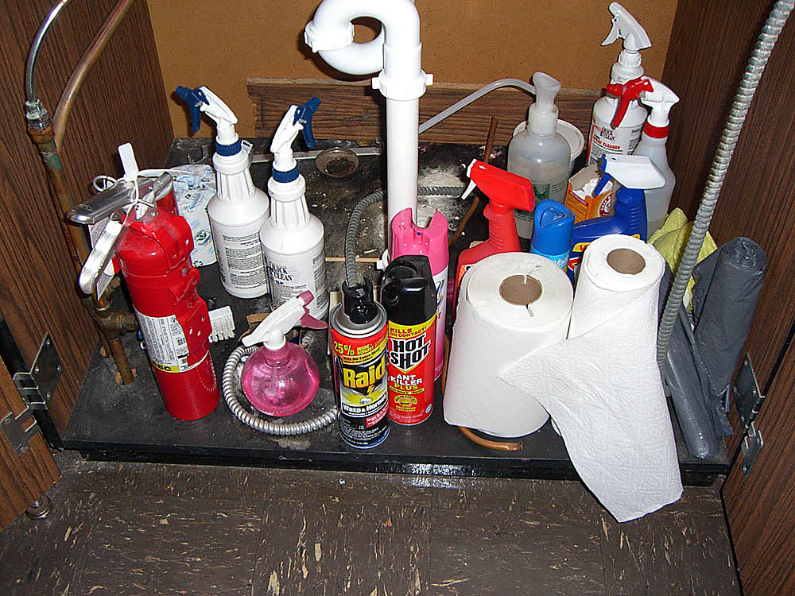
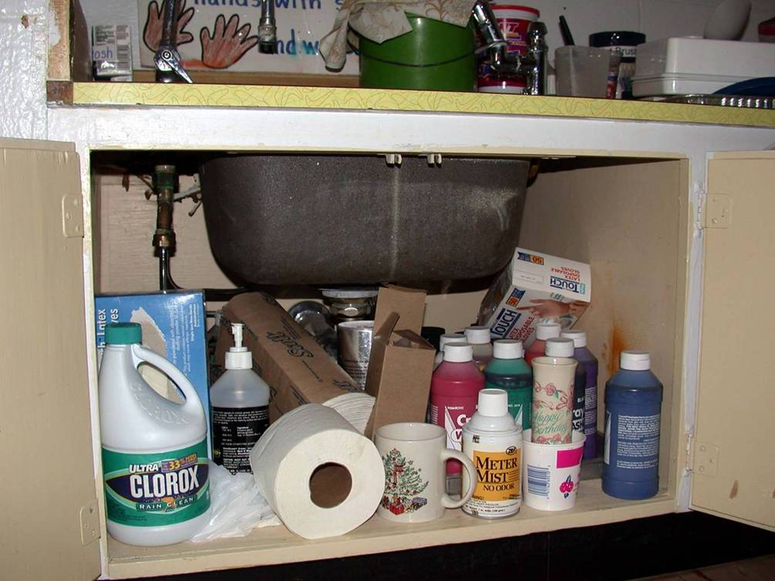
1.
Practicing IPM in Your Classroom
Improperly stored cleaning products and pesticides in sink cupboard in classrooms –
Dawn H. Gouge, University of Arizona

Slide 26
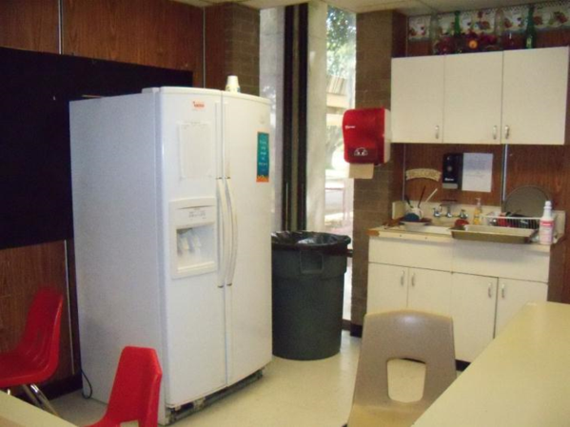
1.
Practicing IPM in the Teachers Lounge
Clean up! The teacher’s lounge is your place to rest and recover during the day
Keep it clean
Clean up after eating, drinking, or food preparation and encourage your colleagues to do the same
Clean and tidy teachers lounge - Jerry Jochim, Monroe
County Community School Corporation

Slide 27
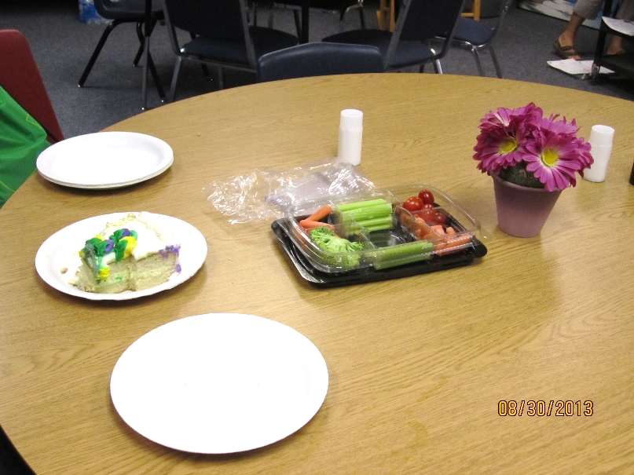
1.
Practicing IPM in the Teachers Lounge
Anything with food remains (including used plates and cups, wrappings, soda cans, cake boxes, etc.) should be placed in trash cans, bagged and taken to outside dumpsters before the day ends
Food left over weekends and breaks generates pest problems
Food left out in a teachers lounge – Shujuan Li, University of Arizona

Slide 28
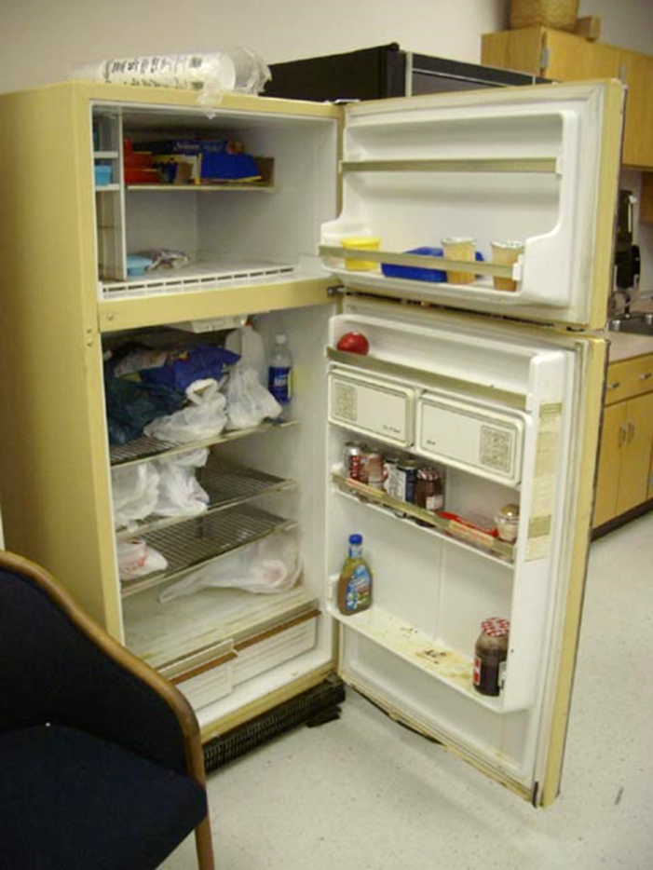
1.
Practicing IPM in the Teachers Lounge
Make sure that common food and drink items (coffee, sugar, creamer, cookies, candy) are stored in sealed containers and encourage your
colleagues to do the same
Have a policy to clear out unused
food items from refrigerators and
cabinets on a regular basis
Clean up promptly and thoroughly
after a spill
Teacher’s lounge fridge with food debris and spills - Jerry Jochim, Monroe
County Community School Corporation

Slide 29
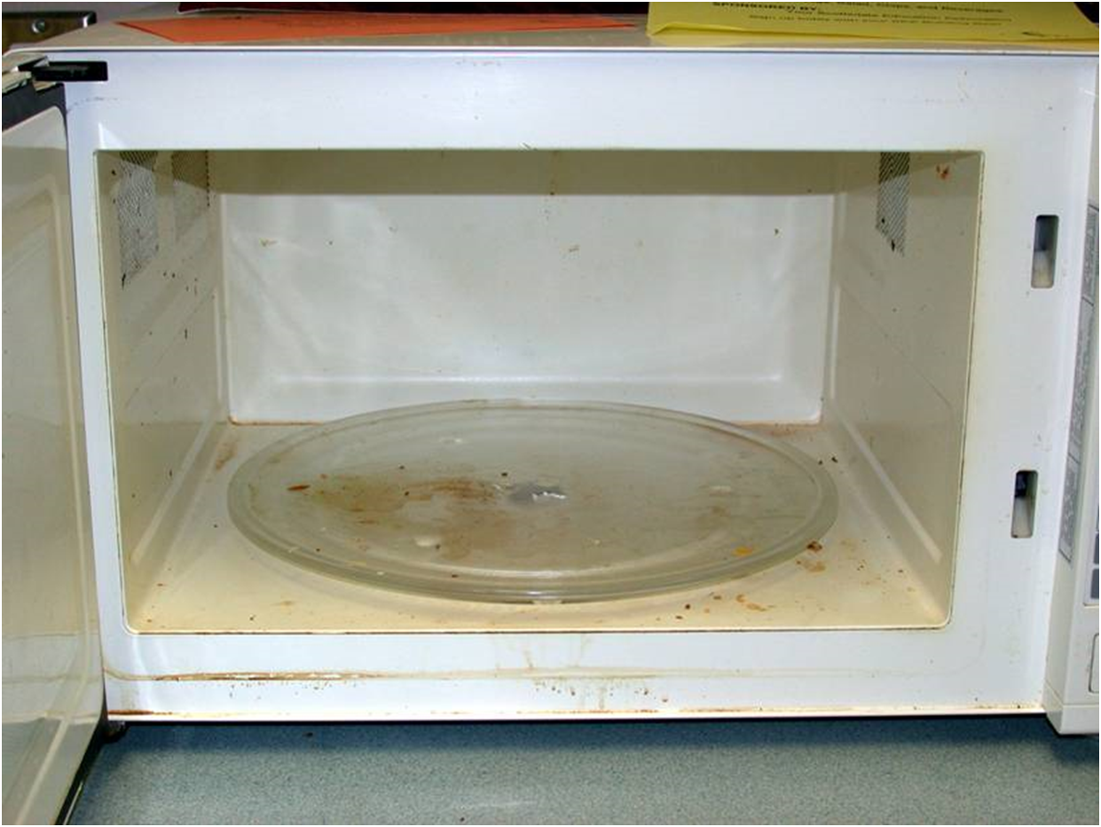
1.
Practicing IPM in the Teachers Lounge
Clean up after
use making
sure there
are no food
remains left
Microwave with food debris in teacher’s lounge – Dawn H. Gouge, University of Arizona

Slide 30
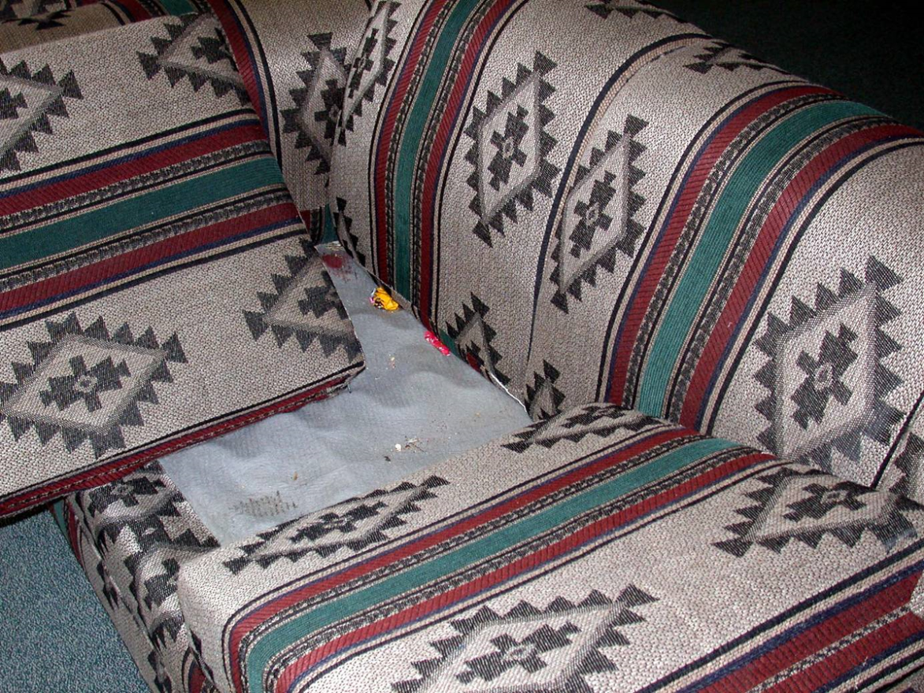
1.
Practicing IPM in the Teachers Lounge
Furniture food: Crumbs collect under couch cushions and in chairs, attracting cockroaches, ants and mice
“Furniture food” in couch in teacher’s lounge – Dawn H. Gouge, University of Arizona

Slide 31
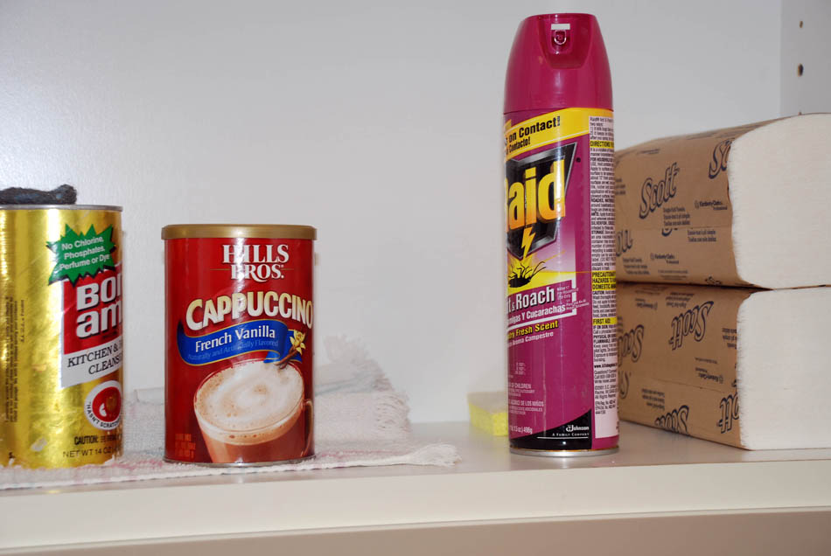
Practicing IPM in the Teachers Lounge
Never bring or apply pesticides in your lounge
These products can worsen pest problems by interfering with or reducing the effectiveness of treatments made by pest management professionals
Always keep cleaning
supplies in locked cabinets
separate from food
cabinets
Improper storage of cleaning product next to cappuccino product, with
contraband pesticide in a teachers lounge cabinet – Dawn H. Gouge, University of Arizona

Slide 32
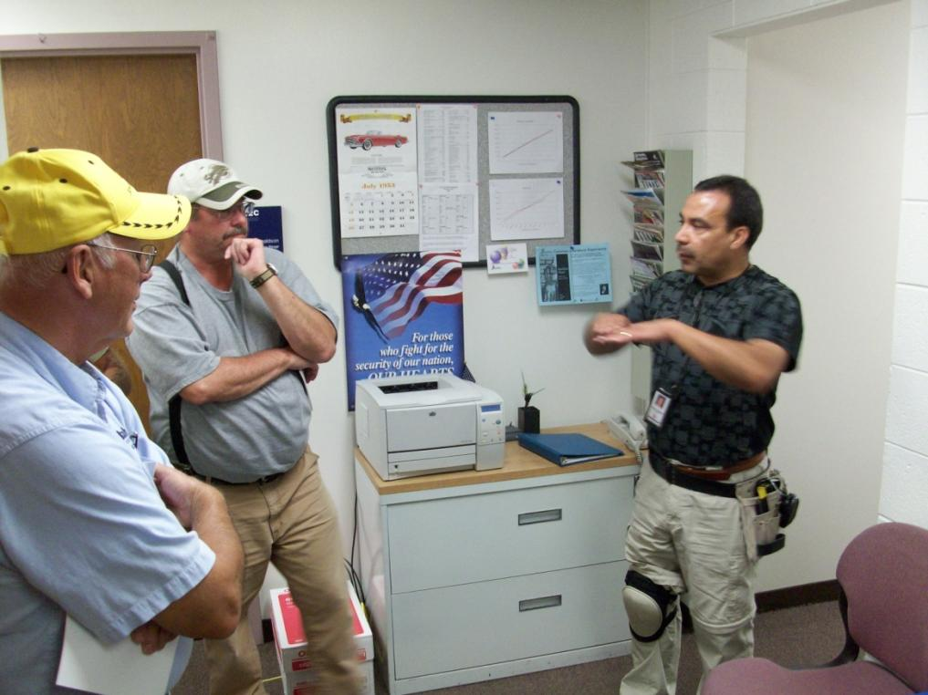
Be Aware, Get Involved!
Ready to step outside your class and teachers lounge?
Get to know your school IPM coordinator or pest-management personnel
Communicate with them, show interest in their work, ask questions, help them to help you
Let them know what pests you
observe, when and under what
situations (e.g., cockroaches were
noticed in a new supply of art
material in cardboard boxes)
Follow their recommendations
and directions
IPM coordinator teaching custodial crew – Marc Lame, Indiana University

Slide 33
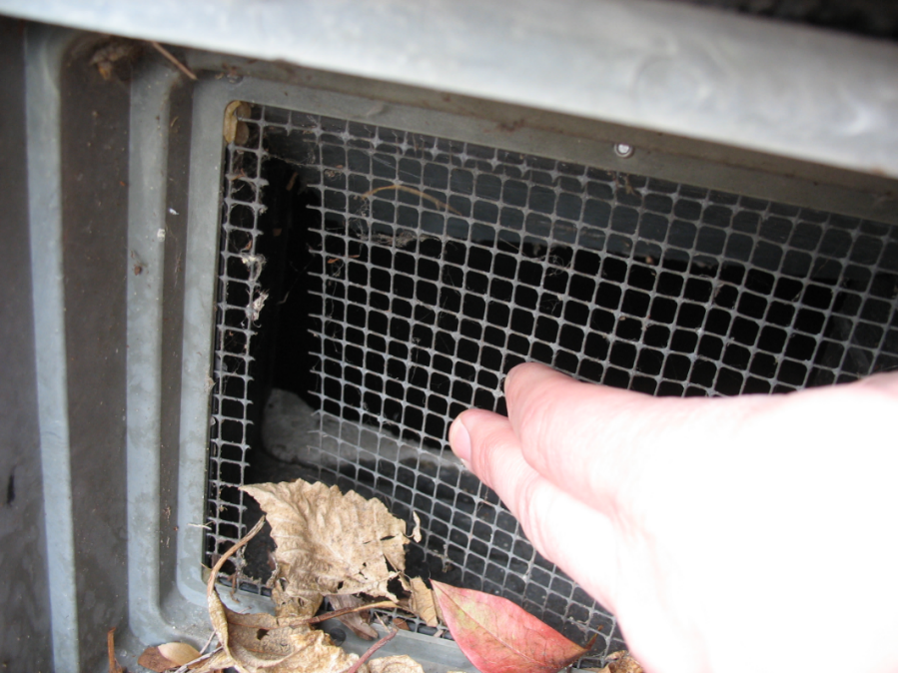
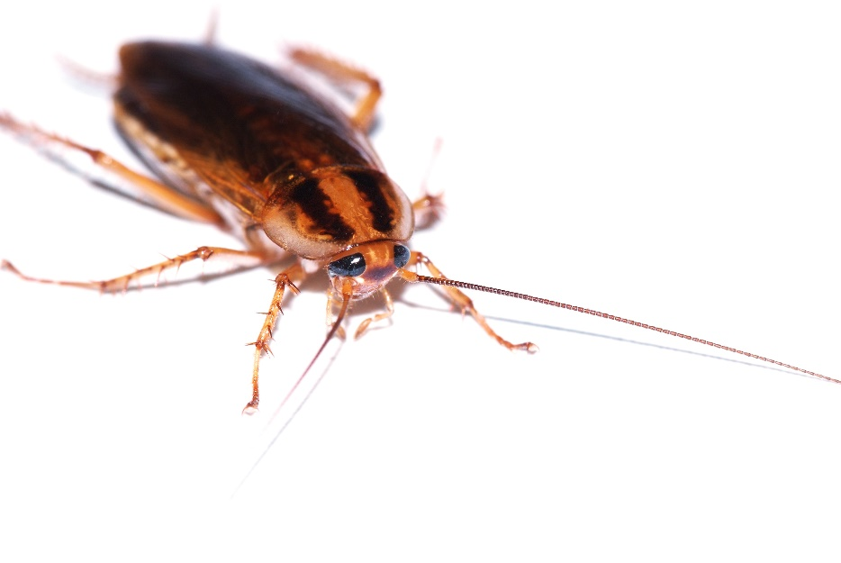
3.
Be Aware, Get Involved!
Observe pest occurrences and pest entryways and report them to the school IPM coordinator or pest-management personnel
The German cockroach is a high-priority
a pest to be reported
Torn mesh on wall void opening that must be reported – Marc Lame, Indiana University

Slide 34
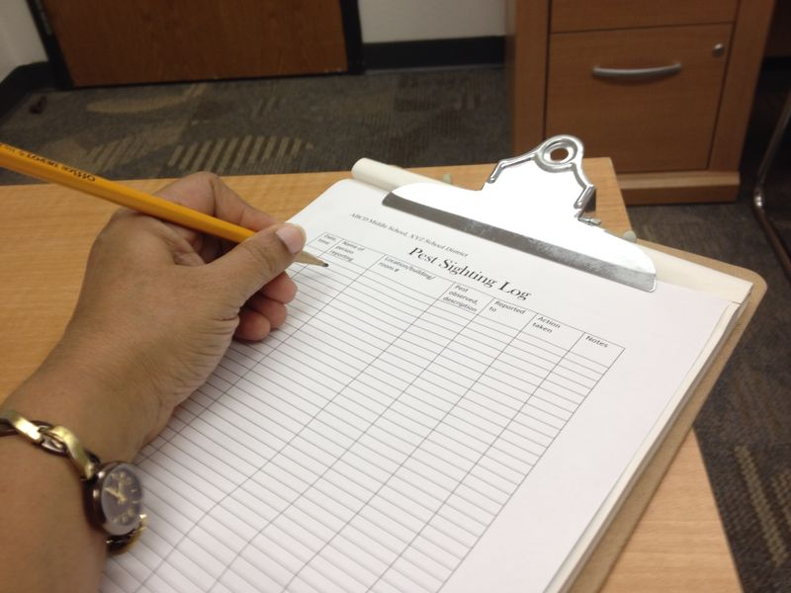
3.
Be Aware, Get Involved!
Use pest-sighting logs - These are a convenient and efficient way to record and report
Find out where your pest-sighting logs are and use them
Pest sighting log – Shaku Nair, University of Arizona

Slide 35
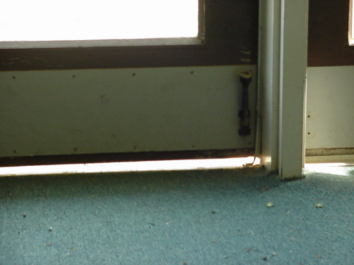
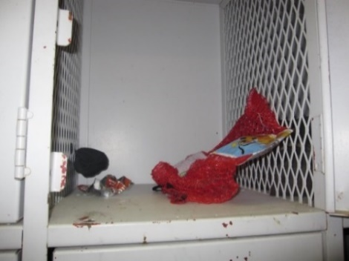
2.
Be Aware, Get Involved!
Know what to look for and report:
Pests
Signs of pests
Pest entry points
Pest conducive conditions - opportunities that provide pests access to food, water, and harborage
Gap under doorway large enough for a rat to enter – Dawn H. Gouge, University of Arizona
Decomposing food and trash in athletic locker – Dawn H. Gouge, University of Arizona

Slide 36
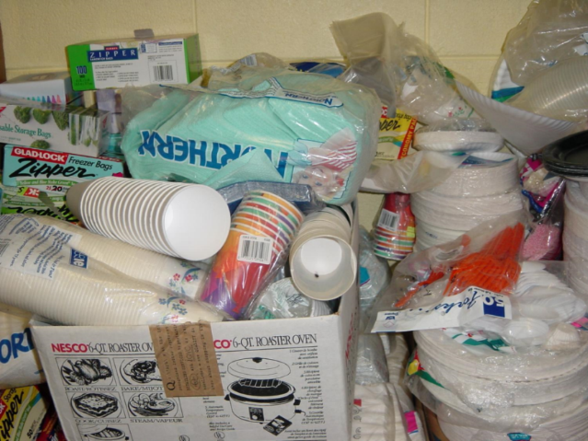
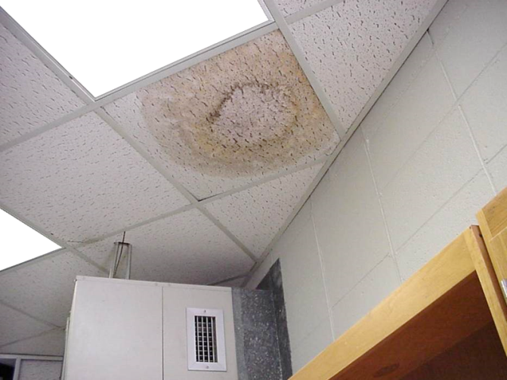
2.
Be Aware, Get Involved!
What to look for:
Clutter in storage areas
Cardboard boxes
Open food items
Warm walls with
penetrations
Unsealed floors and
floor to wall junctures
Undisturbed containers
Moisture
Mouse infested booster club storage – Dawn H. Gouge, University of Arizona
Water marks and mold on ceiling tile – Shaku Nair, University of Arizona

Slide 37

2.
Be Aware, Get Involved!
Learn more about IPM from experts
Everything you learn will apply to your home
Consider discussing IPM and its advantages with your colleagues, principal, and parents of students at suitable venues such as a PTA or faculty meetings
Get involved with your
environmental health
program activities
Set an example, demonstrate your success with IPM

Slide 38
2.
Success Story
“I panicked when I saw mouse droppings on the floor.
I knew about IPM from an in‐service training, so the IPM Coordinator and I looked for a reason why the mouse might be coming to my room.
I found chips I use as rewards open inside my cabinet. The bag had been chewed through!
Now, I put all of my food and snacks in containers with tight-fitting lids. The mouse has not been back!
I was proud to tell the other teachers about my mouse and how I handled the situation.”
Source: IPM for Texas Schools and Teachers, Texas A&M AgriLife Extension

Slide 39
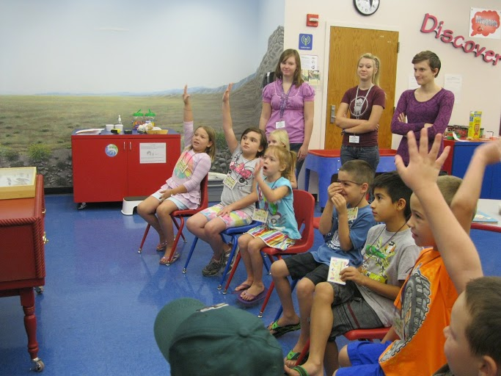
Involve Students in IPM
Students’ role
Catch them young! Lessons learned at a young age will remain with children for life
Emphasize the importance of clutter control, good sanitation, and proper
storage of food and pest
edible items
Emphasize that IPM is
everyone’s job, not the
teacher’s alone
Shujuan Li, University of Arizona

Slide 40

Involve students in IPM
Engage your students in reducing clutter and
organizing the classroom
If there is too much going on in a class, some students find it difficult to focus

Slide 41
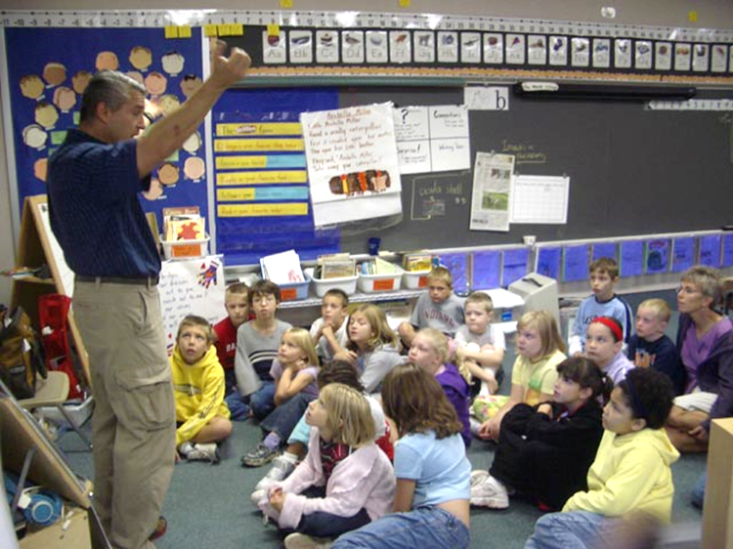
Involve Students in IPM
Have students clean up after class activities so they realize the importance and skills needed to maintain good sanitation and organization
Show them the importance of proper storage of food in sealed containers
Introduce students to pests commonly found in schools
Encourage students to
recognize and report pests,
evidence of pests, and pest- pest conducive conditions
Jerry Jochim, Monroe
County Community School Corporation

Slide 42

Involve Students in IPM
Make sure that students:
  Do not leave food in lockers, classrooms, or common areas
  Do not eat or drink in
  areas not designated
  for food consumption
  Dispose of trash in
  trash cans and recycle
  containers
  appropriately

Slide 43

Managing Classroom Pets
Make sure that pet food and bedding is cleaned and stored properly, so that ants, roaches and mice don’t become class pets also
Animals are effective and valuable teaching aids, but safeguards
are required to reduce
the risk of supporting
pests
Some animals,
bedding, or feed are
asthma triggers

Slide 44
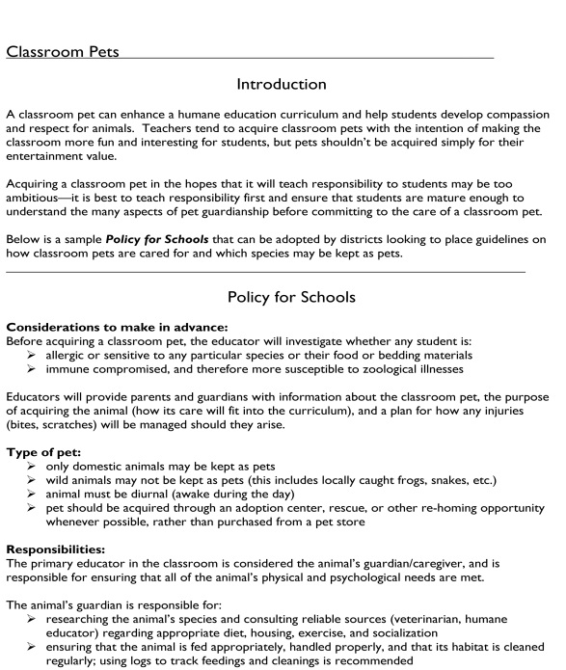
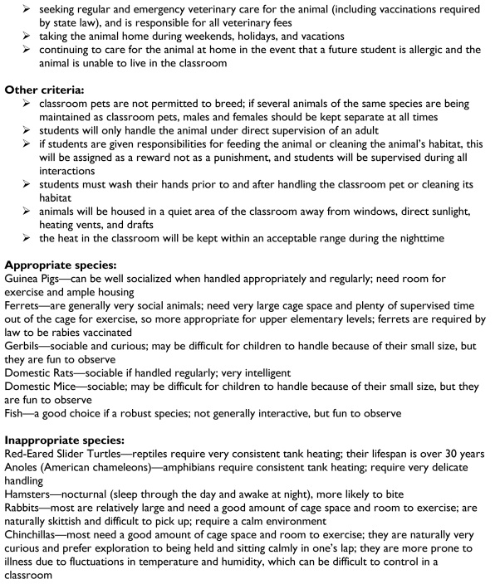

Classroom Pet Policy
Your school district may have classroom pet rules, which may include stipulations mandating that teachers be responsible for cleaning out their cages
School nurses should be consulted prior to housing an animal in a classroom, to
confirm that no students using the classroom
have allergy problems

Slide 45

Communicable/parasitic pests
The top two communicable pests of concern are head lice and bed bugs
Neither transfer between students in school very readily
Head-to-head contact has to occur to transfer the head lice, so discourage
students working so closely
that head-to-head contact
occurs

Slide 46

Communicable/parasitic pests
Transfer of lice on inanimate objects such as hats, helmets or headphones is unlikely!
More information on these pests is included in the school nurse materials
There is no advantage
or justification for
“no-nit” policies

Slide 47
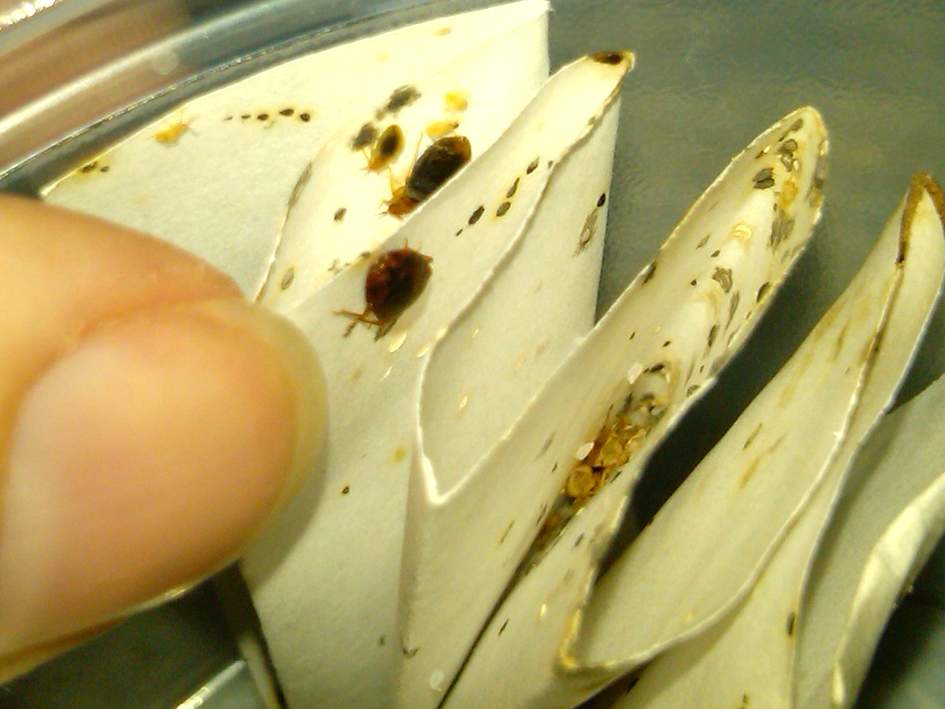
Communicable/parasitic pests
Bed bugs are excellent hitchhikers, and may arrive in school attached to clothing, backpacks, books, and shoes
With parental help, it is quite possible for students who live in infested homes to attend school normally, without bringing the pests into school
More information on these pests and others is included in the school nurse
materials
Bed bugs in paper –
Dawn H. Gouge, University of Arizona

Slide 48
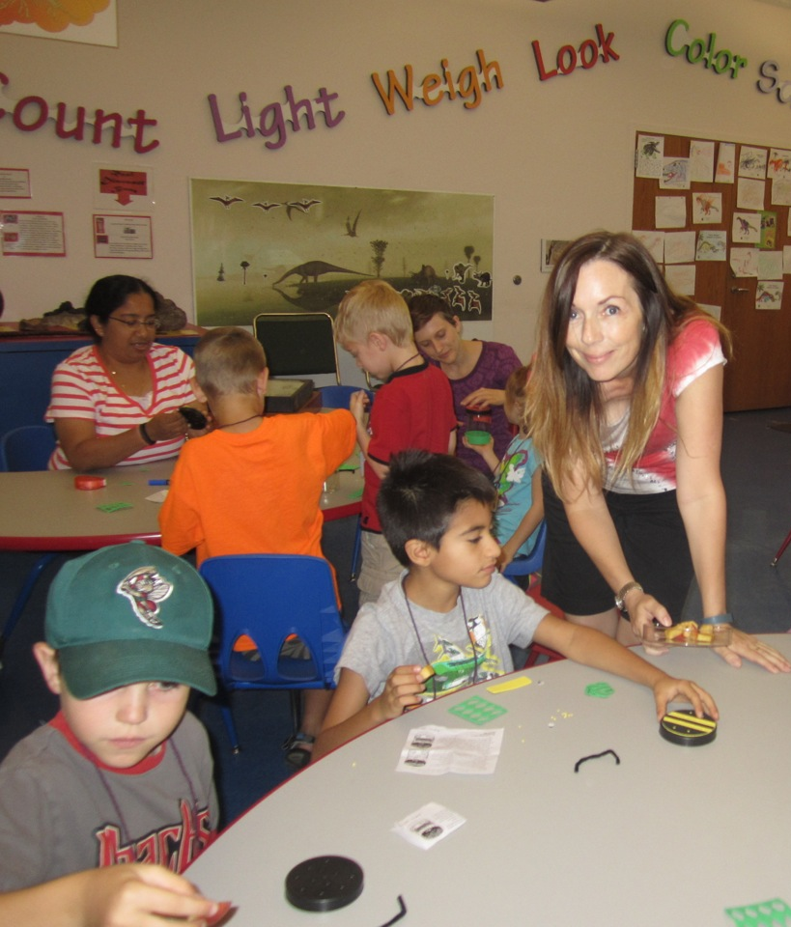
Teachers Show the Way!
“I want my classroom to be a welcome, safe, and comfortable learning environment, free of pests”
Alison Stoltman
Shaku Nair,
University of Arizona

Slide 49

Check In!
In this lesson you learned:
Communicating with parents
about pest and pesticide risks
Importance of observing pesticide application notifications
Importance of clutter control
Proper storage of food and supplies
Proper sanitation methods
Students’ roles and responsibilities in IPM
Congratulations, you have completed School IPM for Teachers
Lesson 2 covers incorporation of IPM in your teaching curriculum

Slide 50

Resources
National School IPM Information Source: IPM for School Faculty and Staff http://schoolipm.ifas.ufl.edu/Florida/faculty.htm
Texas AgriLife Extension Southwest Technical Resource Center for IPM Schools and Child Care Facilities and Texas Integrated Pest Management Affiliate for Public Schools - IPM for Teachers
http://schoolipm.tamu.edu/files/2010/11/Teacher_IPMSmall.pdf
eXtension (2014) School Integrated
Pest Management for Teachers
http://www.extension.org/pages/
21012/school-integrated-pest-
management-for-teachers#.
U9h98rHLNeo

